Slide 1
CS-255
Programming Languages

Slide 2
Introduction to subject
Learning the different techniques in the different paradigms.
what semantic and compiling issues come up in the various languages considered.
The course introduces Imperative Languages, functional programming, declarative programming and semantics of object-oriented programming.

Slide 3
Evaluation Criteria
Mid-term Examination I – 25 marks
Mid-term Examination II – 25 marks
End-term Examination – 100 marks.
Total Theory Marks - 150

Slide 4
Evaluation Criteria (Practical exam)
Evaluation Criteria Mid Term End Term Total
Practical Files 10 10 20
Lab Attendance - 10 10
Viva 10 20 30
Lab Written Work 10 30 40
TOTAL Practical Marks 100

Slide 5
Syllabus of the subject
SYLLABUS

Slide 6
Lesson Plan
Document

Slide 7
Class Schedule
Time Table

Slide 8
Text and Reference Books
Text Book
D. A. Watt.
  Programming Languages and Paradigms,
  Prentice-Hall, 1990.
Reference Books
David A. Watt
Programming Language Design Concepts.
John Wiley & Sons Ltd.
Robert W. Sebesta,
Concepts Of Programming Languages,
Tenth Edition, Pearson

Slide 9
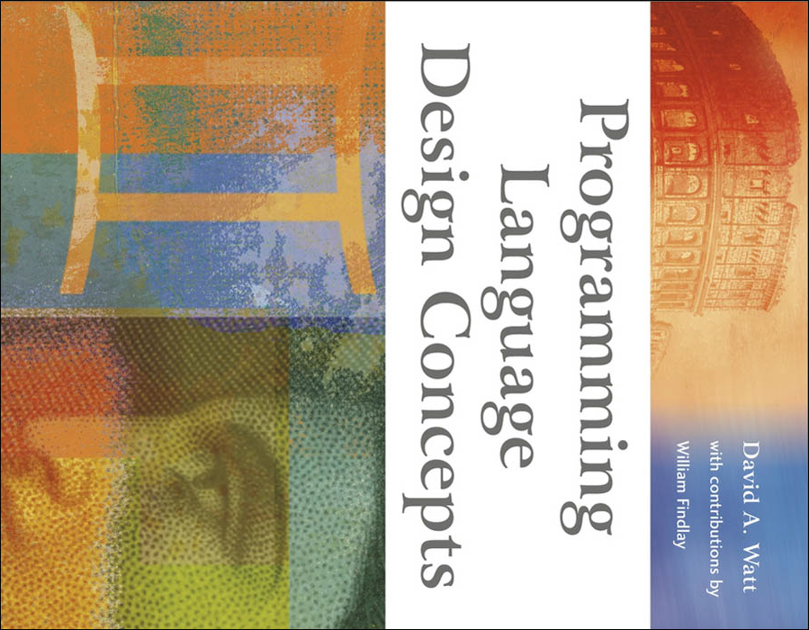

Slide 10
UNIT 1
Introduction to Programming languages
Programming Concepts and paradigms,
Syntax, semantics, and pragmatics,
Language processors,
Historical development.
Reasons for Studying Concepts of Programming Languages.
Programming Domains,
Influences on Language Design.
Language Categories.
Language Design Trade-Offs.
Implementation Methods .
Programming Environments.

