Slide 1
CS-255 Programming Languages
HARISH TIWARI, SCHOOL OF ENGINEERING,
SIR PADAMPAT SINGHANIA UNIVERSITY, UDAIPUR

Slide 2
UNIT 1- Introduction to Programming language
Language Categories.
Language Design Trade-Offs.
Implementation Methods .
Programming Environments.

Slide 3
Language Categories

Slide 4
Language Design Trade-Offs.
There are so many important but conflicting criteria for desiging a new languages.
Two criteria that conflict are reliability and cost of execution.
For example.
in all references to array element be checked to ensure that the index or indices are in their legal ranges.
This step adds a great deal to the cost of execution of Java programs that contain large numbers of references to array elements.
C does not require index range checking, so C programs execute faster than semantically equivalent Java programs,
although Java programs are more reliable. The designers of Java traded execution efficiency for reliability.

Slide 5
Implementation Methods .
Language implementation system cannot be the only software on a computer. Also required is a large collection of programs, called the operating system, which supplies higher-level primitives than those of the machine language.
The operating system and language implementations are layered over the machine language interface of a computer.
These layers can be thought of as virtual computers, providing interfaces to the user at higher levels.
For example,
An operating system and a C compiler provide a virtual C computer.
With other compilers, a machine can become other kinds of virtual computers. Most computer systems provide several different virtual computers.
User programs form another layer over the top of the layer of virtual computers.

Slide 6
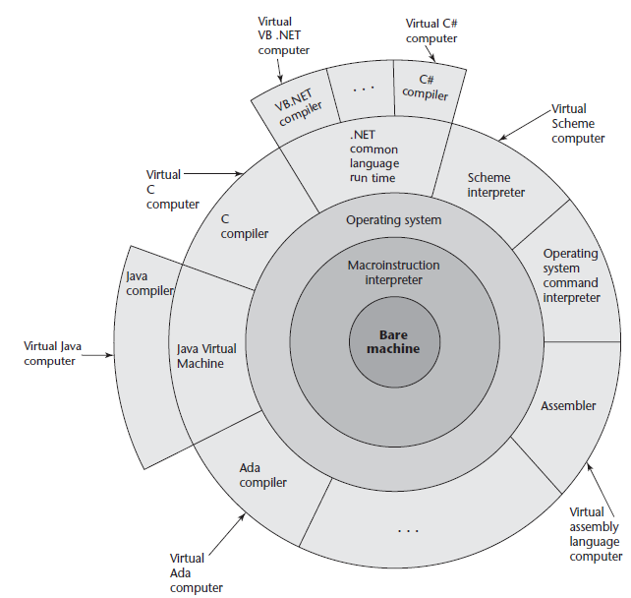
Implementation Methods .

Slide 7
Compilation.
High Level programs can be translated into machine language, which can be executed directly on the computer. This method is called a compiler implementation and
It has the advantage of very fast program execution, once the translation process is complete.
Examples C, COBOL, C++, and Ada.
Compilation process.

Slide 8
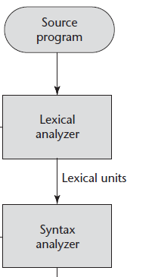
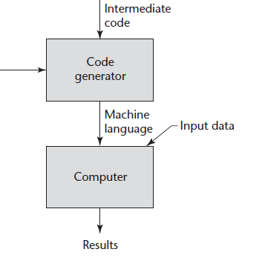
Compilation.

Slide 9
Pure Interpretation.
programs are interpreted by another program called an interpreter, with no translation whatever.
The interpreter program acts as a software simulation of a machine whose fetch-execute cycle deals with high-level language program statements rather than machine instructions.
This software simulation obviously provides a virtual machine for the language.
LISP was purely interpreted,

Slide 10
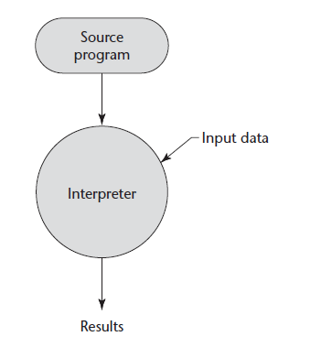
Pure Interpretation.

Slide 11
Pure Interpretation(2)
Advantages
Pure interpretation has the advantage of allowing easy implementation of many source-level debugging operations, because all run-time error messages can refer to source-level units.
Disadvantages
On the other hand, this method has the serious disadvantage that execution is 10 to 100 times slower than in compiled systems.
it often requires more space.

Slide 12
Hybrid Implementation Systems
It is a compromise between compilers and pure interpreters.
These systems translate high-level language programs to an intermediate language designed to allow easy interpretation.
This method is faster than pure interpretation because the source language statements are decoded only once. Such implementations are called hybrid implementation systems.

Slide 13
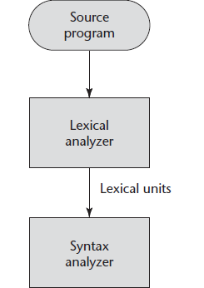
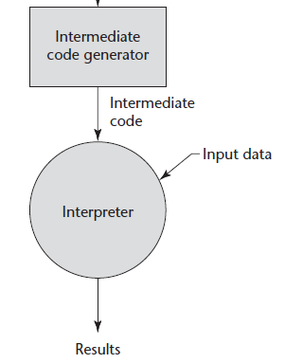
Hybrid Implementation Systems
Parse Tree

Slide 14
Hybrid Implementation Systems
Perl is implemented with a hybrid system.
Perl programs are partially compiled to detect errors before interpretation and to simplify the interpreter.
Initial implementations of Java were all hybrid.
Its intermediate form, called byte code.
This Byte Code provides portability to any machine that has a byte code interpreter and an associated run-time system. Together, these are called the Java Virtual Machine.

Slide 15
Hybrid Implementation Systems
A Just-in-Time ( JIT) implementation system initially translates programs to an intermediate language.
Then, during execution, it compiles intermediate language methods into machine code when they are called.
The machine code version is kept for subsequent calls.
JIT systems are now widely used for Java programs. Also, the .NET languages are all implemented with a JIT system.

Slide 16
Preprocessors
A preprocessor is a program that processes a program immediately before the program is compiled.
Preprocessor instructions are embedded in programs.
The preprocessor is essentially a macro expander.
Preprocessor instructions are commonly used to specify that the code from another file is to be included.

Slide 17
For example, the C preprocessor instruction
#include "myLib.h“
causes the preprocessor to copy the contents of myLib.h into the program at the position of the #include.

Slide 18
Other preprocessor instructions are used to define symbols to represent expressions.
For example,
#define max(A, B) ((A) > (B) ? (A) : (B))
For example
x = max(2 * y, z / 1.73);
would be expanded by the preprocessor to
x = ((2 * y) > (z / 1.73) ? (2 * y) : (z / 1.73);

Slide 19
Programming Environments.
A programming environment is the collection of tools used in the development of software.
This collection may consist of only a file system, a text editor, a linker, and a compiler.
Or it may include a large collection of integrated tools, each accessed through a uniform user interface.
Example: UNIX is the programming enviornment.

Slide 20
Programming Environments.
UNIX provides wide array of powerful support tools for software production and maintenance in a variety of languages.
Earlier UNIX versions does not provides a uniform interface among its tools.
This made it more difficult to learn and to use.
UNIX is now often used through a graphical user interface (GUI) that runs on top of UNIX.
Examples of UNIX GUIs are the
Solaris Common Desktop Environment (CDE),
GNOME.
KDE.
These GUIs make the interface to UNIX appear similar to that of Windows and Macintosh systems.

Slide 21
Programming Environments.
Borland JBuilder is a programming environment that provides an integrated compiler, editor, debugger, and file system for Java development,
These all four are accessed through a graphical interface.
JBuilder is a complex and powerful system for creating Java software.
NetBeans is an another development environment that is primarily used for Java application development
but also supports JavaScript, Ruby, and PHP.

Slide 22
Programming Environments.
Microsoft Visual Studio .NET is a relatively recent step in the evolution of software development environments.
It is a large and elaborate collection of software development tools, all used through a windowed interface.
This system can be used to develop software in any one of the five .NET languages:
C#
Visual BASIC .NET,
JScript (Microsoft’s version of JavaScript),
F# (a functional language),
C++/CLI.

