Slide 1

Linux System Administration and Configuration
Module Number: 01
Module Name: Introduction to Linux

Slide 2
Introduction to Linux
    Objectives
The Objectives of this module are:
P
P
P
P
P
Provide an introduction to Operating System and its various types.
Explain history of Linux, its various flavours & benefits, etc.
Describe the steps to install Linux, login and switching of users in multiusers.
Describe the Linux kernel, date and time configuration.
Outline the shell and bash features.

Slide 3
Introduction to Linux
    Outcome
  At the end of this module, you are expected to learn:
P
P
P
P
P
About Operating System and its various types.
The history of Linux, its flavours & benefits, etc.
The installation steps, login & switching of users in multiusers.
About the Linux kernel, date and time configuration.
The shell and bash features.

Slide 4
Introduction to Linux
    Content
1. Introduction to Operating System
2. Types of Operating System
3. Multi user Operating System
4. Open source licensing
5. Linux
6. History of Linux
7. Unix vs. Linux
8. Flavours of Linux
9. Benefits and characteristics of Linux
10. Installation of Linux
11. Linux booting process
12. Log in and switch users in multiuser run levels
13. Shell and bash features
14. Linux kernel
15. SUDO vs. SU
16. Date and time configuration – Linux run levels

Slide 5


Introduction to Operating System
    Did you know? You and your computer speak different languages?
HELLO
?...

Slide 6
Introduction to Operating System
        It do not speak French, Spanish or Chinese.
Bonjour
Hallo
?...
你好

Slide 7
Introduction to Operating System
        It speaks in 1’s and 0’s.
?
101010

Slide 8


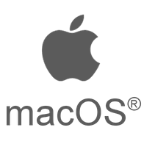
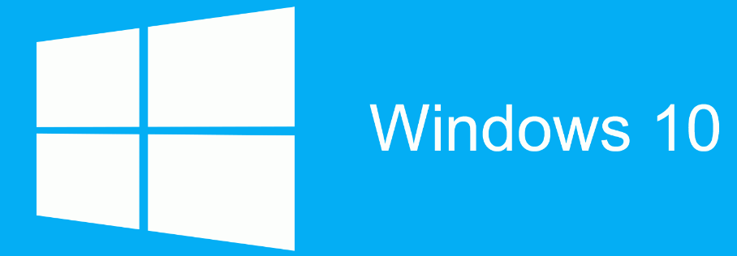
Introduction to Operating System
        You cannot communicate with your computer.
        That’s where, Operating System comes in.

Slide 9
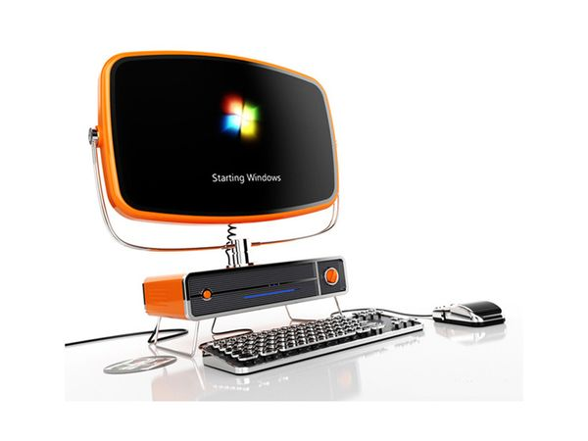
Introduction to Operating System
        What makes your Computer / Laptops operate?

Slide 10
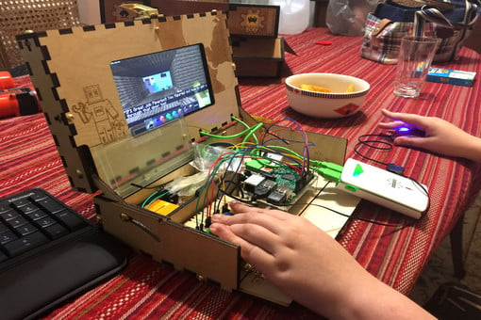
Introduction to Operating System
        Computer / Laptops are just hardware without a Operating System

Slide 11
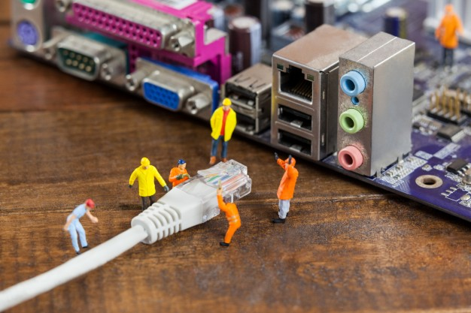
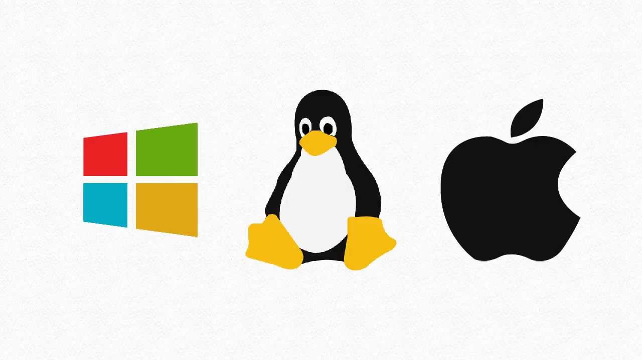
Introduction to Operating System
        Different Operating System makes the hardware to work

Slide 12
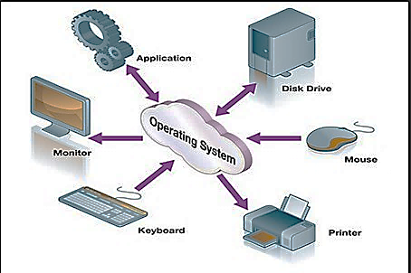
Introduction to Operating System
      Operating System
          An operating system, or "OS," is a software / program that communicates with the hardware and allows other programs to run.
          Operating System controls and manages the hardware and other software on a computer.
Diagram: Operating System
Notes:
Operating System:
An operating system, or "OS," is a software that communicates with the hardware and allows other programs to run.
An operating system is comprised of system software, or the fundamental files your computer needs to boot up and function.
Every desktop computer, tablet, and smart-phone includes an operating system that provides basic functionality for the device.
An Operating System, or OS, is a software that enables a user and application software to interact with a computer’s hardware and the data and other programs stored on the computer.
An OS performs basic tasks, such as recognizing input from the keyboard, sending output to the display screen, keeping track of files and directories on the disk, and controlling peripheral devices such as printers.

Slide 13
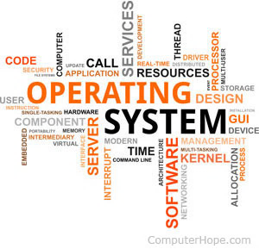
What OS does?
          An operating system performs basic tasks such as:
          Controlling and allocating memory.
          Prioritizing system requests.
          Controlling input and output device.
          Facilitating networking.
          Managing file systems.

Slide 14
Structure of Operating System
Application Programs
System Programs
Software (Operating System)
HARDWARE
Notes:
Hardware: It consists of CPU, Main memory, I/O Devices, etc.
Software (Operating System): It includes process management routines, memory management routines, I/O control routines, file management routines.
System programs: This layer consists of compilers, Assemblers, linker etc.
Application programs: This is dependent on users need. Ex. Railway reservation system, Bank database management etc.

Slide 15
Abstract View of Operating System
User 1
User 2
User n
System
Softwares
Application
Softwares
Software
Operating System
Hardware
CPU
RAM
I/O
Notes:
A computer system can be divided roughly into four components: the hardware, the operating system, the application programs, and the users.
The hardware—the central processing unit (CPU), the memory, and the input/output (I/O) devices—provides the basic computing resources for the system.
The application programs—such as word processors, spreadsheets, compilers, and web browsers—define the ways in which these resources are used to solve users' computing problems.
The operating system controls and coordinates the use of hardware among the various application programs for the various users.

Slide 16
Classification of Operating System
Operating systems can be classified into different types:
Based on Tasks
Single/ Uni-tasking
Multi tasking
Based on Users
Single User
Multi User
Based on Processing
Serial Processing
Batch Processing
Multi processing
Some others
Timesharing OS
Distributed OS

Slide 17
Classification of Operating System
Single/ Uni-Tasking Operating Systems
A single-tasking operating system can support only a single task at any time. In such single tasking environments, the task execution is sequential.
An example of a single-tasking operating system is MS-DOS.
Multitasking Operating Systems
A multitasking operating system also multitasks by executing more than one task at a time.
In such systems, the processor divides its time to execute multiple tasks. This division of time is termed time-sharing.
An example of a multitasking system is Windows 95.
It can handle simultaneous execution of multiple tasks by sharing its resources such as memory and microprocessors.

Slide 18
Classification of Operating System: Based on Users
Single User Operating Systems
The majority of small microcomputer based systems have single user OS, which allows a single user to operate the machine in an interactive mode but normally, only allows one user program to be run in main storage and processed at a time i.e., there is no multiprogramming of user programs.
There is a number of well-established OS that falls into this category such as MS-DOS, PC-DOS are single user program or operating system.
Multiuser Operating Systems
A multi-user OS allows two or more users to run programs at the same time. Some permit hundreds or even thousands of concurrent users. Some of the examples are UNIX, LINUX etc. The multi-user OS shares computer resources among these users, allowing each a small slice of the processor time.
A multi-user OS allows two or more users to run programs at the same time. Some permit hundreds or even thousands of concurrent users. Some of the examples are UNIX, LINUX etc. The multi-user OS shares computer resources among these users, allowing each a small slice of the processor time.

Slide 19
Classification of Operating System: Based on Processing (Contd…)
Serial Processing OS:
The Serial Processing Operating Systems are those which performs all the instructions into a Sequence Manner or the instructions those are given by the user will be executed by using the FIFO (First in First Out) Manner.
All the instructions that are entered first in the system will be executed first and the instructions that are entered later will be executed later.
For running the instructions the program counter is used which is used for executing all the instructions.
But the main problem is that a user does not interact with the system while he is working on the system, means the user will not be able to enter the data for execution.

Slide 20
Types of Operating System: Based on Processing (Contd…)
2. Batch Processing OS:
The batch processing is same as the serial processing technique.
In the batch processing, each user prepares his job on an offline device like punch cards and submits it to the computer operator.
To speed up processing, jobs with similar needs are batched together and run as a group. Similar types of jobs are firstly prepared and they are stored on the card.
The system then performs all the operations on the instructions one by one.
The users of a batch operating system do not interact with the computer directly.
The problems with batch systems are as follows:
Lack of interaction between the user and the job.
CPU is often idle, because the speed of the mechanical i/o devices is slower than the CPU.
Difficult to provide the desired priority.

Slide 21
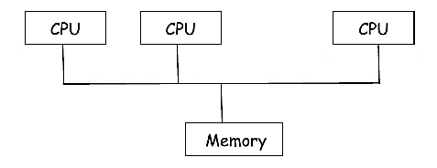
Types of Operating System: Based on Processing (Contd…)
3. Multi Processing OS
  Single processor systems have only one CPU, however multiprocessor system have more than one processor.
  These systems are also known as parallel systems or tightly coupled systems.
  Here the processors share:
      Computer Bus
      Memory
      Clock
      Peripheral Devices
  It is called as parallel system, because number of processors are executing their jobs in parallel.
  A multiprocessor OS controls and manages hardware and software resources such that user can view the entire system as a powerful uniprocessor system as he is not aware of multiprocessor system and interconnection network.

Slide 22
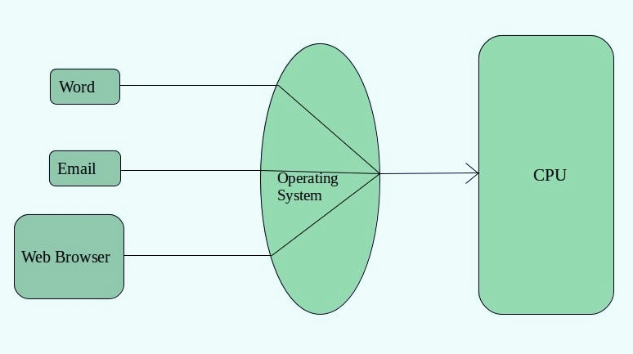
Classification of Operating System: Some Others
Time-Sharing OS
Each task has given some time to execute, so that all the tasks work smoothly. Each user gets time of CPU as they use single system. These systems are also known as Multitasking Systems. The task can be from single user or from different users also. The time that each task gets to execute is called quantum. After this time interval is over OS switches over to next task.
Advantages of Time-Sharing OS:
Each task gets an equal opportunity
Less chances of duplication of software
CPU idle time can be reduced
Disadvantages of Time-Sharing OS:
One must have to take care of security and integrity of user programs and data
Reliability problem
Data communication problem
Examples: Multics, Unix etc.

Slide 23
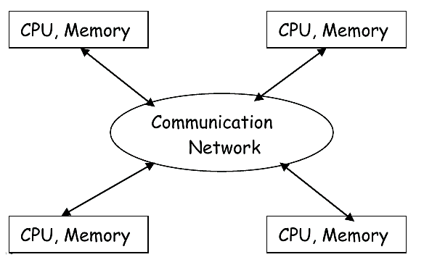
Classification of Operating System: Some Others
Distributed OS
Distributed OS are the OS for a network of autonomous computers, connected by a communication network, that follows message passing mechanism.
In this system, processors cannot share memory or clock. Each processor has its own local memory.
The processors communicate with one another through various communication lines such as high speed bus.
A distributed OS controls and manages the software and hardware resources of a distributed system.
When a program is executed on a distributed system, user is not aware of where the program is executed, on which location etc.
The basic design issue of distributed operating system is:
Process Synchronization
Deadlock
Inter process communication
Memory Management
CPU scheduling
Advantages:
Resource sharing, Computation Speedup & Reliability

Slide 24

Introduction to Linux
        Self Assessment Question
            Which one of the given options is true for Operating System?
                Memory
                Processor
                I/O devices
                Only i
                Only i and ii
                Only ii and iii
                All i, ii and iii
              Answer: d

Slide 25
Introduction to Linux
        Self Assessment Question
            Operating System is a ________ software.
                System
                Application
                Utility
Answer: a

Slide 26
Introduction to Linux
Self Assessment Question
            Which one of the given option provides the platform for Application Software?
                BIOS
                Motherboard.
                OS
Answer: Motherboard
26

Slide 27
Introduction to Linux
Self Assessment Question
            Which one of the given option is the primitive type of Operating System?
                Batch OS
                Time-sharing OS
                Distributed OS
Answer: Batch OS
27

Slide 28
Introduction to Linux
Self Assessment Question
            Which one of the given Operating System uses Punched Cards?
                Batch OS
                Time-sharing OS
                Distributed OS
                All of the Above
Answer: Batch OS
28

Slide 29
Introduction to Linux
Self Assessment Question
            Which one of the given Operating System relies completely on network?
                Batch OS
                Time-sharing OS
                Distributed OS
                All of the Above
Answer: Distributed OS
29

