Slide 1
Linux System Administration and Configuration
Module Number: 01
Module Name: Introduction to Linux

Slide 2
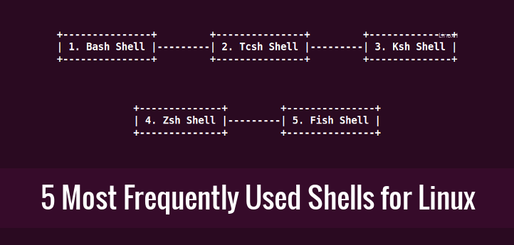
Shell and Types of Shell
The shell is the command interpreter in an operating system such as Unix or GNU/Linux, it is a program that executes other programs. It provides a computer user an interface to the Unix/GNU Linux system so that the user can run different commands or utilities/tools with some input data.
When the shell has finished executing a program, it sends an output to the user on the screen, which is the standard output device. For this reason, it is referred to as the “command interpreter”

Slide 3
(Continued) Shell and Types of Shell
Bash Shell
Bash stands for Bourne Again Shell and it is the default shell on many Linux distributions today. It is also a sh-compatible shell and offers practical improvements over sh for programming and interactive use which includes:
Command line editing
Job Control
Unlimited size command history
Shell Functions and Aliases
Unlimited size Indexed arrays
Integer arithmetic in any base from two to sixty-four

Slide 4
(Continued) Shell and Types of Shell
Tcsh/Csh Shell
Tcsh is enhanced C shell, it can be used as an interactive login shell and shell script command processor. Tcsh has the following features:
C like syntax
Command-line editor
Programmable word and filename completion
Spelling correction
Job control
Ksh Shell
Ksh stands for Korn shell and was designed and developed by David G. Korn. It is a complete, powerful, high-level programming language and also an interactive command language just like many other Unix/GNU Linux shells.

Slide 5
(Continued) Shell and Types of Shell
Zsh Shell
Zsh is designed to be interactive and it incorporates many features of other Unix/GNU Linux shells such as bash, tcsh and ksh.
It is also a powerful scripting language just like the other shells available. Though it has some unique features that includes:
Filename generation
Startup files
Login/Logout watching
Closing comments
Concept index
Variable index
Functions index
Key index and many more that you can find out in man pages

Slide 6
(Continued) Shell and Types of Shell
Fish
Fish in full stands for “friendly interactive shell” and was authored in 2005. It was intended to be fully interactive and user friendly, just like the other shells, it has some pretty good features that include:
Man page completions
Web based configuration
Auto-suggestions
Fully scriptable with clean scripts
Support for term256 terminal technology
These are not all the shells available in Unix/GNU Linux but they are the top most used apart from those that are already installed on different Linux distributions.

Slide 7
Linux kernel
A kernel is the lowest level of easily replaceable software that interfaces with the hardware in your computer. It is responsible for interfacing all of your applications that are running in “user mode” down to the physical hardware, and allowing processes, known as servers, to get information from each other using inter-process communication (IPC).
Different Types of Kernels
Microkernel - A microkernel takes the approach of only managing what it has to: CPU, memory, and IPC.
Monolithic Kernel - Monolithic kernels are the opposite of microkernels because they encompass not only the CPU, memory, and IPC, but they also include things like device drivers, file system management, and system server calls.
Hybrid Kernel - Hybrid kernels have the ability to pick and choose what they want to run in user mode and what they want to run in supervisor mode.

Slide 8
sudo vs su
Linux System is much secured than any of its counterpart. One of the way to implement security in Linux is the user management policy and user permission and normal users are not authorized to perform any system operations.
If a normal user needs to perform any system wide changes he needs to use either ‘su’ or ‘sudo’ command.
A major key difference is who gets the root password. If a user wishes to su to root then they require the password of the root account. If instead the user is executing a command with sudo, they only need their own password and sudo privileges.
‘su’ forces you to share your root password to other users whereas, ‘sudo’ makes it possible to execute system commands without root password.
‘sudo’ lets you use your own password to execute system commands i.e., delegates system responsibility without root password.
They are indeed quite similar in some aspects
The ‘su’ command is basically equivalent to ‘sudo -i’
While the ‘sudo’ command is basically equivalent to ‘su -c’.

Slide 9
Date and time configuration
Modern OS distinguish between the following two types of clocks:
A real-time clock (RTC), commonly referred to as a hardware clock, (typically an integrated circuit on the system board) that is completely independent of the current state of the OS and runs even when the computer is shut down.
A system clock, also known as a software clock, that is maintained by the kernel and its initial value is based on the real-time clock. Once the system is booted and the system clock is initialized, the system clock is completely independent of the real-time clock.
Two methods for setting the date and time in Red Hat Enterprise Linux are:
The Date/Time Properties tool
The command line.

Slide 10
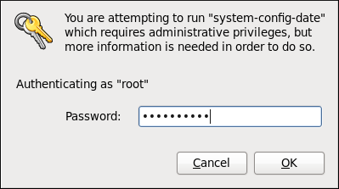
Date and time configuration
Date/ Time Properties Tool
It allows the user to change the system date and time, to configure the time zone used by the system and to set up the Network Time Protocol daemon to synchronize the system clock with a time server.
To start the tool, select
System → Administration → Date & Time from the panel, or type the system-config-date command at a shell prompt (e.g., xterm or GNOME Terminal).
Unless you are already authenticated, you will be prompted to enter the superuser password.

Slide 11
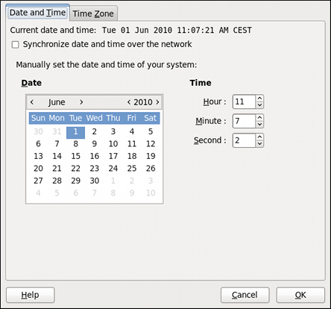
Date and time configuration
(Continued) Date/ Time Properties Tool
The Date/ Time Properties tool is divided into two separate tabs:
Date and Time
Time Zone
To set up your system manually:
Change the current date: Use the arrows to the left and right of the month and year to change the month and year respectively. Then click inside the calendar to select the day of the month.
Change the current time: Use the up and down arrow buttons beside the Hour, Minute, and Second, or replace the values directly.
Click the OK button to apply the changes and exit the application.

Slide 12
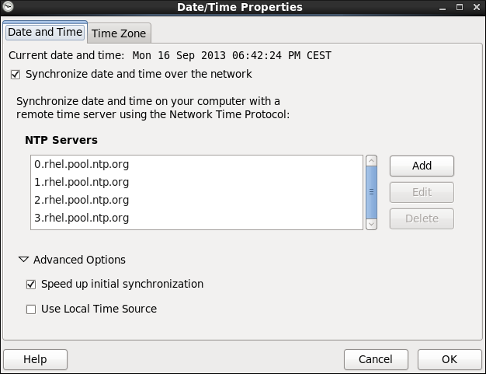
Date and time configuration
(Continued) Date/ Time Properties Tool
Network Time Protocol Properties
If you prefer an automatic setup, select the check box labeled Synchronize date and time over the network instead. This will display the list of available NTP servers.
Here you can choose one of the predefined servers, edit a predefined server by clicking the Edit button, or add a new server name by clicking Add.
In the Advanced Options, you can also select whether you want to speed up the initial synchronization of the system clock, or if you want to use a local time source.
Click the OK button to apply any changes made to the date and time settings and exit the application.
Notes:
Note
Your system does not start synchronizing with the NTP server until you click the OK button at the bottom of the window to confirm your changes.

Slide 13
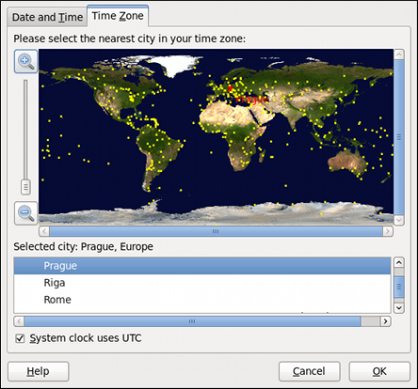
Date and time configuration
(Continued) Date/ Time Properties Tool : Time Zone Properties
To configure the system time zone, click the Time Zone tab
There are two common approaches:
Using the interactive map:
Click “zoom in” and “zoom out” buttons next to the map, or click on the map itself to zoom into the selected region. Then choose the city specific to your time zone. A red X appears and the time zone selection changes in the list below the map.
Use the list below the map:
To make the selection easier, cities and countries are grouped within their specific continents. Note that non-geographic time zones have also been added to address needs in the scientific community.
If your system clock is set to use UTC (Universal Time, Coordinated also known as Greenwich Mean Time-GMT), select the System clock uses UTC option. UTC stands for the , Other time zones are determined by adding or subtracting from the UTC time.
Click OK to apply the changes and exit the program.

Slide 14
Date and time configuration: Command Line
In case your system does not have the Date/Time Properties tool installed, or the X Window Server is not running, you will have to change the system date and time on the command line. Note that in order to perform actions described in this section, you have to be logged in as a Super User:
~]$ su -
Password:
Date and Time Setup: The date command allows the Super User to set the system date and time manually:
Change the current date
Type the command in the following form at a shell prompt, replacing the YYYY with a four-digit year, MM with a two-digit month, and DD with a two-digit day of the month:
~]# date +%D -s YYYY-MM-DD
For example, to set the date to 2 June 2010, type:
~]# date +%D -s 2010-06-02

Slide 15
Date and time configuration: Command Line
Change the current time
Use the following command, where HH stands for an hour, MM is a minute, and SS is a second, all typed in a two-digit form:
~]# date +%T -s HH:MM:SS
If your system clock is set to use UTC (Coordinated Universal Time), add the following option:
~]# date +%T -s HH:MM:SS –u
For instance, to set the system clock to 11:26 PM using the UTC, type:
~]# date +%T -s 23:26:00 -u
You can check your current settings by typing date without any additional argument:
Example 2.1. Displaying the current date and time
~]$ date
Wed Jun 2 11:58:48 CEST 2010

Slide 16
Linux Runlevels of RHEL
RHEL can be booted into one of a number of runlevels. The default runlevel to which the system is configured to boot will, in turn, dictate which services are started:
Runlevel 0 - The halt runlevel. This is the runlevel at which the system shuts down. For obvious reasons it is unlikely you would want this as your default runlevel.
Runlevel 1 – Causes the system to start up in a single user mode under which only the root user can log in. In this mode the system does not start any networking, X windowing or multi-user services. This run level is ideal for system administrators to perform system maintenance or repair activities.
Runlevel 2 - Boots the system into a multi-user mode with text based console login capability. This runlevel does not, however, start the network.

Slide 17
(Continued) Linux Runlevels of RHEL
Runlevel 3 - Similar to runlevel 2 except that networking services are started. This is the most common runlevel for server based systems that do not require any kind of graphical desktop environment.
Runlevel 4 - Undefined runlevel. This runlevel can be configured to provide a custom boot state.
Runlevel 5 - Boots the system into a networked, multi-user state with X Window System capability. By default the graphical desktop environment will start at the end of the boot process. This is the most common run level for desktop or workstation use.
Runlevel 6 - Reboots the system. Another runlevel that, for obvious reasons, you are unlikely to want as your default.

Slide 18
Introduction to Linux
Self Assessment Question
Which one of the given command is used for changing the date?
time
date
timestamp
All of the Above
Answer: date
18

Slide 19
Introduction to Linux
Self Assessment Question
Which one of the given options is the default login shell for RHEL?
bash
sh
Csh
TSh
Answer: bash
19

Slide 20
Introduction to Linux
Self Assessment Question
Which one of the given options is the Single user Mode?
Runlevel 0
Runlevel 1
Runlevel 2
Answer: Runlevel 1
20

Slide 21
Introduction to Linux
Self Assessment Question
Which one of the given command is used for changing the runlevel?
init
runlevel
su
sudo
Answer: init
21

Slide 22
Introduction to Linux
Self Assessment Question
Which one of the given command is used for displaying the current runlevel?
init
runlevel
date
inode
Answer: runlevel
22

Slide 23
Introduction to Linux
Assignment
Define Operating System. List the components of the computer system and different views of the computer.
Explain the evolution of Operating System.
Describe the structure of Operating System.
What is a shell and what are the different types?
Explain the installation process of RHEL.
Explain different types of OS.
Explain the booting process of OS.
Differentiate between sudo and su.
Differentiate between Linux and Unix.
114

Slide 24
Introduction to Linux
Summary
1
2
3
4
5
6
7
An Operating System is a software that manages the computer hardware as well as provides an environment for application programs to run.
The crucial aspects of an OS are Multiprogramming, Time-Sharing, CPU Scheduling
The types of OS structures are Monolithic Approach, Layered Approach, Microkernels, Client-Server approach, Virtual Machines and Exokernels
There are different flavours of Linux which is also called as distribution of Linux or ( Distro Of Linux).
There are various benefits of Linux the vital point is that it’s a part of FOSS.
The Linux Booting process is different than Windows as the latest RHEL v7 also don’t support GPT table.
There are different run levels in Linux and each have different features.
24

Slide 25
Introduction to Linux
Document Links
Topics | URL | Notes
Introduction To OS | https://www.studytonight.com/operating-system/introduction-operating-systems | This link provides documentation to OS basic concepts.
Open Source Licensing | https://opensource.org/licenses | This link is for the open source licensing.
Linux History | https://www.digitalocean.com/community/tutorials/brief-history-of-linux | This link is for Linux History.

Slide 26
Introduction to Linux
Document Links
Topics | URL | Notes
Linux Flavours | https://beginlinux.wordpress.com/2009/05/13/the-many-flavors-of-linux/ | This link provides documentation for Linux Flavours.
RHEL Installation | https://www.tecmint.com/redhat-enterprise-linux-7-installation/ | This link is for the installation of Linux.
Sudo vs Su | https://fossbytes.com/sudo-su-difference-linux/ | This link explains the differences between Sudo and Su.

Slide 27
Introduction to Linux
Video Links
Topics | URL | Notes
Operating Systems Basics | https://www.youtube.com/watch?v=2i2N_Qo_FyM | This video explains introduction to OS
History of Linux | https://www.youtube.com/watch?v=vjMZssWMweA | You will learn History of Linux
Linux booting process | https://www.youtube.com/watch?v=ZtVpz5VWjAs | This video explain the Linux booting process.

Slide 28
Introduction to Linux
E - Book Links
Topics | URL
Red Hat Enterprise Linux 7 System Administrator's Guide | https://access.redhat.com/documentation/en-us/red_hat_enterprise_linux/7/pdf/system_administrators_guide/Red_Hat_Enterprise_Linux-7-System_Administrators_Guide-en-US.pdf
Red Hat Linux Networking and System Administration | https://www.nettech.in/e-books/Linux-Networking-and-System-Admin.pdf

