Slide 1

Linux System Administration and Configuration
Module Number: 01
Module Name: Introduction to Linux
Part: 02

Slide 2
Introduction to Linux
    AIM
To equip students with the concept of directories and files.
Students will learn about the absolute and relative path.
They will also learn to create, remove directory, changing directory path, etc.
They will know about the filters, pipes and system documentation.
1
2
3
4

Slide 3
Introduction to Linux
        Objectives
The Objectives of this module are:
P
P
P
P
P
Explain the concept of directories and files.
Explain the directory structures, absolute and relative path.
Describe how to create, remove directory, changing directory path, etc.
Describe about the file permissions, input – output redirection.
Outline about the filters, pipes and system documentation.

Slide 4
Introduction to Linux
        Outcome
  At the end of this module, you are expected to learn:
P
P
P
P
P
About the concept of directories and files.
The directory structures, absolute and relative path.
To create, remove directory, changing directory path, etc.
The file permissions, input – output redirection.
About the filters, pipes and system documentation.

Slide 5
Introduction to Linux
1. Directories and files
2. Directory structure
3. System directory
4. Absolute path and relative path
5. Creating and removing directory
6. Changing directory path
7. Creating - Removing - Copying and moving files
8. File Permissions
9. Links: Hard Link and Soft Link
10. Input and output redirection
11. Filters and pipes
12. Locate & Read Command
13. Use system documentation including man page
        Content

Slide 6
Directories and Files
      Directory: A directory is a binary file used to track and locate other files and directories. The binary format is used so that directory containing large numbers of filenames can be searched quickly.
      Files: In Linux, everything is a File. So we need to categorise among different files. The following different types of files exist in Linux are:
File Types | Representation | Description
Regular file | - | Normal files such as text, data, or executable files
Directory | d | Files that are lists of other files
Link | l | A shortcut that points to the location of the actual file
Special file | c | Mechanism used for input and output, such as files in /dev
Socket | s | A special file that provides inter-process networking protected by the file system’s access control
Pipe | p | A special file that allows processes to communicate with each other without using network socket semantics

Slide 7
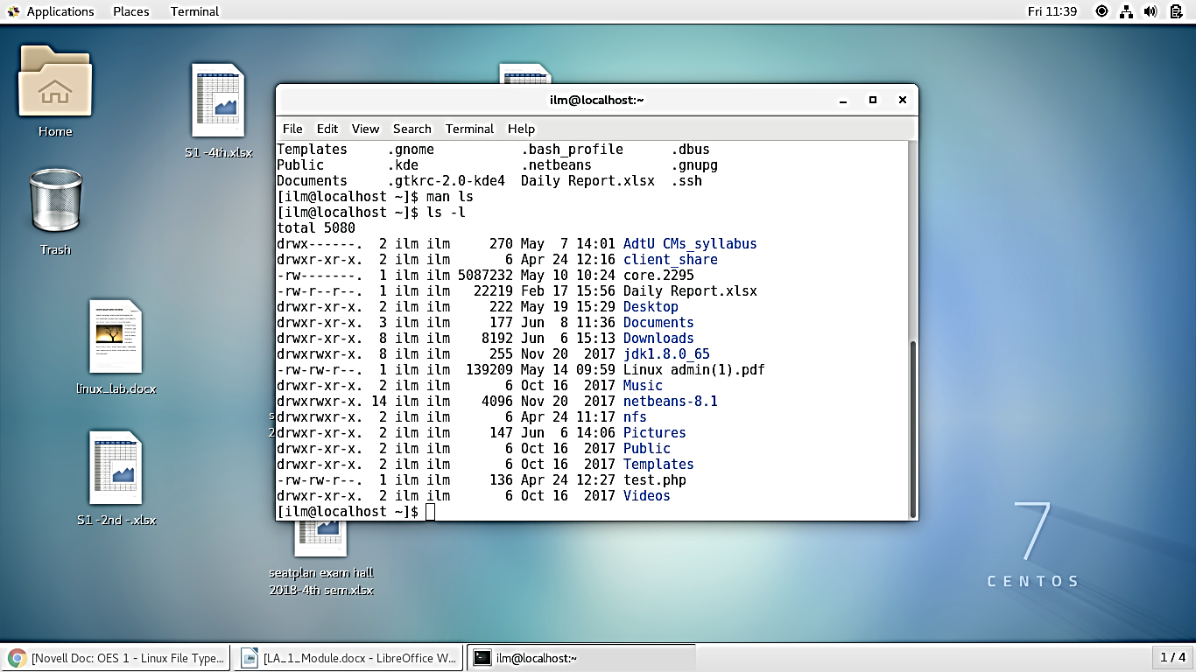
Directories and Files
      To display the type of file we use the command : “ ls -l “.
      The following screen shot displays the output of the command.

Slide 8
Directory Structure
      In Linux we have root file system which is the directory that generally does not contain any files, except perhaps on older systems where the standard boot image for the system, usually called /vmlinuz was kept there.
      1. / – Root
      Every single file and directory starts from the root directory.
      Only root user has write privilege under this directory.
      Please note that /root is root user’s home directory, which is not same as /.
      2. /bin – User Binaries
      Contains binary executables.
      Common Linux commands you need to use in single-user modes are located under this directory.
      Commands used by all the users of the system are located here.
      For example: ps, ls, ping, grep, cp.

Slide 9
(Continued) Directory Structure
      3. /sbin – System Binaries
      Just like /bin, /sbin also contains binary executables.
      But, the Linux commands located under this directory are used typically by system aministrator, for system maintenance purpose.
      For example: iptables, reboot, fdisk, ifconfig, swapon
      4. /etc – Configuration Files
      Contains configuration files required by all programs.
      This also contains startup and shutdown shell scripts used to start/stop individual programs.
      For example: /etc/resolv.conf, /etc/logrotate.conf
      5. /dev – Device Files
      Contains device files.
      These include terminal devices, usb, or any device attached to the system.
      For example: /dev/tty1, /dev/usbmon0

Slide 10
(Continued) Directory Structure
      6. /proc – Process Information
      Contains information about system process.
      This is a pseudo filesystem contains information about running process. For example: /proc/{pid} directory contains information about the process with that particular pid.
      This is a virtual filesystem with text information about system resources. For example: /proc/uptime
      7. /var – Variable Files
      var stands for variable files.
      Content of the files that are expected to grow can be found under this directory.
      This includes — system log files (/var/log); packages and database files (/var/lib); emails (/var/mail); print queues (/var/spool); lock files (/var/lock); temp files needed across reboots (/var/tmp);
      8. /tmp – Temporary Files
      Directory that contains temporary files created by system and users.
      Files under this directory are deleted when system is rebooted.

Slide 11
(Continued) Directory Structure
      9. /usr – User Programs
      Contains binaries, libraries, documentation, and source-code for second level programs.
      /usr/bin contains binary files for user programs. If you cannot find a user binary under /bin, look under /usr/bin. For example: at, awk, cc, less, scp
      /usr/sbin contains binary files for system administrators. If you cannot find a system binary under /sbin, look under /usr/sbin. For example: atd, cron, sshd, useradd, userdel
      /usr/lib contains libraries for /usr/bin and /usr/sbin
      /usr/local contains users programs that you install from source. For example, when you install apache from source, it goes under /usr/local/apache2
      10. /home – Home Directories
      Home directories for all users to store their personal files.
      For example: /home/john, /home/nikita

Slide 12
(Continued) Directory Structure
      11. /boot – Boot Loader Files
      Contains boot loader related files.
      Kernel initrd, vmLinux, grub files are located under /boot
      For example: initrd.img-2.6.32-24-generic, vmlinuz-2.6.32-24-generic
      12. /lib – System Libraries
      Contains library files that supports the binaries located under /bin and /sbin
      Library filenames are either ld* or lib*.so.*
      For example: ld-2.11.1.so, libncurses.so.5.7
      13. /opt – Optional add-on Applications
      opt stands for optional.
      Contains add-on applications from individual vendors.
      add-on applications should be installed under either /opt/ or /opt/ sub-directory.

Slide 13
(Continued) Directory Structure
      14. /mnt – Mount Directory
      Temporary mount directory where sysadmins can mount filesystems.
      15. /media – Removable Media Devices
      Temporary mount directory for removable devices.
      For examples, /media/cdrom for CD-ROM; /media/floppy for floppy drives; /media/cdrecorder for CD writer
      16. /srv – Service Data
      srv stands for service.
      Contains server specific services related data.
      For example, /srv/cvs contains CVS related data.

Slide 14
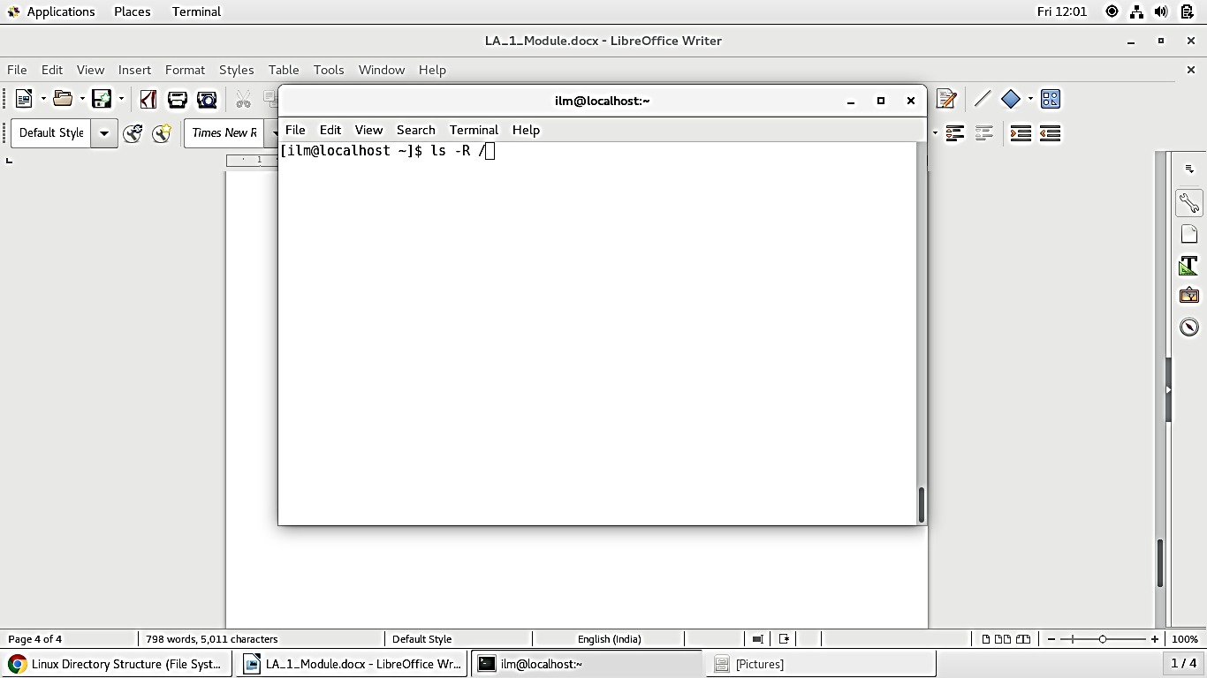
(Continued) Directory Structure
        To display the root file system with all files we use the command: “ ls -R / ”.

Slide 15
Absolute and Relative Path-names
        Path
          A path is a unique location to a file or a folder in a file system of an OS.
          A path to a file is a combination of / and alpha-numeric characters.
Absolute Path
Relative path

Slide 16
Absolute and Relative Path-names
      Absolute Path
      An absolute path is defined as specifying the location of a file or directory from the root directory (/).
      To write an absolute path-name:
      Start at the root directory ( / ) and work down.
      Write a slash ( / ) after every directory name (last one is optional).

Slide 17
Absolute and Relative Path-names
      (Continued) Absolute Path
      For Example:
      $cat abc.sql will work only if the fie “abc.sql” exists in your current directory.
      However, if this file is not present in your working directory and is present somewhere else say in /home/kt , then this command will work only if you will use it like shown below:
      cat /home/kt/abc.sql
      In the above example, if the first character of a pathname is /, the file’s location must be determined with respect to root. When you have more than one / in a pathname, for each such /, you have to descend one level in the file system like in the above kt is one level below home, and thus two levels below root.

Slide 18
Absolute and Relative Path-names
      (Continued) Absolute Path
Changing directory with absolute path concept :
$pwd
/home/kt
$cd /home/kt/abc
$pwd
/home/kt/abc
Absolute Path

Slide 19
Absolute and Relative Path-names
      Relative path
      Relative path is defined as the path related to the present working directly (pwd). It starts at your current directory and never starts with a /.
      UNIX offers a shortcut in the relative pathname– that uses either the current or parent directory as reference and specifies the path relative to it. A relative path-name uses one of these cryptic symbols:
      .(a single dot) - this represents the current directory.
      ..(two dots) - this represents the parent directory.

Slide 20
Absolute and Relative Path-names
(Continued) Relative path
Changing directory with relative path concept :
$pwd
/home/kt
$cd abc
$pwd
/home/kt/abc
Relative path

Slide 21
Creating Directories
      The mkdir command creates new directories.
      $ mkdir directory_name
      and/or
      $ mkdir -p directory_names
      Include the –p option if the directory name includes a path name. The command used with the -p option creates all of the non-existing parent directories that do not yet exist in the path to the new directory. You can use absolute or relative path names on the command line when creating new directories.
      For example, create a new directory, named dir1, within the /tmp directory.
      $ cd /tmp
      $ mkdir dir1

Slide 22
(Continued) Creating Directories
      You can use the command ‘ls -ld’ to view the created directory.
      $ ls -ld dir1
      drwxr-xr-x 2 geek wheel 64 Dec 13 22:26 dir1
      To create a new directory named dir_in located inside a directory named dir_out, use the mkdir command with the –p option. The dir_out directory does not yet exist.
      $ mkdir -p dir_out/dir_in
      To create the dir1, dir2, and dir3 directories, enter the mkdir command with all the directory names in one line as shown below.
      $ mkdir dir1 dir2 dir3
      $ ls -ld dir*

Slide 23
Removing Directories
      You can use the rm command with the -r option to remove directories that contain files and subdirectories.
      $ rm -options directories
      For example, remove the dir1 directory and its content by using the rm –r command.
      $ cd /tmp
      $ rm -r dir1
      $ ls -ld dir1
      ls: dir1: No such file or directory
      If you do not use the -r option with the rm command while removing directories, the following error message appears:
      rm: directoryname: is a directory.

Slide 24
(Continued) Removing Directories
      To interactively remove a directory and its contents, use the –i option along with the rm –r command. For example:
      $ rm -ir dir2
      examine files in directory dir2? y
      remove dir2/file2? y
      remove dir2/file1? y
      remove dir2? Y
      The rmdir command removes empty directories.
      $ rmdir directories
            For example to remove the empty directory dir3, use the command below.
            $ cd /tmp
            $ rmdir dir3
      To remove a directory in which you are currently working in, you must first change to its parent directory.

Slide 25
Creating Files
        The touch command creates a new empty file.
              $ touch filename
        You can create multiple files with the same command. If the file name or directory name already exists, the touch command updates the modification time and access time to the current date and time. You can use absolute or relative path names on the command line when creating new files.
        To create an empty file named file1 in the /tmp directory, enter the following commands:
                $ cd /tmp
                $ touch space
                $ ls -l file1
                $ ls -l file
                -rw-r--r-- 1 geek wheel 0 Dec 13 22:05 file
        To create multiple empty files use the touch commands with the file names in one line as follows:
                $ touch file1 file2 file3
                $ ls -lrt file*

Slide 26
Removing Files
        You can permanently remove files from the directory hierarchy with the rm command.
                $ rm -option filename
        The rm command is a destructive command if not used with the correct option. The table describes the options that you can use with the rm command when removing files and directories.
Option | Description
-r | Includes the contents of a directory and the contents of all subdirectories when you remove a directory
-i | Prevents the accidental removal of existing files or directories
The –r option allows you to remove directories that contain files and subdirectories.
The -i option prompts you for confirmation before removing any file.
– A yes response completes the removal of the file.
– A no response aborts the removal of the file.

Slide 27
(Continued) Removing Files
      For example, remove the file named file1 from the /tmp directory.
            $ cd /tmp
            $ rm file1
      Lets see an example of using the -i option to delete the files.
            $ rm -i file2
            remove file2? y

Slide 28
Copying Files
      Like so many Linux features, you have a variety of options from which to choose when you want to manipulate files and directories. You can also use wildcards when you are copying, moving, or deleting files and directories.
      Basically, the copy command is not much more complex than typing:
            cp <source> <destination>
      So to copy the file sneakers.txt to the directory tigger in your login directory, just type:
            cp sneakers.txt tigger

Slide 29
Moving Files
      To move files, use the mv command (man mv), which is similar to the cp command, except that with mv the file is physically moved from one place to another, instead of being duplicated, as with cp.
      Common options available with mv include:
      -i -- interactive. Will prompt you if the file you have selected will overwrite an existing file in the destination directory. This is a good option, because like the -i option in cp, you will be given the chance to make sure you want to replace an existing file.
      -f -- force. Overrides the interactive mode and moves without prompting. Unless you know what you are doing, this option does not play nice; be very careful about using it until you become more comfortable with your system.
      -v -- verbose. Shows a list of the files being moved.

Slide 30
(Continued) Moving Files
      If you want to move a file out of your home directory and into another directory, you would type:
      mv sneakers.txt tigger
      or
              mv sneakers.txt /home/newuser /home/newuser/tigger using absolute pathnames.

