Slide 1

Linux System Administration and Configuration
Module Number: 01
Module Name: Introduction to Linux
Part: 02

Slide 2
File Permission
      Each file and directory has three user based permission groups:
      Owner - The Owner permissions apply only the owner of the file or directory, they will not impact the actions of other users.
      Group - The Group permissions apply only to the group that has been assigned to the file or directory, they will not affect the actions of other users.
      All users - The All Users permissions apply to all other users on the system, this is the permission group that you want to watch the most.

Slide 3
File Permission Types
      Each file or directory has three basic permission types:
      Read - The Read permission refers to a user's capability to read the contents of the file.
      Write - The Write permissions refers to a user's capability to write or modify a file or directory.
      Execute - The Execute permission affects a user's capability to execute a file or view the contents of a directory.

Slide 4
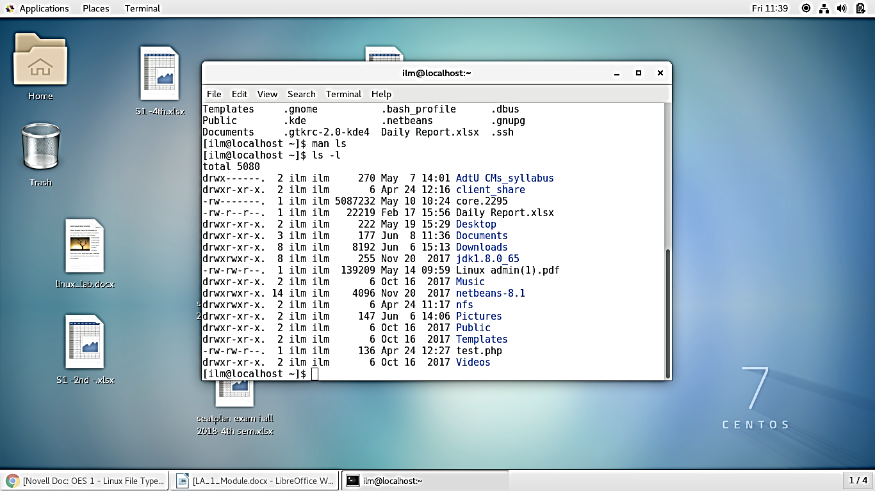
(Continued) File Permission Types
      To display the file permission we use the command: “ ls -l “. The following screenshot displays the output of the command.

Slide 5
Link in Unix/ Linux
      Link
      A link in Unix/ Linux is a pointer to a file. Like pointers in any programming languages, links in Unix are pointers pointing to a file or a directory.
      Creating links is a kind of shortcuts to access a file. Links allow more than one file name to refer to the same file, elsewhere.
      There are two types of links :
Soft Link or Symbolic Links
Hard Links

Slide 6
(Continued) Link in Unix/ Linux
      These links behave differently when the source of the link (what is being linked to) is moved or removed. Symbolic links are not updated (they merely contain a string which is the pathname of its target); hard links always refer to the source, even if moved or removed.
      For example, if we have a file a.txt, we create a hard link to the file and then delete the file, we can still access the file using hard link. But if we create a soft link of the file and then delete the file, we cannot access the file through soft link and soft link becomes dangling. Basically hard link increases reference count of a location while soft links work as a shortcut (like in Windows).

Slide 7
Soft Links or Symbolic Links
        A soft link is similar to the file shortcut feature which is used in Windows Operating systems. Each soft linked file contains a separate Inode value that points to the original file. As similar to hard links, any changes to the data in either file is reflected in the other. Soft links can be linked across different file systems, although if the original file is deleted or moved, the soft linked file will not work correctly (called hanging link).
        ls -l command shows all links with first column value 1? and the link points to original file.
        Soft Link contains the path for original file and not the contents.
        Removing soft link does not affect anything but removing original file, the link becomes “dangling” link which points to nonexistent file.
        A soft link can link to a directory.
        Link across filesystems: If you want to link files across the filesystems, you can only use symlinks/soft links.
        Command to create a Soft link is:
        $ ln -s [original filename] [link name]

Slide 8
Hard Links
      Each hard linked file is assigned the same Inode value as the original, therefore they refer the same physical file location. Hard links more flexible and remain linked even if the original or linked files are moved throughout the file system, although hard links are unable to cross different file systems.
      ls -l command shows all the links with the link column shows number of links.
      Links have actual file contents.
      Removing any link, just reduces the link count, but does not affect other links.
      We cannot create a hard link for a directory to avoid recursive loops.
      If original file is removed, then the link will still show the content of the file.
      Command to create a hard link is:
      $ ln [original filename] [link name]

Slide 9
Input and output redirection
      One of the most important and interesting topics under Linux administration is I/O redirection. This feature of the command line enables you to redirect the input and/or output of commands from and/or to files, or join multiple commands together using pipes to form what is known as a “command pipeline”.
      All the commands that we run fundamentally produce two kinds of output:
      The command result – data the program is designed to produce.
      The program status and error messages that informs a user of the program execution details.

Slide 10
(Continued) Input and output redirection
      In Linux and other Unix-like systems, there are three default files named below which are also identified by the shell using file descriptor numbers:
      stdin or 0 – It is connected to the keyboard, most programs read input from this file.
      stdout or 1 – It is attached to the screen, and all programs send their results to this file.
      stderr or 2 – Programs send status/error messages to this file which is also attached to the screen.
      Therefore, I/O redirection allows you to alter the input source of a command as well as where its output and error messages are sent to. And this is made possible by the “<” and “>” redirection operators.

Slide 11
How to Redirect Standard Output to File in Linux
      You can redirect standard output as in the example below. Here, we want to store the output of the top command for later inspection:
      $ top -bn 5 >top.log
          Where the flags:
          -b – Enables top to run in batch mode, so that you can redirect its output to a file or another command.
          -n – Specifies the number of iterations before the command terminates.

Slide 12
Filter and Pipe
      Filter
      A filter takes the standard input, does something useful with it, and then returns it as a standard output. Linux has a large number of filters. Some useful ones are the commands awk, grep, sed, spell, and wc.
      Pipe
      A pipe can pass the standard output of one operation to the standard input of another, but a filter can modify the stream.

Slide 13

Locate Command
      The locate command is very easy to use.
      All you have to do is to pass it the filename you want to search.
      locate [filename]
      For example, if you want to search for all filenames that have the string 'dir2' in them, then we can do that using locate in the following way:

Slide 14
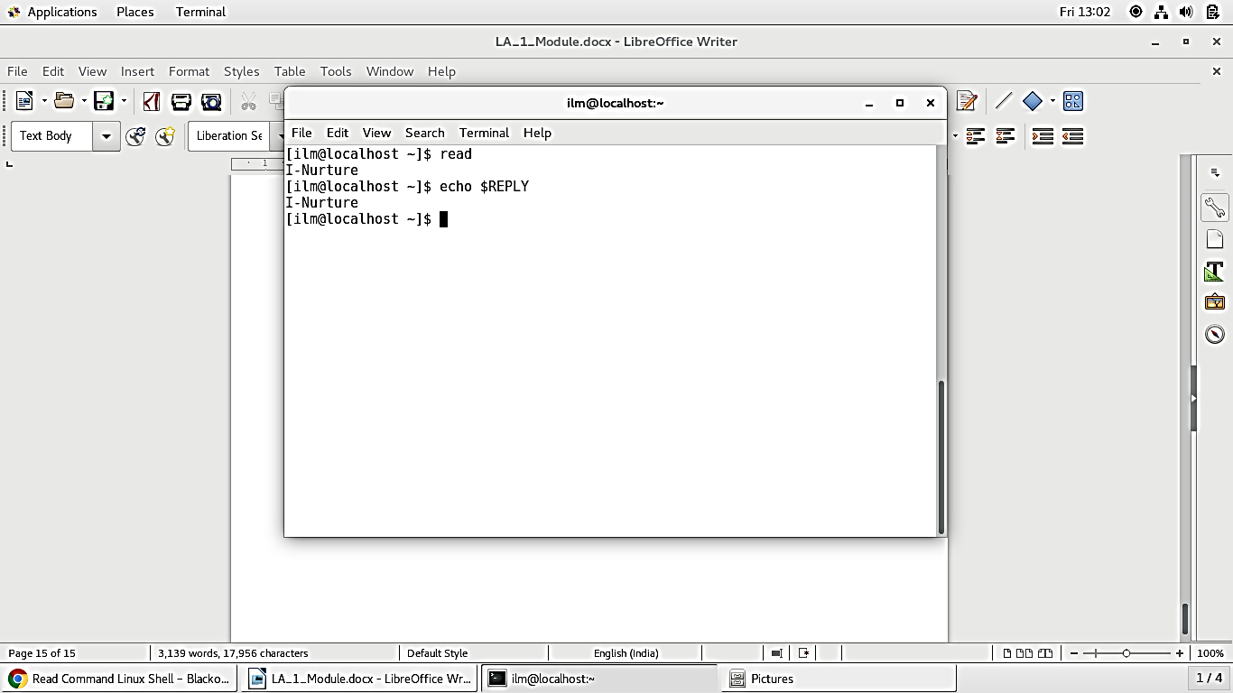
Read Command
        Read the data until you press the enter key.
        Here we will not specify the variable where to store the data.
        By default the data is stored in the variable called REPLY.
        So we can invoke the data as $REPLY.

Slide 15
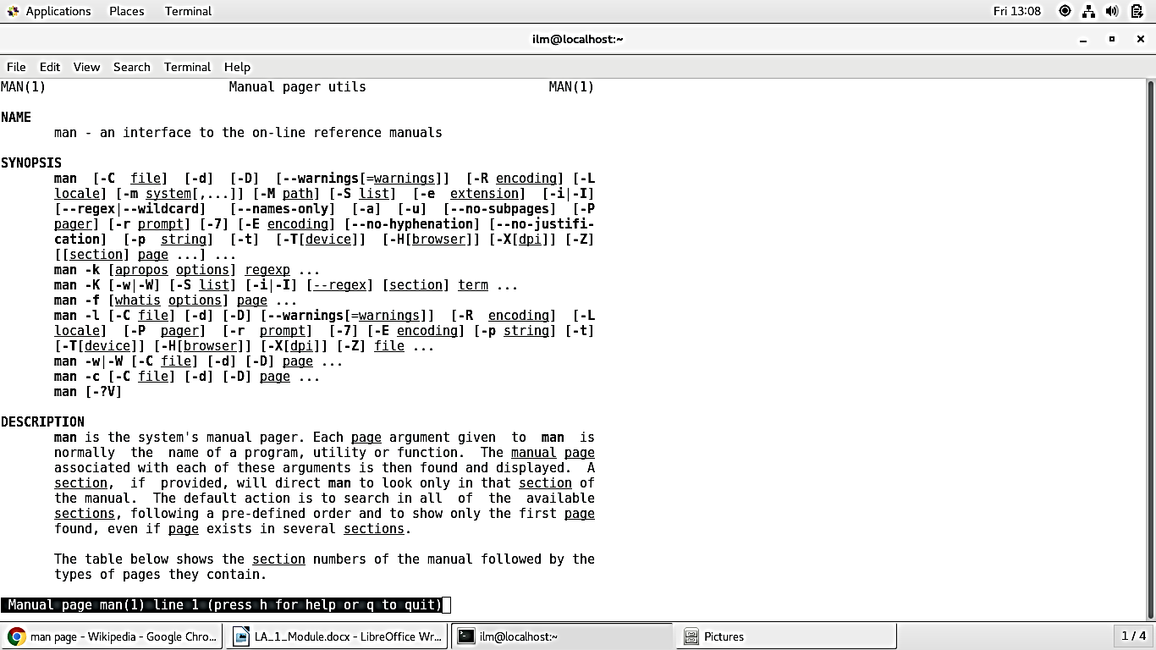
System Documentation and MAN page
        A man page (short for manual page) is a form of software documentation usually found on a Unix or Unix-like operating system.
        Topics covered include computer programs (including library and system calls), formal standards and conventions, and even abstract concepts.
        A user may invoke a man page by issuing the man command.

Slide 16

Introduction to Linux
Self Assessment Question
            Which one of the given option is the root partition?
                /
                /root
                /bin
                None of the Above
Answer: /
16

Slide 17
Introduction to Linux
Self Assessment Question
            Which one of the given files is/are used for IPC?
                Socket
                Pipe
                Device file
                Only i
                Only i and ii
                All i, ii and iii
Answer: Only i and ii
17

Slide 18
Introduction to Linux
Self Assessment Question
            Which one of the given partition contains the user files?
                /home
                /add
                /bin
                None of the Above
Answer: /home
18

Slide 19
Introduction to Linux
Self Assessment Question
            Which one of the given command is used to create a directory?
                mkdir
                deltree
                sue
                None of the Above
Answer: mkdir
19

Slide 20
Introduction to Linux
Self Assessment Question
            Which one of the given command is used for removing a directory?
                rmdir
                rm -r
                Del
                Only i
                Only i and ii
                All i, ii and iii
Answer: Only i and ii
20

Slide 21
Introduction to Linux
Self Assessment Question
            Which one of the given command is used for creating blank file?
                touch
                create
                mkfile
                None of the Above
Answer: touch
21

Slide 22
Introduction to Linux
Self Assessment Question
            Which one of the given command is used for changing the file permission?
                chmod
                chgroup
                chown
                None of the Above
Answer: chmod
22

Slide 23
Introduction to Linux
Self Assessment Question
            8. Which command is used for displaying long listing of the directory?
                ls -l
                chgroup
                ckl
                None of the Above
Answer: ls -l
23

Slide 24
Introduction to Linux
Self Assessment Question
            How to display the hidden files?
                ls -A
                chg
                ckla
                None of the Above
Answer: ls -A
24

Slide 25
Introduction to Linux
Self Assessment Question
            How to create a hidden file?
                touch .file_name.extension
                touchgh
                cklt
                None of the Above
Answer: touch .file_name.extension
25

Slide 26
Introduction to Linux
Self Assessment Question
            What does “..” signifies in the Directory?
                Parent Working Directory
                Parent Directory
                Current directory
                None of the Above
Answer: Parent Working Directory
26

Slide 27

Introduction to Linux
Assignment
Please answer the below set of questions. These set of questions are meant for testing unit 1.
  The answers should be clear, legible and well presented.
  Illustrate your answers with suitable examples wherever necessary.
  Please quote sources (if any) of data, images, facts etc.
      Explain the root file system.
      Explain file permissions.
      What is a file and explain its types?
      How to rename the file using command?
      What is path? Differentiate between absolute and relative path?
      What are the filter commands in Linux?
      Differentiate between hard and soft link.
      How to change the path using absolute and relative path?

Slide 28
Introduction to Linux
Summary
1
2
3
4
5
6
7
8
9
In Linux, everything is considered as a file including Directory also.
The root partition is “/”.
There are two types of path : Absolute path & Relative Path.
The commands in Linux are case sensitive.
To view the long listing of file we use “ ls –l”.
The command for creating blank directory is “ mkdir directory_name”.
There are no commands in Linux for renaming a file but “mv” is used for renaming as well.
The file permissions is very strict in Linux and we categorise them under “UGO”.
To view the documentation we have “man command_name” which provides all details.
28

Slide 29

Introduction to Linux
        Document Links
Topics | URL | Notes
Linux File System | https://www.computernetworkingnotes.com/rhce-study-guide/Linux-file-system-explained-with-shell-and-kernel.html | This link explains about Linux File System.
Linux File Permissions | https://www.guru99.com/file-permissions.html | You will learn file permissions and configuring File Permissions.
Linux filter and pipes | https://www.Linux.com/news/pipes-and-filters | This link explains about Linux Filter & Linux Pipe.

Slide 30

Introduction to Linux
        Video Links
Topics | URL | Notes
Absolute path & Relative path | https://www.youtube.com/watch?v=UKmL72XgXUw | This video explains about path and absolute & relative path.
Linux File types and permissions | https://www.youtube.com/watch?v=SdgiYoOi0CY | You will learn file types and file permissions.
Linux Hard & Soft Link | https://www.youtube.com/watch?v=4-vye3QFTFo | This video will help in understanding Hard link and soft link.

Slide 31

Introduction to Linux
Introduction To Linux
        E - Book Links
Topics | URL
Red Hat Enterprise Linux 7 System Administrator's Guide | https://access.redhat.com/documentation/en-us/red_hat_enterprise_Linux/7/pdf/system_administrators_guide/Red_Hat_Enterprise_Linux-7-System_Administrators_Guide-en-US.pdf
Red Hat Linux Networking and System Administration | https://www.nettech.in/e-books/Linux-Networking-and-System-Admin.pdf

Slide 32


