Slide 1
The UNIX File System
Module Number: 04
Module Name: Unix File System

Slide 2
Topic to be Covered
Inodes.
Structure of a regular file.
Directories.
Conversion of a path name to an inode,
Super block.
Inode assignment to a new file.
Allocation of disk blocks.

Slide 3
3. Directories
Directory files have entries of sub directories and files that reside inside them.
Directory files have the mapping of a file name and its inode number.
One directory entry takes 16 bytes. 14 bytes are given for the name of the file and 2 bytes for inode number. For example:

Slide 4
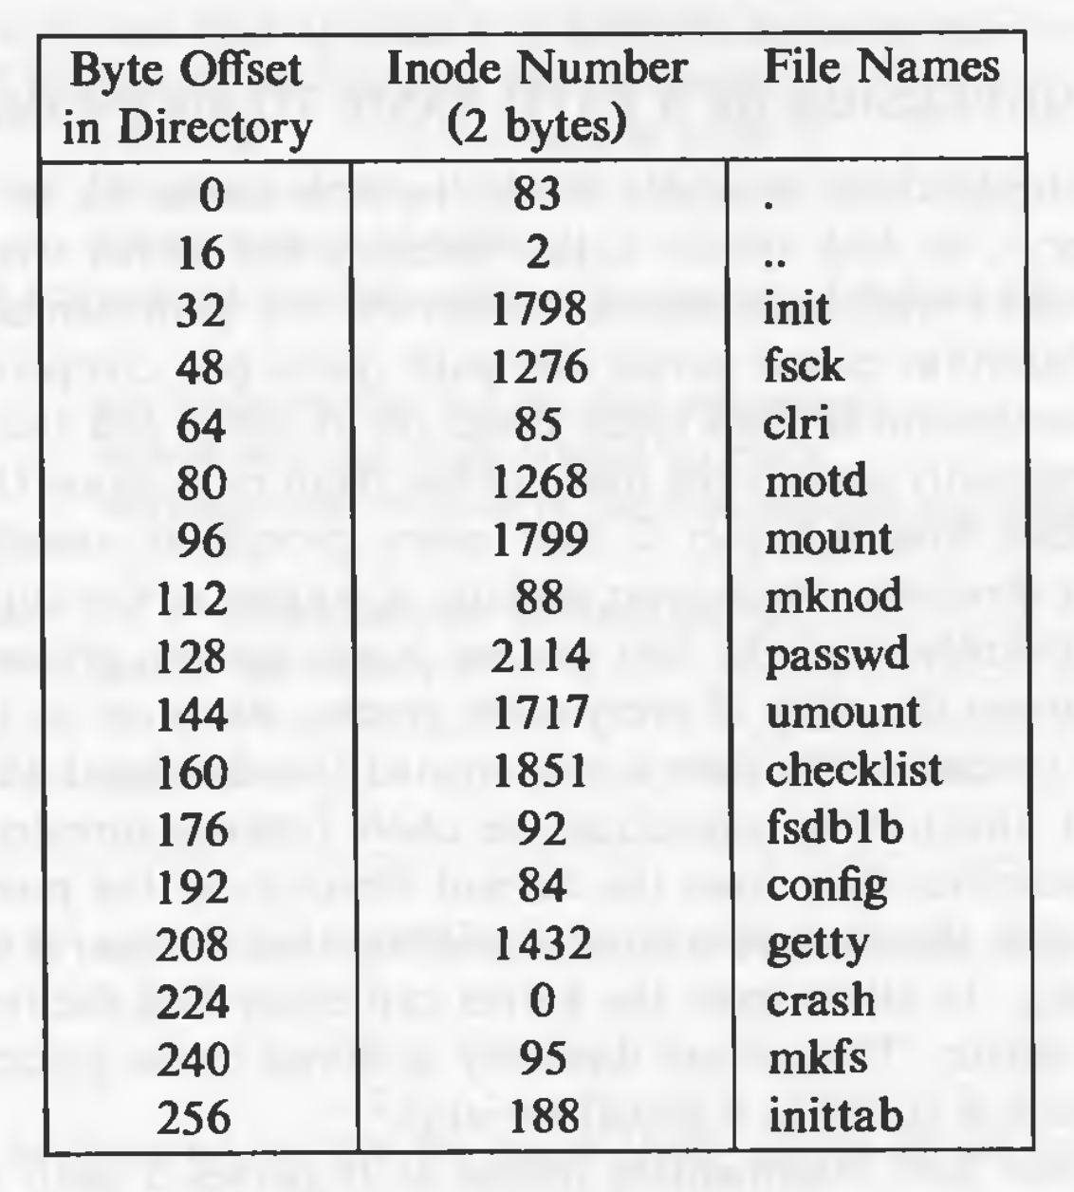

Slide 5
Directories conti…
The entry . has the inode number of the the directory file itself.
The Entry .. has the inode number of the parent directory.
The . and .. for the root directory are nothing but inode numbers of the root directory itself.
Entries that have the inode number 0 are empty (i.e. deleted files).
The kernel has exclusive writes to a directory.
The access permission for directories mean different things.
Read permission is for reading the contents of the directory.
Write permission given the permission to create files and directories in that directory.
and the execute permission gives the right to search in that directory.

Slide 6
4. Conversion of Path Name to an Inode
Algorithm namei (name to inode) is used for converting a path to an inode number.
The kernel parses the path by accessing each inode in the path and finally returning the inode of the required file.
Every process has a current directory.
The current directory of process 0 is the root directory.
For every other process, it is the current directory of its parent process.
Searches start with respect to the current directory unless the path begins with the / component, stating that the search should start with the root directory.

Slide 7
//Algorithm: namei
//Input: pathname
//Output: locked inode
{
if (path name starts from root)
working inode = root inode (algorithm: iget);
else
working inode = current directory inode (algorithm: iget);
while (there is more path name)
{
read next path name component from input;
verify that working inode is of a directory and access permissions are OK;
if (working inode is of root and component is "..")
continue;
read directory (working inode) by repeated use of algorithms: bmap, bread, brelse;
if (component matches an entry in the directory (working inode)
{
get inode number for matched component;
release working inode (algorithm: iput);
working inode = inode of matched component (algorithm: iget);
}
else
return (no inode) // component not in the directory
}
return (working inode);
}

Slide 8
5. Superblock
The contents of the super block are:
Size of the file system.
Number of free blocks in the file system.
List of free blocks in the file system.
pointer to the next free block in the free blocks list
Size of the inodes list.
Number of free inodes in the file system.
List of free inodes in the file system.
Pointer to the next free inode in the free inodes list.
Lock fields for the free blocks and free inodes list.
A field indicating whether the super block has changed.
Note: The kernel periodically writes the superblock to the disk if it had been modified so that it is consistent with the data on the disk.

Slide 9
6. Inode Assignment to a New File
Algorithm ialloc is used to assign an inode to a newly crated file.
If the list of inodes numbers in the super block is not empty.
The kernel assigns the next inode number.
Allocates a free in-core inode for the newly assigned disk inode using algorithm iget.
copies the disk inode to the in-core copy.
initializes the fields in the inode.
returns the locked inode.
It updates the inode on disk to indicate that the inode is in use.
If the super block list of free inodes is empty, the kernel searches the disk and places as many free inode numbers as possible into the super block. The kernel reads the inode list on disk, block by block, and fills the super block list of inode numbers to capacity, remembering the highest-numbered inode that it finds ("remembered" inode). It is the last one saved in the super block.

Slide 10
6. Inode Assignment to a New File cont..
If the super block list of free inodes is empty.
the kernel searches the disk and places as many free inode numbers as possible into the super block.
The kernel reads the inode list on disk, block by block, and fills the super block list of inode numbers to capacity.
remembering the highest-numbered inode that it finds ("remembered" inode). It is the last one saved in the super block.

Slide 11
/* Algorithm: ialloc
* Input: file system
* Output: locked inode
*/
{ while (not done){
if (super block locked){
sleep (event: super block becomes free);
continue;
}
if (indoe list in super block is empty){
lock super block;
get remembered inode for free inode search;
search disk for free inodes until super block full, or no more free inodes (algorithm: bread and brelse);
unlock super block;
wake up (event: super block becomes free);
if (no free inodes found on disk)
return (no inode);
set remembered inode for next free inode search;
}
// there are inodes in super block inode list
get inode number form super block inode list;
get inode (algorithm: iget);
if (inode not free after all){
write inode to disk;
release inode (algorithm: iput);
continue;
}
// inode is free
initialize inode;
write inode to disk;
decrement file system free inode count;
return inode;
}
}

Slide 12
7. Allocation of free blocks
When data is written on a file, the kernel must allocate disk blocks from the file system (for direct data blocks or sometimes, indirect data blocks).
The file system super block contains an array that is used to cache the numbers of free disk blocks in the file system.
The utility program mkfs (make file system) organizes the data blocks of a file system in a linked list, such that each link of the list is a disk block that contains an array of free disk block numbers, and one array entry is the number of the next block of the linked list.

