Slide 1

The UNIX File System
Module Number: 04
Module Name: Unix File System

Slide 2
Topic to be Covered
Inodes.
Structure of a regular file.
Directories.
Conversion of a path name to an inode,
Super block.
Inode assignment to a new file.
Allocation of disk blocks.

Slide 3
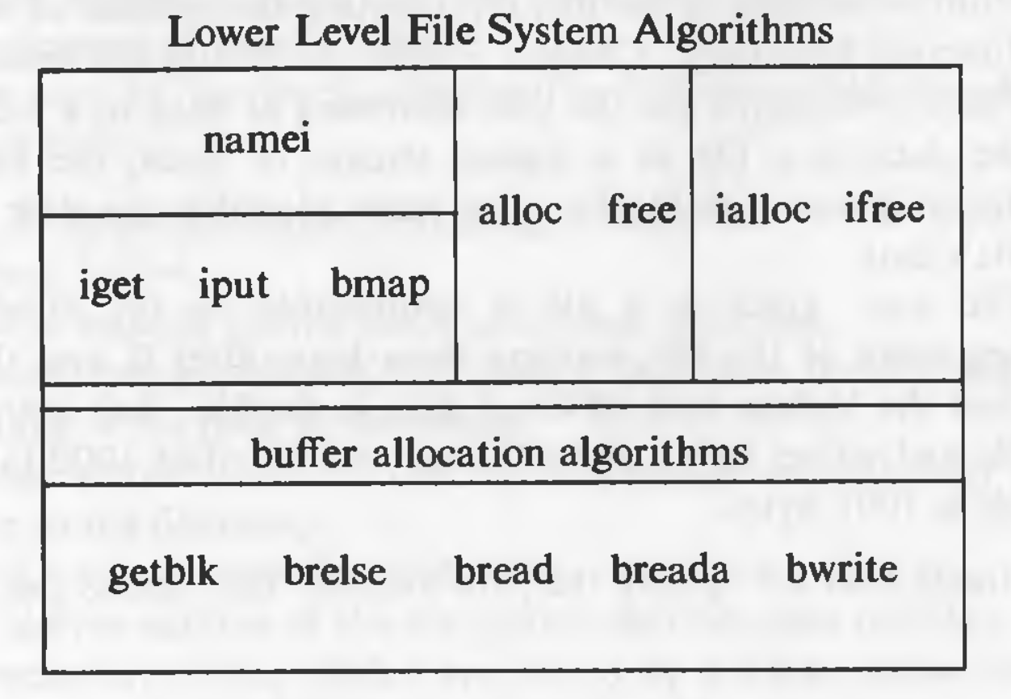
Internal Representation of Files
Every file a UNIX system has a unique inode.
Processes interact with files using well defined system calls.
The users specify a file with a character string which is the file's path and then the system get the inode which is mapped to the file which corresponds to the path.
The algorithms described below are above the layer of buffer cache.
Diagrammatically, it can be shown like this:

Slide 4
1. Inodes
Inodes exist in a static form on the disk.
The kernel reads them into in-core inodes and modifies them.
The inode does not specify the pathname/pathnames that access the file.
Disk inodes consists of the following fields:
Owner information: Ownership is divided into a user and a group of users. Root user has access to all the files.
File type: it states whether a file is a normal file, a directory, a block or character special file, or a device file.
File access permissions: there are 3 types of access permissions: owner, group and others. There are separate permissions for reading, writing and executing. Since execute permission is not applicable to a directory, execute permission for a directory gives the right to search inside the directory.

Slide 5
Inodes (Continue)
Access times: the times at which the file was last accessed and last modified, and the time at which the inodes was last modified.
Number of links: number of places from which the file is being referred.
Array of disk blocks: even if the users get a logically sequential representation of data in files, the actual data is scattered across the disk. This array keeps the addresses of the disk blocks on which the data is scattered.
File size: the addressing of the file begins from location 0 from relative to the starting location and the size of the file is the maximum offset of the file + 1. For example, if a user creates a file and writes a byte at offset 999, the size of the file is 1000.

Slide 6
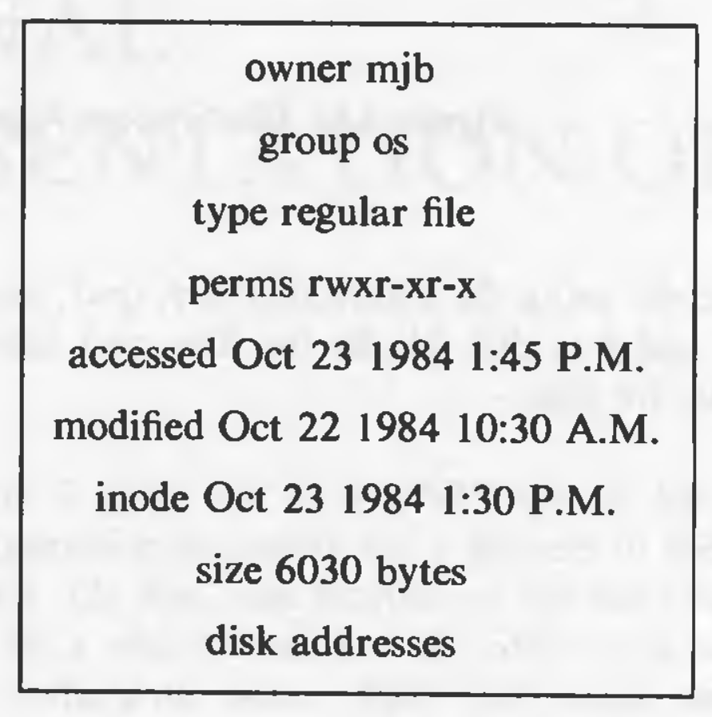
3

Slide 7
Inodes (Continue)
just like the buffer cache, the in-core inodes are nothing but a cache for disk inodes (but with some extra information which is deterministic).
The in-core inodes contain the following fields in additional to the fields of the disk inode:
Status of the inode
  Locked.
  A process is (or many processes are) waiting for it to be unlocked.
  The data in the inode differs from the disk inode due to change in the inode data.
  The data in the inode differs from the disk inode due to change in the file data.
  The file is a mount point (discussed later).
The device number of the logical device of the file system on which the file resides.

Slide 8
Inodes (Continue)
Inode number: the disk inodes are placed in an array. So the number of the inode is nothing but the index of the inode in the array. That is why the disk copy does not need to store the inode number.
Points to inodes: In-core inodes also have hash queues and a free list and the lists behave in a very similar way to the buffer lists. The inode has next and previous pointers to the inodes in the hash queue and free lists. The hash queues have a hash function based on the device number and inode number.
Reference count: it gives the number of instances of files that are active currently.

Slide 9
Inodes (Continue)
The most striking difference between an in-core inode and a buffer header is the reference count.
The reference count increases when a process allocates that inode, for example, by opening a file.
An inode is on the free list if and only if the reference count of the inode is 0.
If it is greater, some process is still accessing the inode. This means, that an inode can be on a hash queue and not on the free list even if its not locked.

Slide 10
Accessing Inodes
The algorithm iget allocates an in-core copy of an inode.
If the inode is not found on a hash queue, it allocates an inode from the free list and reads the disk copy into the in-core inode.
It already knows the inode number and device number.
It calculates the logical block number on which the disk inode resides according to how many inodes fit into one disk block.
block number = ((inode number - 1) / number of inodes per block) + start block of inode list
To find the byte offset of the inode in that block, this following formula is used:
byte offset = ((inode number - 1) % number of inodes per block) * size of disk inode

Slide 11
2. Structure of a Regular File
In UNIX, the data in files is not stored sequentially on disk.
  If it was to be stored sequentially, the file size would not be flexible without large fragmentation. In case of sequential storage, the inode would only need to store the starting address and size.
Instead, the inode stores the disk block numbers on which the data is present. But for such strategy, if a file had data across 1000 blocks, the inode would need to store the numbers of 1000 blocks and the size of the inode would differ according to the size of the file.
To be able to have constant size and yet allow large files, indirect addressing is used.
The inodes have array of size 13 which for storing the block numbers, although, the number of elements in array is independent of the storage strategy.

Slide 12
Structure of a Regular File
The first 10 members of the array are "direct addresses", meaning that they store the block numbers of actual data.
The 11th member is "single indirect", it stores the block number of the block which has "direct addresses".
The 12th member is "double indirect", it stores block number of a "single indirect" block.
The 13th member is "triple indirect", it stores block number of a "double indirect" block.
This strategy can be extended to "quadruple" or "quintuple" indirect addressing.

Slide 13
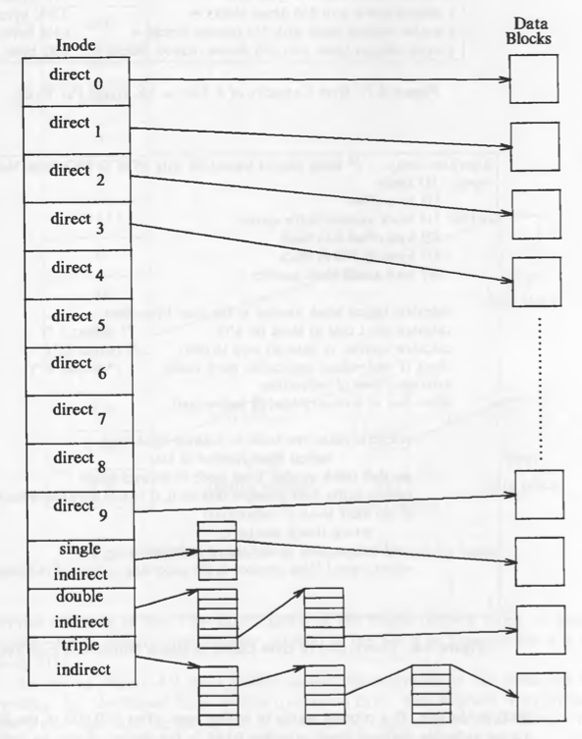

Slide 14


