Slide 1

Linux System Administration and Configuration
Module Number: 04
Module Name: Managing system and infrastructure services

Slide 2
Managing system and infrastructure services
        Objectives
The Objectives of this module are:
P
P
P
P
Explain the system Management.
Explain the shutting, suspending hibernating the Systems.
Describe how to control systems on remote machine.
Describe how to configure different servers.

Slide 3
Managing system and infrastructure services
        Outcome
  At the end of this module, you are expected to learn:
P
P
P
P
Define Managing system services, shutting down, suspending and hibernating the system.
Controlling systems on remote machine.
Creating and modifying systemd unit files.
Configuration of servers like DHCP, HTTP, FTP, Mail Server, Samba, NTP, NFS.

Slide 4
Managing system and infrastructure services
        Content
1. Managing system services
2. Shutting down, suspending and hibernating the system
3. Controlling systems on remote machine
4. Creating and modifying system unit files
5. DHCP Configuration
6. HTTP server Configuration
7. FTP server Configuration
8. Mail server Configuration
9. Samba server Configuration
10. NTP server Configuration
11. NFS server Configuration

Slide 5
Managing system and infrastructure services
      1. Managing System Srvices
        In RHEL, for managing service one new method is introduced systemd.
        To view, start, stop, restart, enable, or disable system services, use the systemctl command.
        Previous versions of Red Hat Enterprise Linux, init or Upstart scripts were used.
          The used init scripts located in the /etc/rc.d/init.d/ directory.
          These init scripts were typically written in Bash, and allowed the system administrator to control the state of services and daemons in their system.
        In Red Hat Enterprise Linux 7, the following init scripts have been replaced with “service units”
  #systemctl restart httpd.service
  #systemctl restart httpd

Slide 6
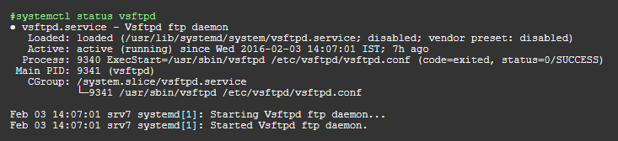
Managing system and infrastructure services
    2. Displaying Service Status
    In above outputs, there are some fields which were scripted as below
    Loaded Information whether the service unit has been loaded, the absolute path to the unit file, and a note whether the unit is enabled.
    Active Information whether the service unit is running followed by a time stamp.
    Main PID The PID of the corresponding system service followed by its name.
    Status Additional information about the corresponding system service.
    Process Additional information about related processes.
    CGroup Additional information about related Control Groups (cgroups).

Slide 7


Managing system and infrastructure services
  3. Managing System Services (using is-active)
      It is possible to know only status of a service on system.
      It is possible to know service is enable on boot or not.

Slide 8
Managing system and infrastructure services
  4. Start, Stop and restart of Service
        For start ,stop, restart and reload of service use below commands.
        #systemctl stop vsftpd
        #systemctl start vsftpd
        #systemctl restart vsftpd
        #systemctl reload vsftpd
  5. Enabling or Disabling of service
        To start service automatically on boot time, we have to enable service. For reverse, we have to disable service with below commands.
          #systemctl enable vsftpd
          #systemctl is-enabled vsftpd
          enabled
          #systemctl disable vsftpd
          #systemctl is-enabled vsftpd
          disabled

Slide 9
systemctl vs. service
How you start|stop|restart a service will depend upon whether your distribution uses systemd or init.
There are two officially adopted methods for controlling services:
  systemctl
  service
Which one you use will depend on if your distribution makes use of systemd or init.
  Most modern distributions have made the switch to systemd, so systemctl is the service manager of choice.
  However, older way to start|stop|restart with using service command. Fortunately, the developers of systemd made sure to retain service and redirect it to systemctl.

Slide 10
systemctl vs. service
systemctl usage
In fact, the stopping|starting|restarting of services on Linux is now quite simpleusing systemctl command
Syntax :
systemctl start|stop|restart|reload name.service
  Example : (Starting httpd service)
    sudo systemctl start httpd
    The service would start and you'd be returned to your bash prompt.
  Example : (Stopping httpd service)
    sudo systemctl stop httpd
    The Apache server would stop and you'd be returned to the bash prompt.
    Example : (Restarting httpd service)
    sudo systemctl restart httpd

Slide 11
systemctl vs. service
service usage
  The service command still works -- even for those distributions that have migrated to systemd and systemctl.
  In the case of service, the command will redirect to systemctl.\
  The service command usage is a bit different from systemctl. The service name and start|stop|restart options are switched:
Syntax :
​ ​sudo service <Service name> start|stop|restart
  Example : (Starting httpd service)
    sudo service httpd start
    The service would start and you'd be returned to your bash prompt.
  Example : (Stopping httpd service)
    sudo service httpd stop
    The Apache server would stop and you'd be returned to the bash prompt.
    Example : (Restarting httpd service)
    sudo service httpd restart

Slide 12
Managing system and infrastructure services
  Start, Stop and restart of Service
      Some of comparison in between service command and systemctl
SERVICE | SYSTEMCTL | DESCRIPTION
service name start | systemctl start name.service | Starts a service.
service name stop | systemctl stop name.service | Stops a service.
service name restart | systemctl restart name.service | Restarts a service.
service name condrestart | systemctl try-restart name.service | Restarts a service only if it is running.
service name reload | systemctl reload name.service | Reloads configuration.
service name status | systemctl status name.service systemctl is-active name.service | Checks if a service is running.
service –status-all | systemctl list-units --type service--all | Displays the status of all services.

Slide 13
Managing system and infrastructure services
  Shutting down, suspending and hibernating the system
In RHEL 7, the systemctl utility replaces some older power management commands used in previous versions. The table below compares the older and new equivalent systemctl commands. The old commands listed in the table still exist for compatibility reasons.
Older Command | systemctl equivalent | Description
halt | systemctl halt | Halts the system
poweroff | systemctl poweroff | Powers off the system
reboot | systemctl reboot | Restarts the system
pm-suspend | systemctl suspend | Suspends the system
pm-hibernate | systemctl hibernate | Hibernates the system
pm-suspend-hybrid | systemctl hybrid-sleep | Hibernates and suspends the system

Slide 14
Managing system and infrastructure services
    Suspend
      Suspending the system saves the system state in RAM and with the exception of the RAM module, powers off most of the devices in the machine.
      When you turn the machine back on, the system then restores its state from RAM without having to boot again.
      Because the system state is saved in RAM and not on the hard disk, restoring the system from suspend mode is significantly faster than restoring it from hibernation, but as a consequence, a suspended system state is also vulnerable to power outages.
    Hibernate
      Hibernating the system saves the system state on the hard disk drive and powers off the machine.
      When you turn the machine back on, the system then restores its state from the saved data without having to boot again.
      Because the system state is saved on the hard disk and not in RAM, the machine does not have to maintain electrical power to the RAM module, but as a consequence, restoring the system from hibernation is significantly slower than restoring it from suspend mode.

Slide 15
Managing system and infrastructure services
    Controlling systemd on remote machine
    Systemd system and services manager can be controlled using the systemctl command line utility. It enables you to manage systemd locally or on a remote Linux machine over the SSH protocol.
    Here, we will show you how to manage systemd system and service manager on a remote Linux machine over a SSH session.
    To connect to a remote server, run systemctl with the --host or -H flag as follows. In the command below, we are connecting to the remote server as the root user and status is a subcommand of systemctl utility used to view the status of the httpd service on centos.temint.lan (remote Linux server).
    $ systemctl --host root@centos.temint.lan status httpd.service
    OR
    $ systemctl -H root@centos.temint.lan status httpd.service
      *We recommend using public/private key pairs for passwordless authentication for SSH, as opposed to passwords, and also employing additional methods to secure SSH service, as explained in these guides.

Slide 16
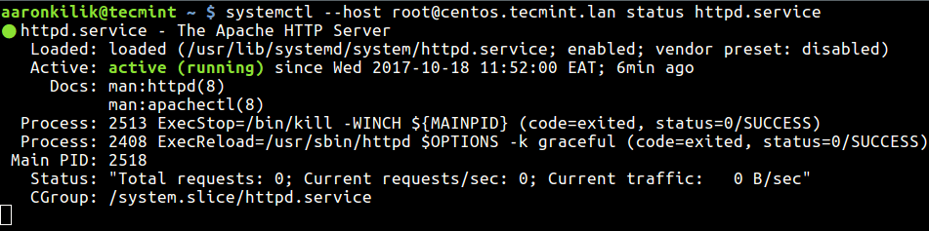
Managing system and infrastructure services
    Controlling systemd on remote machine

Slide 17
Managing system and infrastructure services
    (Continued) Controlling systemd on remote machine
    Similarly, you can also start, stop or restart remote systemd service as shown:
          $ systemctl --host root@centos.temint.lan start httpd.service
          $ systemctl --host root@centos.temint.lan stop httpd.service
          $ systemctl --host root@centos.temint.lan restart httpd.service
            To end the session, simply type [Ctrl+C]. For more information and usage options, see the systemctl man page: $ man systemctl

Slide 18
Managing system and infrastructure services
  Creating and modifying systemd unit files
    A unit file contains configuration directives that describe the unit and define its behaviour. Several systemctl commands work with unit files in the background. To make finer adjustments, system administrator must edit or create unit files manually. The /etc/systemd/system/ directory is reserved for unit files created or customized by the system administrator.
    Unit file names take the following form:
          unit_name.type_extension
    Here, unit_name stands for the name of the unit and type_extension identifies the unit type. For example, there usually is sshd.service as well as sshd.socket unit present on your system.

Slide 19
Managing system and infrastructure services
      (Continued) Creating and modifying systemd unit files
      Unit files can be supplemented with a directory for additional configuration files. For example, to add custom configuration options to sshd.service, create the sshd.service.d/custom.conf file and insert additional directives there.
      Also, the sshd.service.wants/ and sshd.service.requires/ directories can be created. These directories contain symbolic links to unit files that are dependencies of the sshd service. The symbolic links are automatically created either during installation according to [Install] unit file options or at runtime based on [Unit] options. It is also possible to create these directories and symbolic links manually.
      Many unit file options can be set using the so called unit specifiers – wildcard strings that are dynamically replaced with unit parameters when the unit file is loaded. This enables creation of generic unit files that serve as templates for generating instantiated units.

Slide 20
Managing system and infrastructure services
      (Continued) Creating and modifying systemd unit files
      There are several use cases for creating unit files from scratch: you could run a custom daemon, create a second instance of some existing service, or import a SysV init script.
        Prepare the executable file with the custom service. This can be a custom-created script, or an executable delivered by a software provider. If required, prepare a PID file to hold a constant PID for the main process of the custom service. It is also possible to include environment files to store shell variables for the service. Make sure the source script is executable (by executing the chmod a+x) and is not interactive.
        Create a unit file in the /etc/systemd/system/ directory and make sure it has correct file permissions. Execute as root.
        Replace name with a name of the service to be created. Note that file does not need to be executable.
        Open the name.service file created in the previous step, and add the service configuration options. There is a variety of options that can be used depending on the type of service you wish to create, see Section 10.6.1, “Understanding the Unit File Structure”.

Slide 21
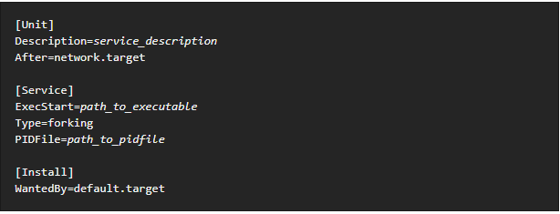
Managing system and infrastructure services
      (Continued) Creating and modifying systemd unit files
      The following is an example unit configuration for a network-related service:
      Where:
      service_description is an informative description that is displayed in journal log files and in the output of the systemctl status command.

Slide 22
Managing system and infrastructure services
      (Continued) Creating and modifying systemd unit files
      The After setting ensures that the service is started only after the network is running. Add a space-separated list of other relevant services or targets.
      Path_to_executable stands for the path to the actual service executable.
      Type=forking is used for daemons that make the fork system call. The main process of the service is created with the PID specified in path_to_pidfile.
      WantedBy states the target or targets that the service should be started under. Think of these targets as of a replacement of the older concept of runlevels.
      Notify systemd that a new name.service file exists by executing the following command as root systemctl daemon-reload
              systemctl start name.service

Slide 23
Managing system and infrastructure services
    Modifying Existing Unit Files
      Services installed on the system come with default unit files that are stored in the /usr/lib/systemd/system/ directory. System Administrators should not modify these files directly, therefore any customization must be confined to configuration files in the /etc/systemd/system/ directory. Depending on the extent of the required changes, pick one of the following approaches:
      Create a directory for supplementary configuration files at /etc/systemd/system/unit.d/. This method is recommended for most use cases. It enables extending the default configuration with additional functionality, while still referring to the original unit file. Changes to the default unit introduced with a package upgrade are therefore applied automatically.
      Create a copy of the original unit file /usr/lib/systemd/system/ in /etc/systemd/system/ and make changes there. The copy overrides the original file, therefore changes introduced with the package update are not applied. This method is useful for making significant unit changes that should persist regardless of package updates.

Slide 24
Managing system and infrastructure services
    (Continued) Modifying Existing Unit Files
      In order to return to the default configuration of the unit, just delete custom-created configuration files in /etc/systemd/system/. To apply changes to unit files without rebooting the system, execute:
      systemctl daemon-reload
      The daemon-reload option reloads all unit files and recreates the entire dependency tree, which is needed to immediately apply any change to a unit file. As an alternative, you can achieve the same result with the following command:
      init q
      Also, if the modified unit file belongs to a running service, this service must be restarted to accept new settings:
      systemctl restart name.service
      To modify properties, such as dependencies or timeouts, of a service that is handled by a SysV initscript, do not modify the initscript itself. Instead, create a systemd drop-in configuration file for the service.

Slide 25


