Slide 1

Linux System Administration and Configuration
Module Number: 04
Module Name: user Management

Slide 2
Creating a local user account
You can add multiple user accounts to your computer.
One account can be given to each person in the household or company.
Every user has their own home folder, documents, and settings.
You need administrator privileges to add user accounts.
Open the Activities overview and start typing Users.
Click on Users to open the panel.
Press Unlock in the top right corner and type in your password when prompted.
Press the + button, below the list of accounts on the left, to add a new user account.
If you want the new user to have administrative access to the computer, select Administrator for the account type.
    Administrators can do things like add and delete users, install software and drivers, and change the date and time.
Enter the new user’s full name. The username will be filled in automatically based on the full name. If you do not like the proposed username, you can change it.
You can choose to set a password for the new user, or let them set it themselves on their first login.
    If you choose to set the password now, you can press the icon to automatically generate a random password.
Click Add.

Slide 3
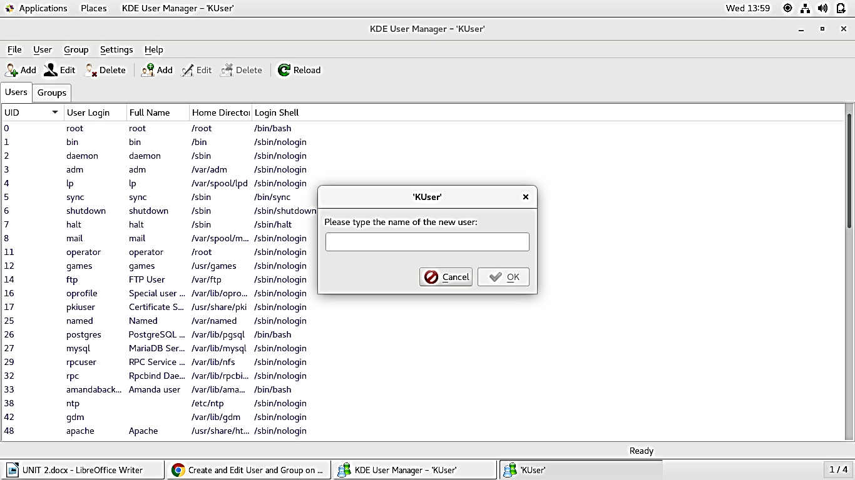
(Continued) Creating a local user account

Slide 4
Deleting a local user account
You can add multiple user accounts to your computer.
If somebody is no longer using your computer, you can delete that user’s account.
You need administrator privileges to delete user accounts.
Open the Activities overview and start typing Users.
Click Users to open the panel.
Press Unlock in the top right corner and type in your password when prompted.
Select the user that you want to delete and press the - button, below the list of accounts on the left, to delete that user account.
Each user has their own home folder for their files and settings. You can choose to keep or delete the user’s home folder. Click Delete Files if you are sure that they will not be used anymore and you need to free up disk space. These files are permanently deleted. They cannot be recovered. You may want to back up the files to an external storage device before deleting them.

Slide 5
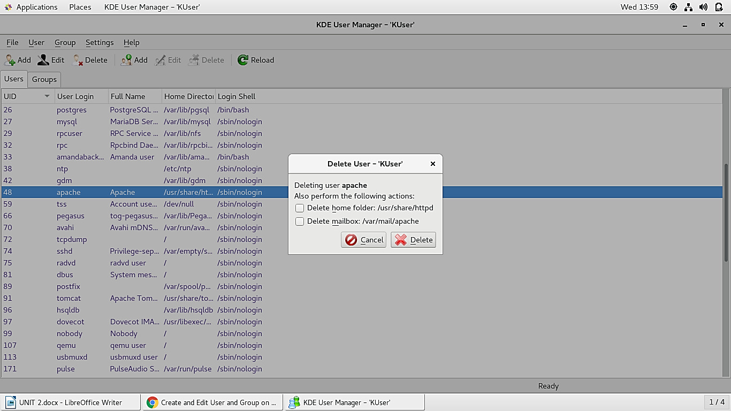
(Continued) Deleting a local user account

Slide 6
Changing the password for local user accounts
Open the Activities overview and start typing Users.
Click Users to open the panel.
Click the label ····· next to Password.
  If you are changing the password for a different user, you will first need to Unlock the panel.
Enter your current password, then a new password.
  Enter your new password again in the Verify New Password field.
You can press the icon to automatically generate a random password.
Click Change.

Slide 7
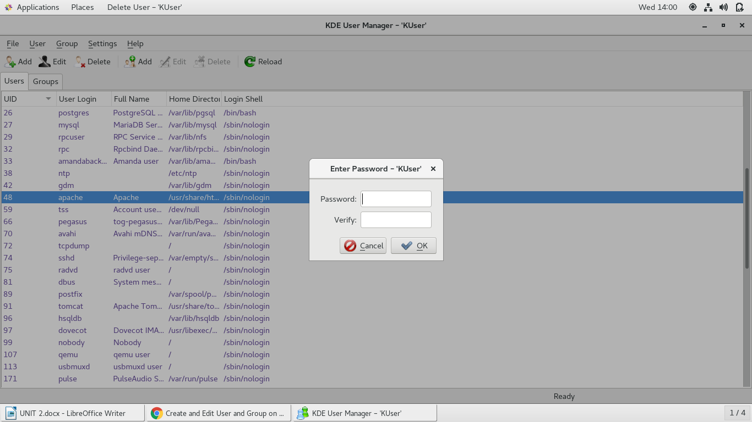
(Continued) Changing the password for local user accounts

Slide 8
Creating User account using command
Basic Syntax to Create an Account
useradd -d homedir -g groupname -m -s shell -u userid accountname
The following table lists out the parameters −
Sr.No. | Option & Description
1 | -d homedir Specifies home directory for the account
2 | -g groupname Specifies a group account for this account
3 | -m Creates the home directory if it doesn't exist
4 | -s shell Specifies the default shell for this account
5 | -u userid You can specify a user id for this account
6 | Accountname Actual account name to be created

Slide 9
Creating User account using command
If you do not specify any parameter, then the system makes use of the default values. The useradd command modifies the /etc/passwd, /etc/shadow, and /etc/group files and creates a home directory.
Following is the example that creates an account Student, setting its home directory to /home/student and the group as developers. This user would have Korn Shell assigned to it.
$ useradd -d /home/student -g developers -s /bin/ksh student
Before issuing the above command, make sure you already have the developers group created using the groupadd command.

Slide 10
Modify the user account
The usermod command enables you to make changes to an existing account from the command line. It uses the same arguments as the useradd command, plus the -l argument, which allows you to change the account name.
For example, to change the account name student to studentcse and to change home directory accordingly, you will need to issue the following command −
$ usermod -d /home/studentcse -m -l student studentcse

Slide 11
Deleting an account
The userdel command can be used to delete an existing user.
This is a very dangerous command if not used with caution.
There is only one argument or option available for the command -r, for removing the account's home directory and mail file.
For example, to remove account studentcse, issue the following command −
$ userdel -r studentcse

Slide 12
Creating Local Groups
Groups allow system administrators to apply certain permissions or access to groups of users.
Groups must be created first before you can assign a user to that group.
To add a new group, you will use the groupadd command.
Syntax: The syntax for the groupadd command is:
groupadd -g Group_ID Group_Name
Parameters or Arguments
The groupadd command requires only the “Group_Name” parameters

Slide 13
(Continued) Creating local groups
Group_Name
The name of the group you would like to add.
Group names should be entered in lowercase and may contain underscores.
It is recommended that you do not use the same group name more than once.
The “groupadd” command also takes Group_ID which is optional.
-g Group_ID
The -g parameter indicates that a group number will follow.
This is the group number that will be assigned to this new group.
The group number must be unique.

Slide 14
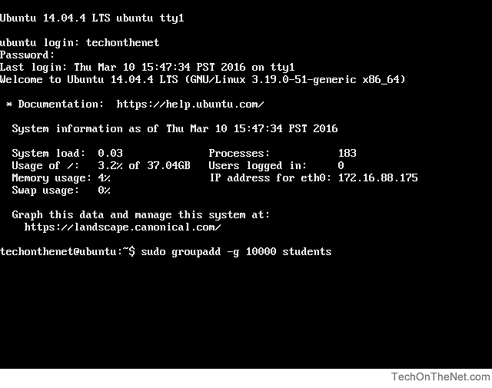
Creating a group
Steps to create a group
To begin adding a new group to your system, we will need to be logged in using a valid user account.
We will add a new group with a Group ID of 10000 and a Group Name of students. To add the group called students, we would enter the following command:
sudo groupadd -g 10000 students
The following screenshot demonstrates what you will see.
When you have entered the command, press the Enter key to execute the command.

Slide 15
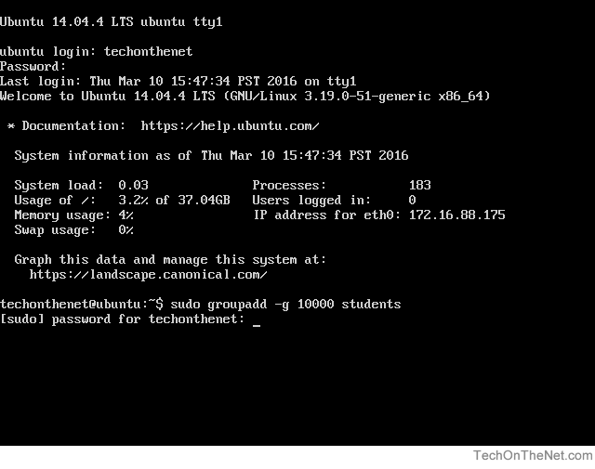
(Continued) Creating a group
The sudo command will now prompt you to enter the password for your administrator account.
[Please note that no characters will show as you type your password. This is normal and is important to preserve the security of your password.]
After you have entered your password, press the Enter key to continue.

Slide 16
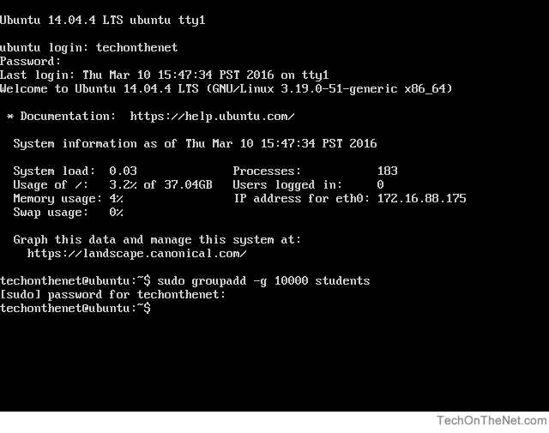
(Continued) Creating a group
If all goes well, you will see the system prompt appear again without any errors. This indicates that the new group called students has been added successfully.

Slide 17
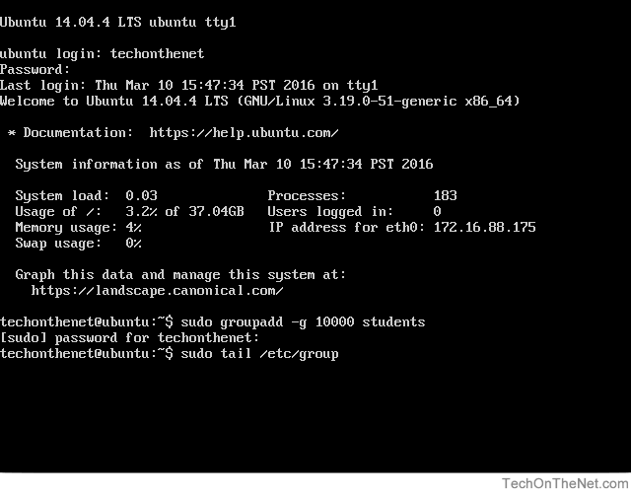
(Continued) Creating a group
In this step we will check to ensure that the group called students was added to the system. Since new groups are added to the end of the system group file called /etc/group, we can use the tail command to verify that the new group was added.
Enter the following tail command after the system prompt to show the last few lines of the system group file:
sudo tail /etc/group
The following screenshot demonstrates what the command will look like after it is typed.
When you have typed the command, press the Enter key to execute the command.

Slide 18
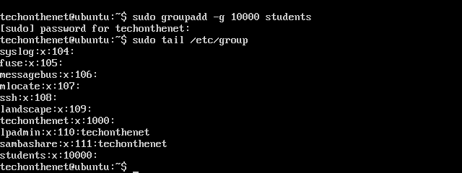
(Continued) Creating a group
As seen in the screenshot below, the following line appears at the end of the /etc/group file indicating that the students group was created.
students:x:10000:

Slide 19
Deleting a group
The syntax for the groupdel command is:
groupdel Group_Name
Parameters or Arguments:
The groupdel command requires the following parameter:
Group_Name - The name of the group you would like to remove. It should be in lowercase and may contain underscores.

Slide 20
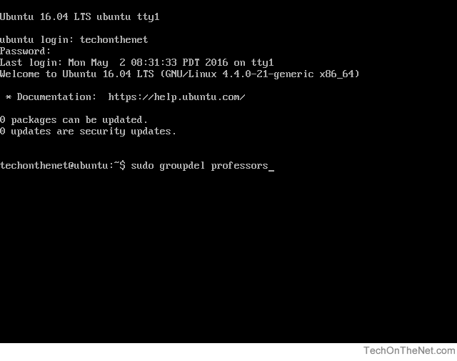
Removing a group
Steps to remove a group
IMPORTANT:
Certain pre-installed groups are required for the system to operate properly.
Do NOT remove a group from a system unless you are sure it is not needed.
To remove an existing group from your system, you will need to be logged in using a valid user account.
Now that you are logged in, we can remove the group with a Group Name of professors by entering the following groupdel command:
sudo groupdel professors
This screenshot demonstrates what you will see.
When you have typed in the command, press the Enter key to execute the command.

Slide 21
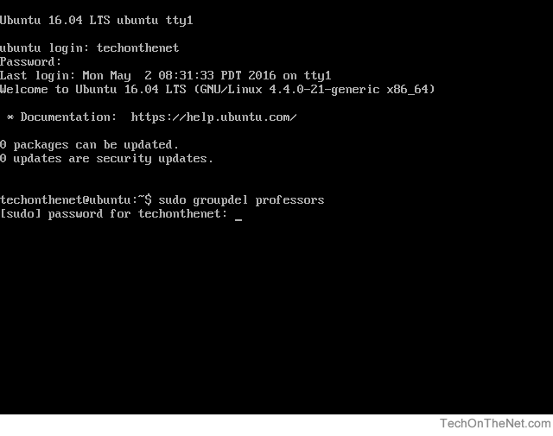
(Continued) Removing a group
The sudo command will now prompt you to enter the password for your administrator account.
Please note that no characters will show as you type your password. This is normal and is important to preserve the security of your password.
After you have entered your password, press the Enter key to continue.

Slide 22
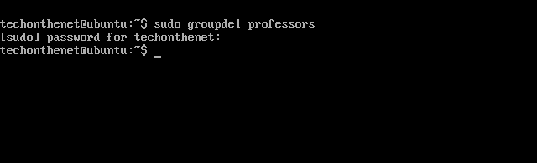
(Continued) Removing a group
If all goes well, you will see the system prompt appear again without any errors. This indicates that the group called professors has been successfully removed.

Slide 23
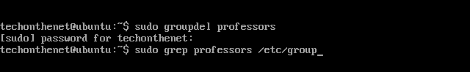
(Continued) Removing a group
This step and step #6 are optional.
In this step we will check to ensure that the group called professors was removed from the system by using the grep command to search the system /etc/group file for the professors group.
If the professors group is not found then we have confirmed that the group has been removed.
Enter the following grep command after the system prompt to search the system group file:
sudo grep professors /etc/group
The following screenshot demonstrates what the command will look like after it is typed.
When you have typed the command, press the Enter key to execute the command.

Slide 24
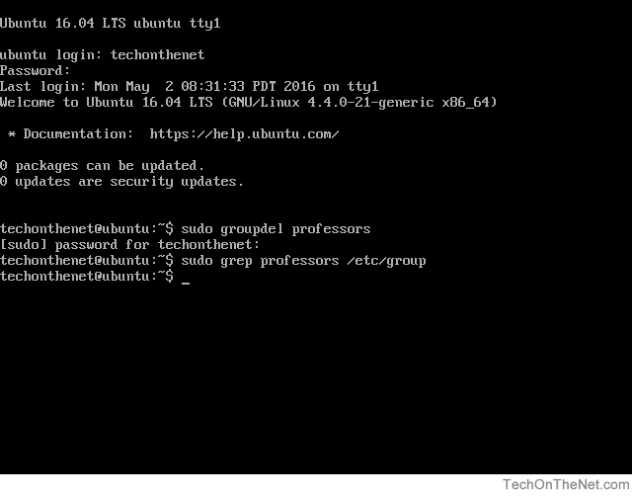
(Continued) Removing a group
As seen in the screenshot below, the professors group was not found by the grep command confirming that we have removed the professors group from the system.

Slide 25
Linux chown Command to Change Owner and Group
The concept of owner and groups for files is fundamental to Linux. Every file is associated with an owner and a group.
You can use chown and chgrp commands to change the owner or the group of a particular file or directory.
Now, we will discuss the ‘chown’ command as it covers most part of the ‘chgrp’ command also.
Even if you already know this command, probably one of the examples mentioned below might be new to you
Change the owner of a file
# ls -lart tmpfile
-rw-r--r-- 1 himanshu family 0 2012-05-22 20:03 tmpfile
# chown root tmpfile
# ls -l tmpfile
-rw-r--r-- 1 root family 0 2012-05-22 20:03 tmpfile
So we see that the owner of the file was changed from ‘himanshu’ to ‘root’.

Slide 26
(Continued) Linux chown Command to Change Owner and Group
Change the group of a file
Through the chown command, the group (that a file belongs to) can also be changed.
# ls -l tmpfile
-rw-r--r-- 1 himanshu family 0 2012-05-22 20:03 tmpfile
# chown :friends tmpfile
# ls -l tmpfile
-rw-r--r-- 1 himanshu friends 0 2012-05-22 20:03 tmpfile
If you observe closely, the group of the file changed from ‘family’ to ‘friends’. So we see that by just adding a ‘:’ followed by the new group name, the group of the file can be changed.

Slide 27
(Continued) Linux chown Command to Change Owner and Group
3. Change both owner and the group
# ls -l tmpfile
-rw-r--r-- 1 root family 0 2012-05-22 20:03 tmpfile
# chown himanshu:friends tmpfile
# ls -l tmpfile
-rw-r--r-- 1 himanshu friends 0 2012-05-22 20:03 tmpfile
So we see that using the syntax ‘<newOwner>:<newGroup>’, the owner as well as group can be changed in one go.

Slide 28
(Continued) Linux chown Command to Change Owner and Group
4. Using chown command on symbolic link file
Here is a symbolic link :
# ls -l tmpfile_symlnk
lrwxrwxrwx 1 himanshu family 7 2012-05-22 20:03 tmpfile_symlnk -> tmpfile
So we see that the symbolic link ‘tmpfile_symlink’ links to the file ‘tmpfile’.
Lets see what happens if chown command is issued on a symbolic link:
# chown root:friends tmpfile_symlnk
# ls -l tmpfile_symlnk
lrwxrwxrwx 1 himanshu family 7 2012-05-22 20:03 tmpfile_symlnk -> tmpfile
# ls -l tmpfile
-rw-r--r-- 1 root friends 0 2012-05-22 20:03 tmpfile
When the chown command was issued on symbolic link to change the owner as well as the group then its the referent of the symbolic link ie ‘tmpfile’ whose owner and group got changed. This is the default behavior of the chown command. Also, there exists a flag ‘–dereference’ for the same.

Slide 29
(Continued) Linux chown Command to Change Owner and Group
5. Using chown command to forcefully change the owner/group of symbolic file.
Using flag ‘-h’, you can forcefully change the owner or group of a symbolic link as shown below.
# ls -l tmpfile_symlnk
lrwxrwxrwx 1 himanshu family 7 2012-05-22 20:03 tmpfile_symlnk -> tmpfile
# chown -h root:friends tmpfile_symlnk
# ls -l tmpfile_symlnk
lrwxrwxrwx 1 root friends 7 2012-05-22 20:03 tmpfile_symlnk -> tmpfile

Slide 30
(Continued) Linux chown Command to Change Owner and Group
6. Change owner only if a file is owned by a particular user
Using chown “–from” flag, you can change the owner of a file, only if that file is already owned by a particular owner.
# ls -l tmpfile
-rw-r--r-- 1 root friends 0 2012-05-22 20:03 tmpfile
# chown --from=guest himanshu tmpfile
# ls -l tmpfile
-rw-r--r-- 1 root friends 0 2012-05-22 20:03 tmpfile
# chown --from=root himanshu tmpfile
# ls -l tmpfile
-rw-r--r-- 1 himanshu friends 0 2012-05-22 20:03 tmpfile

Slide 31
(Continued) Linux chown Command to Change Owner and Group
6. (Continued) Change owner only if a file is owned by a particular user
In the example above, we verified that the original owner/group of the file ‘tmpfile’ was root/friends.
Next we used the ‘–from’ flag to change the owner to ‘himanshu’ but only if the existing owner is ‘guest’.
Now, as the existing owner was not ‘guest’. So, the command failed to change the owner of the file.
Next we tried to change the owner if the existing owner is ‘root’ (which was true) and this time command was successful and the owner was changed to ‘himanshu’.
On a related note, if you want to change the permission of a file, you should use chmod command.
If you are a beginner, you should start by reading the basics of file permissions.

Slide 32
(Continued) Linux chown Command to Change Owner and Group
7. Change group only if a file already belongs to a certain group
Here also the flag ‘–from’ is used but in the following way:
    # ls -l tmpfile
    -rw-r--r-- 1 himanshu friends 0 2012-05-22 20:03 tmpfile
    # chown --from=:friends :family tmpfile
    # ls -l tmpfile
    -rw-r--r-- 1 himanshu family 0 2012-05-22 20:03 tmpfile
Since the file ‘tmpfile’ actually belonged to group ‘friends’ so the condition was correct and the command was successful.
So we see that by using the flag ‘–from=:<conditional-group-name>’ we can change the group under a particular condition.
Notes:
NOTE: By following the template ‘–from=<conditional-owner-name>:<conditional-group-name>’, condition on both the owner and group can be applied.

Slide 33
(Continued) Linux chown Command to Change Owner and Group
8. Copy the owner/group settings from one file to another
This is possible by using the ‘–reference’ flag.
    #ls -l file
    -rwxr-xr-x 1 himanshu family 8968 2012-04-09 07:10 file
    # ls -l tmpfile
    -rw-r--r-- 1 root friends 0 2012-05-22 20:03 tmpfile
    # chown --reference=file tmpfile
    # ls -l tmpfile
    -rw-r--r-- 1 himanshu family 0 2012-05-22 20:03 tmpfile
In the above example, we first checked the owner/group of the reference-file ‘file’ and then checked the owner/group of the target-file ‘tmpfile’. Both were different.
Then we used the chown command with the ‘–reference’ option to apply the owner/group settings from the reference file to the target file.
The command was successful and the owner/group settings of ‘tmpfile’ were made similar to the ‘file’.
Notes:
NOTE: By following the template ‘–from=<conditional-owner-name>:<conditional-group-name>’, condition on both the owner and group can be applied.

Slide 34
(Continued) Linux chown Command to Change Owner and Group
9. Change the owner/group of the files by traveling the directories recursively
This is made possible by the ‘-R’ option.
    # ls -l linux/linuxKernel
    -rw-r--r-- 1 root friends 0 2012-05-22 21:52 linux/linuxKernel
    # ls -l linux/ubuntu/ub10
    -rw-r--r-- 1 root friends 0 2012-05-22 21:52 linux/ubuntu/ub10
    # ls -l linux/redhat/rh7
    -rw-r--r-- 1 root friends 0 2012-05-22 21:52 linux/redhat/rh7
    # chown -R himanshu:family linux/
    # ls -l linux/redhat/rh7
    -rw-r--r-- 1 himanshu family 0 2012-05-22 21:52 linux/redhat/rh7
    # ls -l linux/ubuntu/ub10
    -rw-r--r-- 1 himanshu family 0 2012-05-22 21:52 linux/ubuntu/ub10
    # ls -l linux/linuxKernel
    -rw-r--r-- 1 himanshu family 0 2012-05-22 21:52 linux/linuxKernel
So we see that after checking the owner/group of all the files in the directory ‘linux’ and its two sub-directories ‘ubuntu’ and ‘redhat’.
We issued the chown command with the ‘-R’ option to change both the owner and group.
The command was successful and owner/group of all the files was changed successfully.
Notes:
NOTE: By following the template ‘–from=<conditional-owner-name>:<conditional-group-name>’, condition on both the owner and group can be applied.

Slide 35
(Continued) Linux chown Command to Change Owner and Group
10. Using chown command on a symbolic link directory
Lets see what happens if we issue the ‘chown’ command to recursively change the owner/group of files in a directory that is a symbolic link to some other directory.
Here is a symbolic link directory ‘linux_symlnk’ that links to the directory ‘linux’
    $ ls -l linux_symlnk
    lrwxrwxrwx 1 himanshu family 6 2012-05-22 22:02 linux_symlnk -> linux/
    Now, lets change the owner (from himanshu to root) of this symbolic link directory recursively :
    # chown -R root:friends linux_symlnk
    # ls -l linux_symlnk/
    -rw-r--r-- 1 himanshu friends 0 2012-05-22 21:52 linuxKernel
    drwxr-xr-x 2 himanshu friends 4096 2012-05-22 21:52 redhat
    drwxr-xr-x 2 himanshu friends 4096 2012-05-22 21:52 Ubuntu
In the output above we see that the owner of the files and directories was not changed. This is because by default the ‘chown’ command cannot traverse a symbolic link.
This is the default behavior but there is also a flag ‘-P’ for this.
Notes:
NOTE: By following the template ‘–from=<conditional-owner-name>:<conditional-group-name>’, condition on both the owner and group can be applied.

Slide 36
(Continued) Linux chown Command to Change Owner and Group
11. Using chown to forcefully change the owner/group of a symbolic link directory recursively
This can be achieved by using the flag -H
    # chown -R -H guest:family linux_symlnk
    # ls -l linux_symlnk/
    total 8
    -rw-r--r-- 1 guest family 0 2012-05-22 21:52 linuxKernel
    drwxr-xr-x 2 guest family 4096 2012-05-22 21:52 redhat
    drwxr-xr-x 2 guest family 4096 2012-05-22 21:52 Ubuntu
So we see that by using the -H flag, the owner/group of all the files/folder were changed.
Notes:
NOTE: By following the template ‘–from=<conditional-owner-name>:<conditional-group-name>’, condition on both the owner and group can be applied.

Slide 37
(Continued) Linux chown Command to Change Owner and Group
12. List all the changes made by the chown command
Use the verbose option -v, which will display whether the ownership of the file was changed or retained as shown below.
# chown -v -R guest:friends linux
changed ownership of `linux/redhat/rh7' to guest:friends
changed ownership of `linux/redhat' retained to guest:friends
ownership of `linux/redhat_sym' retained as guest:friends
ownership of `linux/ubuntu_sym' retained as guest:friends
changed ownership of `linux/linuxKernel' to guest:friends
changed ownership of `linux/ubuntu/ub10' to guest:friends
ownership of `linux/ubuntu' retained as guest:friends
ownership of `linux' retained as guest:friends
Notes:
NOTE: By following the template ‘–from=<conditional-owner-name>:<conditional-group-name>’, condition on both the owner and group can be applied.

Slide 38
Changing the Group Ownership of a File Using chgrp
All users on the system belong to at least one group. You can find out which groups you belong to using the following command:
groups username
You can then change the group ownership of a specific file using the chgrp command:
chgrp webdev file.txt
s -l file.txt
-rw-rw-r-- 1 robert webdev 0 Feb 25 15:51 file.txt
The file file.txt now belongs to the webdev group.

Slide 39

Package, User and Group Management
Self Assessment Question
            Which one of the given default account is used for administrative task?
                Root
                Sysadmin
                Admin
                None of the above
Answer: root
39

Slide 40
Package, User and Group Management
Self Assessment Question
            ____________ command is used for changing the file ownership.
                chown
                changeown
                adminown
                None of the Above
Answer: chown
40

Slide 41
Package, User and Group Management
Self Assessment Question
            Which one of the given command is used for changing the group?
                chgrp
                changegrp
                admingrp
                None of the Above
Answer: chgrp
41

Slide 42
Package, User and Group Management
Self Assessment Question
            _________ user account can change the file ownership.
                root
                administartor
                adminadmin
                None of the Above
Answer: root
42

Slide 43
Package, User and Group Management
Self Assessment Question
            Which one of the given user account is enabled by default in a single user mode?
                root
                administrator
                adminadmin
                None of the Above
Answer: root
43

Slide 44
Package, User and Group Management
Self Assessment Question
            ____________ command is used for user creation.
                adduser
                useraddition
                createuser
                None of the Above
Answer: adduser
44

Slide 45
Package, User and Group Management
Self Assessment Question
            Which one of the given command is used for creating groups?
                groupadd
                grpadd
                addgrp
                None of the Above
Answer: groupadd
45

Slide 46
Package, User and Group Management
Self Assessment Question
            __________ command is used for deleting user accounts.
                userdel
                deltree
                sue
                None of the Above
Answer: userdel
46

Slide 47
Package, User and Group Management
Self Assessment Question
            Which one of the given options is the default location for user accounts?
                /home
                /root
                /sbin
                None of the Above
Answer: /home
47

Slide 48
Package, User and Group Management
Self Assessment Question
            Which one of the given options is the starting UID for normal user account?
                500
                550
                600
                None of the Above
Answer: 500
48

Slide 49
Package, User and Group Management
Self Assessment Question
            Which one of the given options is the starting GID?
                1000
                5500
                600
                None of the Above
Answer: 1000
49

Slide 50
Package, User and Group Management
Self Assessment Question
            Which one of the given command is used for deleting user home directory?
                userdel –R user_name
                Userdeltree user_name
                Chown user_name
                None of the Above
Answer: userdel –R user_name
50

Slide 51
Package, User and Group Management
Self Assessment Question
            Which one of the given command is used for modifying the User account?
                chmod
                moduser
                chown
                None of the Above
Answer: chmod
51

Slide 52
Package, User and Group Management
Self Assessment Question
            ____________ command is used for setting the UID during the user creation?
                adduser
                setuser
                chuser
                None of the Above
Answer: adduser
52

Slide 53
Package, User and Group Management
Self Assessment Question
            ________ is used to set the group manually for user creation.
                adduser -G
                Setuser -r
                chuser
                None of the Above
Answer: adduser -G
53

Slide 54

Package, User and Group Management
Assignment
  General Instructions:
  Please answer the below set of questions. These set of questions are meant for testing unit 2.
          The answers should be clear, legible and well presented.
          Illustrate your answers with suitable examples wherever necessary.
          Please quote sources (if any) of data, images, facts etc.
        Which file maintains the user accounts in RHEL?
        Explain different methods for creating user accounts.
        How can we delete user accounts.
        Explain the format of /etc/shadow file.
        Explain the format for /etc/passwd file.
        Explain different archive format available in RHEL
        Explain rpm.
        Explain the repository in Linux.
        Explain different functionalities of yum command.
54

Slide 55
Package, User and Group Management
Summary
1
2
3
4
5
6
7
8
The package format for RHEL,fedora, etc except Debian based is “rpm”.
The rpm command can be used only for root user or with “sudo”.
The Linux distro maintain a repository and packages can be installed using “yum” as well.
The “tar” command is used for archive file and supports various compression format except “rar’ format.
The User management task is done only by “root” user .
The “userdel” command do not delete the User files from the “/home”
We have option to include users under a group which ease in setting the policies.
There are two files that maintains the user information /etc/passwd” & “/etc/shadow”.
55

Slide 56

Package, User and Group Management
        Document Links
Topics | URL | Notes
RPM | http://rpm.org/ | This link presents description about the RPM packages.
RPM & YUM | https://www.ibm.com/developerworks/library/l-lpic1-102-5/index.html | This link presents description about the RPM and YUM packages.
Create, delete & modify local user accounts | https://www.thegeekdiary.com/rhel-7-rhcsa-notes-create-delete-and-modify-local-user-accounts/ | This link explains the creating, deleting & modification of local user accounts and local user groups.
Linux chown Command to Change Owner and Group | https://www.thegeekstuff.com/2012/06/chown-examples/ | This link provide the Linux chown Command to Change Owner and Group

Slide 57

Package, User and Group Management
        Video Links
Topics | URL | Notes
rpm,yum | https://www.youtube.com/watch?v=6ItI793zBgY | This video gives a quick overview of using RPM, YUM and DNF for installing software packages in RPM-based Linux distributions.
Repository | https://www.youtube.com/watch?v=hw2xRj-lkmg | This video will show you how to configure Yum server on Linux.
Local Repository | https://www.youtube.com/watch?v=S_P6NLGGhbk | This video will show how to configure local repository in RHEL 7

Slide 58

Package, User and Group Management
        E - Book Links
Topics | URL
Red Hat Enterprise Linux 7 System Administrator's Guide | https://access.redhat.com/documentation/en-us/red_hat_enterprise_linux/7/pdf/system_administrators_guide/Red_Hat_Enterprise_Linux-7-System_Administrators_Guide-en-US.pdf
Red Hat Linux Networking and System Administration | https://www.nettech.in/e-books/Linux-Networking-and-System-Admin.pdf

Slide 59


