Slide 1
This work is licensed under a Creative Commons Attribution-ShareAlike 4.0 International License. This presentation is released under Creative Commons-A6ribute,on 4.0 License. You are free to use, distribute and modify it ,
including for commercial purposes, provided you acknowledge the source.

Slide 2
Module 1 Overview of operating System
CS-2013
Operating System
Lecture 4

Slide 3
Topics to be Cover
Operating System Structure
System Components.
Operating System Services.
System Calls.
What is System Calls
How system calls are executed.
How to pass argument between program and OS
Types of System Calls
System Programs.
OS Kernel and Shell
Operating System Structures

Slide 4
A. Common System Components
Process Management
Main Memory Management
File Management
I/O System Management
Secondary Management
Networking
Protection System
Command-Interpreter System

Slide 5
1. Process Management
A process is a program in execution.
A process needs certain resources, including CPU time, memory, files, and I/O devices, to accomplish its task.
The operating system is responsible for the following activities in connection with process management.
Process creation and deletion.
process suspension and resumption.
Provision of mechanisms for:
process synchronization
process communication

Slide 6
2. Main-Memory Management
Memory is a large array of words or bytes, each with its own address.
It is a repository of quickly accessible data shared by the CPU and I/O devices.
Main memory is a volatile storage device.
It loses its contents in the case of system failure.
The operating system is responsible for the following activities in connections with memory management:
Keep track of which parts of memory are currently being used and by whom.
Decide which processes to load when memory space becomes available.
Allocate and deallocate memory space as needed.

Slide 7
3. File Management
A file is a collection of related information defined by its creator. Commonly, files represent programs (both source and object forms) and data.
The operating system is responsible for the following activities in connections with file management:
File creation and deletion.
Directory creation and deletion.
Support of primitives for manipulating files and directories.
Mapping files onto secondary storage.
File backup on stable (nonvolatile) storage media.

Slide 8
4. I/O System Management
The I/O system consists of:
A buffer-caching system
A general device-driver interface
Drivers for specific hardware devices

Slide 9
5. Secondary-Storage Management
Since main memory (primary storage) is volatile and too small to accommodate all data and programs permanently, the computer system must provide secondary storage to back up main memory.
Most modern computer systems use disks as the principle on-line storage medium, for both programs and data.
The operating system is responsible for the following activities in connection with disk management:
Free space management
Storage allocation
Disk scheduling

Slide 10
6. Networking (Distributed Systems)
A distributed system is a collection processors that do not share memory or a clock.
Each processor has its own local memory.
The processors in the system are connected through a communication network.
Communication takes place using a protocol.
A distributed system provides user access to various system resources.
Access to a shared resource allows:
Computation speed-up
Increased data availability
Enhanced reliability

Slide 11
7. Protection System
Protection refers to a mechanism for controlling access by programs, processes, or users to both system and user resources.
The protection mechanism must:
distinguish between authorized and unauthorized usage.
specify the controls to be imposed.
provide a means of enforcement.

Slide 12
8. Command-Interpreter System
Many commands are given to the operating system by control statements which deal with:
process creation and management
I/O handling
secondary-storage management
main-memory management
file-system access
protection
networking

Slide 13
Command-Interpreter System (Cont.)
The program that reads and interprets control statements is called variously:
command-line interpreter
shell (in UNIX)
Its function is to get and execute the next command statement.

Slide 14
B. Operating System Services
An operating system provides an environment for the execution of programs. It provides certain services to programs and to the users of those programs. The specific services provided, of course, differ from one operating system to another, but we can identify common classes.
Program execution –
I/O operations
File-system manipulation –
Communications –
Error detection –
since user programs cannot execute I/O operations directly, the operating system must provide some means to perform I/O.
program capability to read, write, create, and delete files.
exchange of information between processes executing either on the same computer or on different systems tied together by a network. Implemented via shared memory or message passing.
ensure correct computing by detecting errors in the CPU and memory hardware, in I/O devices, or in user programs.
system capability to load a program into memory and to run it.

Slide 15
Additional Operating System Functions
Additional functions exist not for helping the user, but rather for ensuring efficient system operations.
Resource allocation – allocating resources to multiple users or multiple jobs running at the same time.
Accounting – keep track of and record which users use how much and what kinds of computer resources for account billing or for accumulating usage statistics.
Protection – ensuring that all access to system resources is controlled.

Slide 16
System Calls
System calls provide the interface between a running program and the operating system.
Generally available as assembly-language instructions.
These calls are generally available as routines written in C and C++, although certain low-level tasks (for example, tasks where hardware must be accessed directly instructions.
Languages defined to replace assembly language for systems programming allow system calls to be made directly (e.g., C, C++).

Slide 17
How system calls are used?
Example:
write a simple program to read the contents of one file and copy into another file.
For performing above task operating system issues various system calls.
The first input that the program will need is the names of the two files:
A input file and A output file.
These names can be specified in many ways, depending on the operating-system design.
One approach is for the program to ask the user for the names of the two files at command line.
In an interactive system, this approach will require a sequence of system calls, first to write a prompting message on the screen and then to read from the keyboard the characters that define the two files.
On mouse-based and icon-based systems, a menu of file names is usually displayed in a window. The user can then use the mouse to select the source name, and a window can be opened for the destination name to be specified. This sequence requires many I/O system calls.

Slide 18
In the next step the program must open the input file and create the output file(Each of these operations requires another system call.) There are also possible error conditions for each operation.
When the program tries to open the input file, it may find that there is no file of that name.
It may be possible that the file is protected against access.
In these cases, the program should print a message on the console (another sequence of system calls) and then terminate abnormally (another system call).
If the input file exists, then we must create a new output file.
We may find that there is already an output file with the same name. This situation may cause the program to abort (a system call), or we may delete the existing file (another system call) and create a new one (another system call).
in an interactive system, is to ask the user whether to replace the existing file or to abort the program.(another sequence of system calls.

Slide 19
In the next step we enter a loop that reads from the input file (a system call) and writes to the output file (another system call).
Each read and write must return status information regarding various possible error conditions.
On input, the program may find that the end of the file has been reached or that there was a hardware failure in the read (such as a parity error).
The write operation may encounter various errors, depending on the output device (no more disk space, printer out of paper, and so on).
After copy operation, the program closes both files (another system call),
write a message to the console or window (more system calls), and finally terminate normally (the final system call).
As we can see, even simple programs may make heavy use of the operating system.
Frequently, systems execute thousands of system calls per second.

Slide 20
Passing parameters between program and OS
Three general methods are used to pass parameters between a running program and the operating system.
Pass parameters in registers.
Store the parameters in a table in memory, and the table address is passed as a parameter in a register.
Push (store) the parameters onto the stack by the program, and pop off the stack by operating system.

Slide 21
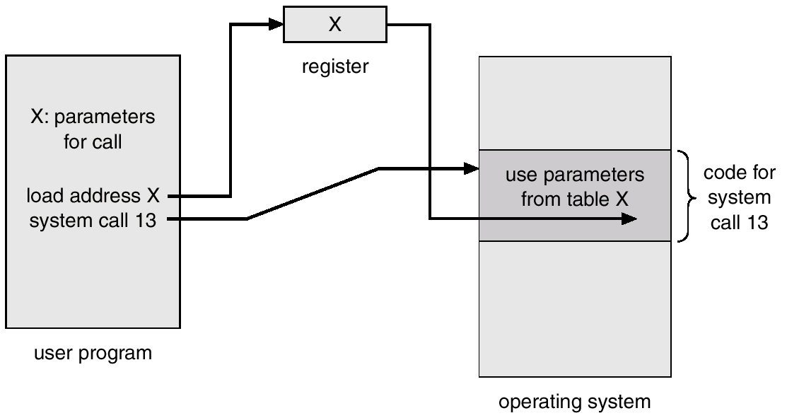
Passing of Parameters As A Table

Slide 22
Types of System Calls
Process control
File management
Device management
Information maintenance
Communications

Slide 23
1. Process Control
end, abort process.
01
Load and execute
02
Create process and terminate process
03
Get process attributes, set process attributes.
04
Wait for time
05
Wait event, signal event
06
Allocate and free memory.
07

Slide 24
2. File Management
Create file
Delete file
Open and close file
Read, write and reposition.
Get file attributes/ set file attribute

Slide 25
3. Device Management.
Request device/release device
Read/ write/ reposition.
Get device attributes/ set device attributes.

Slide 26
4. Information management.
Get Time or Date
Set Time and Date.
Get System data/set System data
Get process, file and device attributes.
Set process file and device attributes.

Slide 27
5. Communication.
create/ delete Communication connection.
Send and receive message.
Transfer status information.
Attach /detach remote devices.

Slide 28
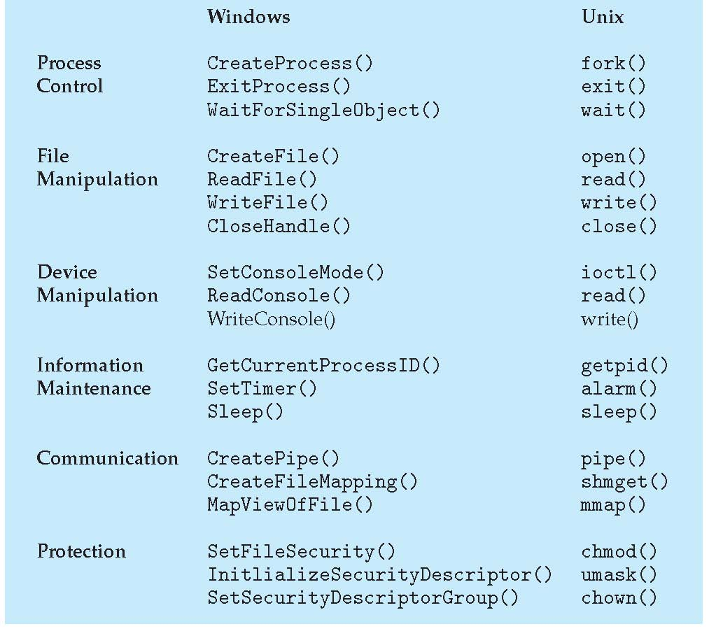
Examples of Windows and Unix System Calls
parent process to wait for the child process termination
Sets the input mode of a console's input buffer or the output mode of a console screen buffer
allocates a shared memory segment
map files or devices into memory
four-digit octal number that UNIX uses to determine the file permission for newly created files
changes the user and group ownership of a file.
Notes:
Waitforsingleagent() –
SetConsoleMode() -

Slide 29
System Programs
Another aspect of a modern system is the collection of system programs.
System programs provide a convenient environment for program development and execution.
They can be divided into:
File manipulation- These programs create, delete, copy, rename, print, dump, list, and generally manipulate files and directories.
Status information -These programs format and print the output to the terminal or other output devices or files or display it in a window of the GUI.
For example-
1. some programs ask for the date, time, amount of available memory or disk space, number of users, or similar status information.
2.Others are more complex, providing detailed performance, logging, and debugging information.
File modification - Several text editors may be available to create and modify the content of files stored on disk or other storage devices. There may also be special commands to search contents of files or perform transformations of the text.

Slide 30
System Programs conti…..
Programming language support - Compilers, assemblers, debuggers and interpreters for common programming languages are often provided to the user with the operating system.
Program loading and execution- The system may provide absolute loaders, relocatable loaders, linkage editors, and overlay loaders for assembled or compiled program in to the memory for execution.
Communications - These programs provide the mechanism for creating virtual connections among processes, users, and computer systems. They allow users to send messages to one another's screens, to browse web pages, to send electronic-mail messages, to log in remotely, or to transfer files from one machine to another.
Application programs - most operating systems are supplied with application programs that are useful in solving common problems or performing common operations that includes web browsers, word processors and text formatters, spreadsheets, database systems, compilers, plotting and statistical-analysis packages, and games.
Most users’ view of the operating system is defined by system programs, not the actual system calls.

