Slide 1
This work is licensed under a Creative Commons Attribution-ShareAlike 4.0 International License. This presentation is released under Creative Commons-A6ribute,on 4.0 License. You are free to use, distribute and modify it ,
including for commercial purposes, provided you acknowledge the source.

Slide 2
Module 1 Overview of operating System
CS-2013
Operating System
Lecture 5

Slide 3
Topics to be Cover
Operating System Structure
System Components.
Operating System Services.
System Calls.
What is System Calls
How system calls are executed.
How to pass argument between program and OS
Types of System Calls
System Programs.
OS Kernel and Shell
Operating System Structures

Slide 4
OS Kernel and Shell
A program that runs all the time on the computer system.
It constitutes the central core of a computer operating system.
It has complete control over everything that occurs in the system.
It is the first part of the operating system to load into memory during booting.
it is to be as small as possible while still providing all the essential services needed by the other parts of the operating system and by the various application programs.
the kernel code is usually loaded into a protected area of memory, which prevents it from being overwritten by other, less frequently used parts of the operating system or by application programs.
When a computer crashes, it actually means the kernel has crashed.

Slide 5
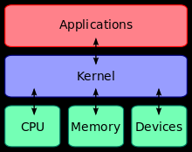
OS Kernel and Shell Conti…
OS Kernel and Shell
the kernel is a computer program that manages input/output requests from software and translates them into data processing instructions for the central processing unit and other electronic components of a computer.

Slide 6
Operating System Structure
An operating system is a large and complex system, so it need to be engineered carefully so that it can work properly and modified properly.
A common approach is to partition the task into small components rather than have one monolithic system.
Each of these modules should be a well-defined portion of the system, with carefully defined inputs, outputs, and functions.
How these components are interconnected and melded into a kernel.
Simple Structure
Layered Structure
Microkernels.
Modules.

Slide 7
1. Simple Structure
small, simple, and limited systems and then grew
Example : MS-DOS
It was started as small, simple, and limited system
It was not divided into modules.
Although MS-DOS has some structure, its interfaces and levels of functionality are not well separated.
Application programs are able to access the basic I/O routines to write directly to the display and disk drives
Another example : UNIX operating system.
UNIX is another system that initially was limited by hardware functionality.
It consists of two separable parts: the kernel and the system programs.
The kernel is further separated into a series of interfaces and device drivers, which have been added and expanded over the years as UNIX has evolved.

Slide 8
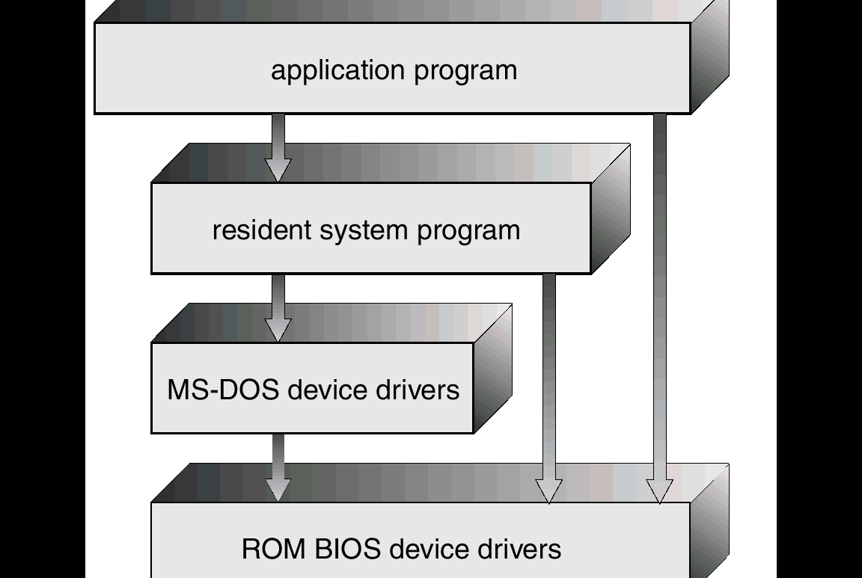
Example: MS-DOS Layer Structure

Slide 9
2. Layered Approach
The operating systems can be broken into pieces that are smaller and more appropriate than those allowed by the original MS-DOS or UNIX systems.
In this approach the operating system has much greater control over the computer and over the applications that make use of that computer.
Under the top-down approach, the overall functionality and features are determined and are separated into components.
One method is the Layered Approach, in which the operating system is broken up into a number of layers (levels).
The bottom layer (layer 0) is the hardware.
the highest (layer N) is the user interface.

Slide 10
2. Layered Approach
Layer N User Interface
Layer N User Interface
.
.
.
:
Layer 1
Layer 0
Hardware

Slide 11
Layered Approach continue..
The main advantage of the layered approach is simplicity of construction and debugging.
The layers are selected so that each uses functions (operations) and services of only lower-level layers.
This approach simplifies debugging and system verification.
The first layer can be debugged without any concern for the rest of the system, because, by definition, it uses only the basic hardware (which is assumed correct) to implement its functions.
Once the first layer is debugged, its correct functioning can be assumed while the second layer is debugged, and so on.
If an error is found during the debugging of a particular , the error must be on that layer, because the layers below it are already debugged. Thus, the design and implementation of the system is simplified.

Slide 12
3. Microkernels
In the mid-1980s, researchers at Carnegie Mellon University developed an operating system called Mach that modularized the kernel using the microkernel approach.
They removed all nonessential components from the kernel and implemented them as system and user-level programs.
The result is a smaller kernel.
Microkernels provide minimal process and memory management.
The main function of the microkernel is to provide a communication facility between the client program and the various services that are also running in user space.
Communication is provided by message passing,

Slide 13
Advantages of Microkernels Approach
Ease of extending the operating system.
All new services are added to user space and consequently do not require modification of the kernel.
When the kernel does have to be modified, the changes tend to be fewer, because the microkernel is a smaller kernel.
provides more security and reliability.
since most services are running as user—rather than kernel—processes. If a service fails, the rest of the operating system remains untouched
Examples of operating systems that uses the microkernel approach.
Tru64 UNIX (formerly Digital UNIX) provides a UNIX interface to the user, but it is implemented with a Mach kernel.
Another example is QNX. QNX is a real-time operating system that is also based on the microkernel design.

Slide 14
4. Modules
Modern Current methodology for operating-system design involves using object-oriented programming techniques to create a modular kernel.
The kernel has a set of core components and dynamically links in additional services either during boot time or during run time.
It uses dynamically loadable modules and is common in modern implementations of UNIX, such as Solaris, Linux, and Mac OS X.
For example, the Solaris operating system structure, is organized around a core kernel with seven types of loadable kernel modules.
Scheduling classes
Loadable system calls
Executable formats
STREAMS modules
Miscellaneous
Device and bus drivers.

Slide 15
Example- Solaris Loadable Modules
Core Solaris Kernel
Scheduling Classes
File Systems
Loadable System Calls
Executable Formats
Miscellaneous
STREAM Modules
Device and Bus Drivers

Slide 16
Modules conti..
Such a design allows the kernel to provide core services yet also allows certain features to be implemented dynamically.
it is more flexible than a layered system in that any module can call any other module.
The approach is like the microkernel approach in that the primary module has only core functions and knowledge of how to load and communicate with other modules.
It is more efficient than microkernel approach, because modules do not need to invoke message passing in order to communicate.

Slide 17
Question Bank
After reading this chapter, student must know the answers of following questions.
What is the purpose of system calls?
What are the five major activities of an operating system in regard to process management?
What are the three major activities of an operating system in regard to memory management?
What are the three major activities of an operating system in regard to secondary-storage management?
What is the purpose of the command interpreter? Why is it usually separate from the kernel?
What is the purpose of system programs?
What is the main advantage of the layered approach to system design?
What are the disadvantages of using the layered approach?
List five services provided by an operating system. Explain how each provides convenience to the users.
What are the main advantages of the microkernel approach to system design?

