Slide 1
This work is licensed under a Creative Commons Attribution-ShareAlike 4.0 International License. This presentation is released under Creative Commons-A6ribute,on 4.0 License. You are free to use, distribute and modify it ,
including for commercial purposes, provided you acknowledge the source.

Slide 2
Module 2 Process Concept and Scheduling
CS-2013
Operating System
Lecture 11

Slide 3
Topics to be cover
Basic Concepts ( completed)
Scheduling Criteria ( completed)
Scheduling Algorithms
First Come First Serve CPU Scheduling Algorithm ( FCFS)
Shortest Job First SJF
Priority based CPU Scheduling Algorithm
Round Robin CPU Scheduling Algorithm
Multiple-Processor Scheduling
Real-Time Scheduling

Slide 4
Shortest-Job-First (SJF) Scheduling
Each process is Associated with the length of its next CPU burst.
Use these lengths to schedule the process with the shortest time.
When the CPU is available, it is assigned to the process that has the smallest next CPU burst.
If two processes have the same length next CPU burst, FCFS scheduling is used to break the tie.
It is also called shortest next CPU burst algorithm or shortest remaining time first scheduling(Preempted SJF)

Slide 5
Two schemes:
Nonpreemptive – once CPU given to the process it cannot be preempted until completes its CPU burst.
Preemptive – if a new process arrives with CPU burst length less than remaining time of current executing process, preempt. This scheme is know as the Shortest-Remaining-Time-First (SRTF).
SJF is optimal – gives minimum average waiting time for a given set of processes.

Slide 6
Example of Non preemptive SJF Algorithm
Consider the following set of processes, with the length of the CPU burst given in milliseconds:
Process
P1
P2
P3
P4
Burst Time
6
8
7
3
Waiting Time
Turn around Time
3
6 + 3 = 9
16
8+16=24
9
7+9=16
0
0 + 3 = 3
The Gantt chart can be created as
P4 | P1 | P3 | P2
0 3 9 16 24

Slide 7
Average Turnaround time is
={tat(P1) + tat(P2) + tat(P3) + tat(P4)}/4
=(9 + 24 + 16 + 3)/4
=52/4
=13 milliseconds
Average waiting Time is
={ w(P1) + w(P2) + w(P3) + w(P4) } / 4
=( 3 + 16 + 9 + 0) / 4
=28/4
=7 milliseconds
Note:If we were using the FCFS scheduling scheme, then the average waiting time would be 10.25 milliseconds.

Slide 8
Priority Scheduling
In priority scheduling algorithm, a priority is associated with each process, and the CPU is allocated to the process with the highest priority.
Equal-priority processes are scheduled in FCFS order.
Priorities are generally some fixed range of numbers, such as 0 to 7, or 0 to 4095. However, there is no general agreement on whether 0 is the highest or lowest priority. Some systems use low numbers to represent low priority; others use low numbers for high priority.
The CPU is allocated to the process with the highest priority (smallest integer ≡ highest priority).

Slide 9
Example of Priority Scheduling
As an example, consider the following set of processes, assumed to have arrived at time 0, in the order PI, P2, ..., P5, with the length of the CPU-burst time given in milliseconds:
Process
P1
P2
P3
P4
P5
Priority
3
1
3
4
2
Burst Time
10
1
2
1
5
Turnaround Time
Waiting Time
10+6=16
6
1+0=1
0
2+16=18
16
1+18=19
18
5+1=6
1

Slide 10
The Gantt chart can be created as-
0 1 6 16 18 19
P2 | P5 | P1 | P3 | P4
Average Turnaround time:
=( 16 + 1 + 18 + 19 + 6 ) / 5
=60/5
=12 Milliseconds
Average Waiting time:
=( 6 + 0 + 16 + 18 + 1 ) / 5
=41/5
=8.2 Milliseconds

Slide 11
Types of Priority scheduling
Preemptive
Nonpreemptive
When a process arrives at the ready queue, its priority is compared with the priority of the currently running process.
A preemptive priority scheduling algorithm will preempt the CPU if the priority of the newly arrived process is higher than the priority of the currently running process.
A nonpreemptive priority scheduling algorithm will simply put the new process at the head of the ready queue

Slide 12
Problem ≡ Starvation – low priority processes may never execute
A priority scheduling algorithm can leave some low-priority processes waiting indefinitely for the CPU.
Higher-priority processes can prevent a low-priority process from ever getting the CPU.
Solution ≡ Aging – as time progresses increase the priority of the process.
Aging is a technique of gradually increasing the priority of processes that wait in the system for a long time.
For example, if priorities range from 127 (low) to 0 (high), we could decrement the priority of a waiting process by 1 every 15 minutes. Eventually, even a process with an initial priority of 127 would have the highest priority in the system and would be executed.

Slide 13
Round Robin Scheduling Algorithm
It is designed especially for timesharing systems.
It is similar to FCFS scheduling, but preemption is added to switch between processes.
A small unit of time, called a time quantum, or time slice, is defined. A time quantum is generally from 10 to 100 milliseconds.
The ready queue is treated as a circular queue.
The CPU scheduler goes around the ready queue, allocating the CPU to each process for a time interval of up to 1 time quantum.
After this time has elapsed, the process is preempted and added to the end of the ready queue.

Slide 14
Round Robin (RR)
There are two possibilities during the execution with CPU
If the process’s CPU burst of less than 1 time quantum. In this case, the process itself will release the CPU voluntarily. The scheduler will then proceed to the next process in the ready queue.
Otherwise, if the CPU burst of the currently running process is longer than 1 time quantum,
the timer will go off will cause an interrupt to the operating system.
A context switch will be executed,
and the process will be put at the tail of the ready queue.
The CPU scheduler will then select the next process in the ready queue.

Slide 15
If there are n processes in the ready queue and the time quantum is q, then each process gets 1/n of the CPU time in chunks of at most q time units at once.
No process waits more than (n-1)q time units.
Average waiting time in the round robin scheduling algorithm is often long.
Performance
q large ⇒ FIFO
q small ⇒ q must be large with respect to context switch, otherwise overhead is too high.

Slide 16
Consider the following set of processes that arrive at time 0, with the length of the CPU burst given in milliseconds: (a time quantum of 4 milliseconds)
The Gantt chart is as follows
0 4 7 10 14 18 22 26 30
Process
P1
P2
P3
Burst Time
24
3
3
Turnaround Time
30
7
10
Waitting Time
6
4
7
Average 47/3=19 ms 17/3=5.66 ms

Slide 17
Example of RR with Time Quantum = 20
Process Burst Time
P₁ 53
P₂ 17
P₃ 68
P₄ 24
The Gantt chart is:
Typically, higher average turnaround than SJF, but better response.
P₁
P₂
P₃
P₄
P₁
P₃
P₄
P₁
P₃
P₃
0
20
37
57
77
97
117
121
134
154
162

Slide 18
Time Quantum and Context Switch Time

Slide 19
Multilevel Queue
Used when processes can classified in different groups. Since different set of processes requires different response time from the CPU.
Ready queue is partitioned into separate queues like-
foreground (interactive)
background (batch)
Each queue has its own scheduling algorithm like. foreground – RR background – FCFS
Process is permanently assigned to particular queue.
Processes do not move from one queue to another queue since they do not change their foreground and background nature.

Slide 20
There must be the scheduling among the queues, commonly implemented as fixed priority preemptive scheduling like-
Foreground queue has higher priority than background queue.
Scheduling must be done between the queues.
Fixed priority scheduling; (i.e., serve all from foreground then from background). Possibility of starvation.
Time slice – each queue gets a certain amount of CPU time which it can schedule amongst its processes; i.e.,

Slide 21
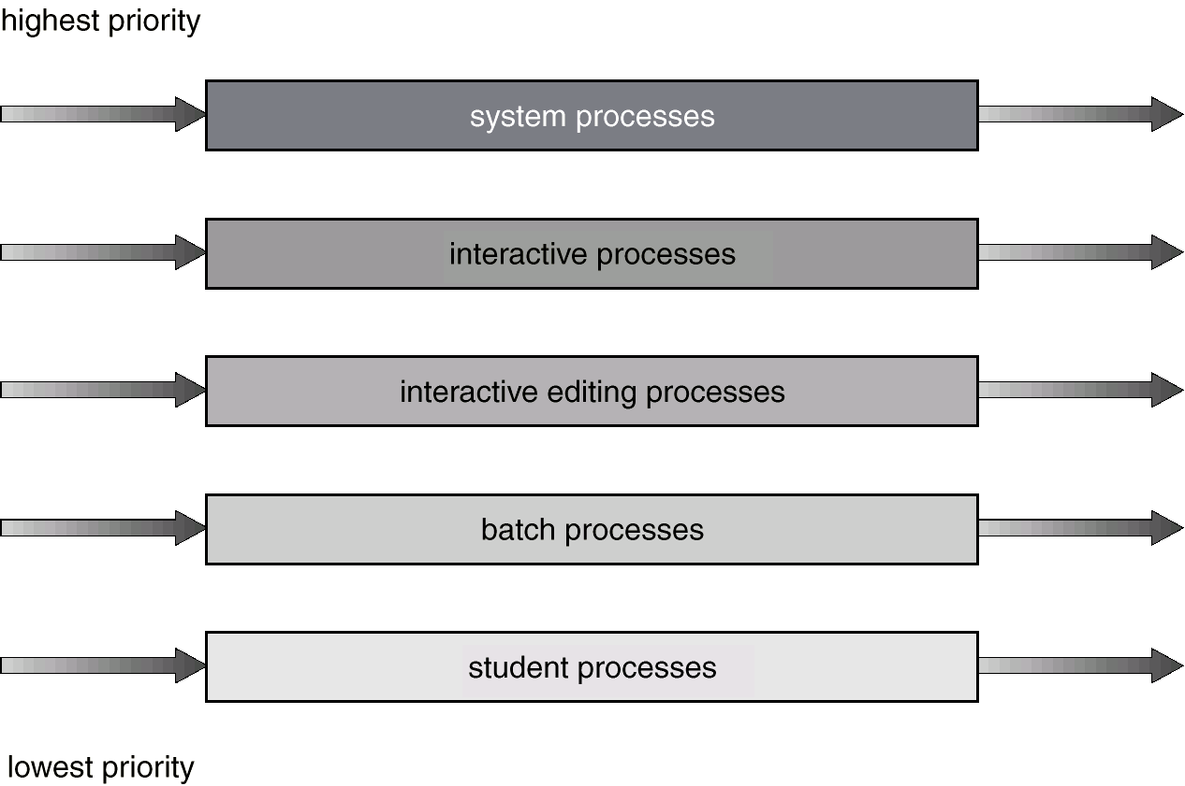
Multilevel Queue Scheduling

Slide 22
Multilevel Feedback Queue
A process can move between the various queues; aging can be implemented this way.
Multilevel-feedback-queue scheduler defined by the following parameters:
number of queues
scheduling algorithms for each queue
method used to determine when to upgrade a process
method used to determine when to demote a process
method used to determine which queue a process will enter when that process needs service

Slide 23
Example of Multilevel Feedback Queue
Three queues:
Q₀ – time quantum 8 milliseconds
Q₁ – time quantum 16 milliseconds
Q₂ – FCFS
Scheduling
A new job enters queue Q₀ which is served FCFS. When it gains CPU, job receives 8 milliseconds. If it does not finish in 8 milliseconds, job is moved to queue Q₁.
At Q₁ job is again served FCFS and receives 16 additional milliseconds. If it still does not complete, it is preempted and moved to queue Q₂.

Slide 24
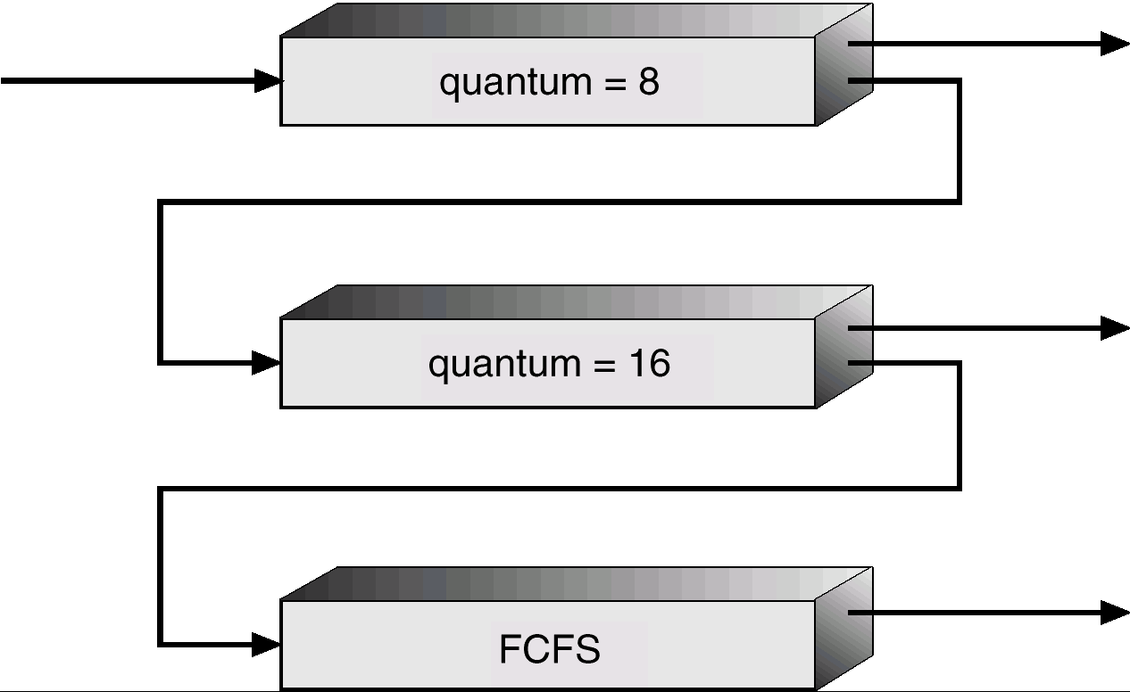
Multilevel Feedback Queues

Slide 25
Multiple-Processor Scheduling
CPU scheduling more complex when multiple CPUs are available.
Homogeneous processors within a multiprocessor.
Load sharing
Asymmetric multiprocessing – only one processor accesses the system data structures, alleviating the need for data sharing.

Slide 26
Real-Time Scheduling
Hard real-time systems – required to complete a critical task within a guaranteed amount of time.
Soft real-time computing – requires that critical processes receive priority over less fortunate ones.

Slide 27
Dispatch Latency

