Slide 1
This work is licensed under a Creative Commons Attribution-ShareAlike 4.0 International License. This presentation is released under Creative Commons-A6ribute,on 4.0 License. You are free to use, distribute and modify it ,
including for commercial purposes, provided you acknowledge the source.

Slide 2
Module 2 Process Concept and Scheduling
CS-2013
Operating System
Lecture 6

Slide 3
Harish Tiwari
Faculty, Sir Padampat Singhania University, udaipur
Subject Name - Operating System
Subject Code - CS-2013
Branch - CSE
Semester - IV Semester (CSE IV+CTIS IV)
Credits - 4,0,0

Slide 4
Processes
Need of process
Process Concept.
Process Introduction
Process State
Process Control Block.
Process scheduling
Scheduling queues
Schedulers
Context Switching
Operations on Process.
Creating Process
Terminating Process
Cooperating process
Inter process Communication

Slide 5
Process Concept:
An operating system executes a variety of programs:
Batch system – jobs
Time-shared systems – user programs or tasks
Process – a program in execution; process execution must progress in sequential fashion.
A program by itself not a process; it is a passive entity such as a file containing a list of instructions stored on the disk.
A process is active entity that includes:
program counter
Values in CPU registers
Stack( to store temporary data)
data section( global variables)
Heap(memory that is allocated dynamically at run time).

Slide 6
Process conti……
A program in execution.
An instance of the program running on a computer.
An entity that can be assigned to and executed on a processor.
A unit of activity characterized by the execution of the a sequence of the instructions, a current state and an associated set of resources.

Slide 7
Process State
As a process executes, it changes state.
The state of the program is defined in part by the current activity of that process.
New: The process is being created.
Ready: The process is waiting to be assigned to a processor.
Waiting: The process is waiting for some event to occur.
Running: Instructions are being executed.
Terminated-The process has finished execution.
Only one process can be run on any processor at any instant, where many process may be in ready and waiting state.

Slide 8
Diagram of Process State

Slide 9
Process Control Block (PCB)
Each process is represented in the operating system by the Process Control Block(PCB)- also called as Task Control Block
PCB contains various piece of information associated with each process.
Process identifier: A number that uniquely identifies each process in the system.
Process state- may be any state like running, waiting etc.
Program counter -stores the next instruction in the program to be executed.
CPU registers- no of CPU registers and their types depends on architecture of the processor, includes accumulator, index register, stack pointer, flag register and general purpose register.
CPU scheduling information- stores scheduling parameters like process priority, pointer to scheduling queue.
Memory-management information- depending on the memory used by the operating system, includes value of base resister, limit register, page table, segment table etc.

Slide 10
7. Accounting information – amount of CPU time and the real time, time limit, job or process numbers.
8. I/O status information – list of IO devices allocated to the process, list of open files and so on.

Slide 11
Process Control Block (PCB)

Slide 12
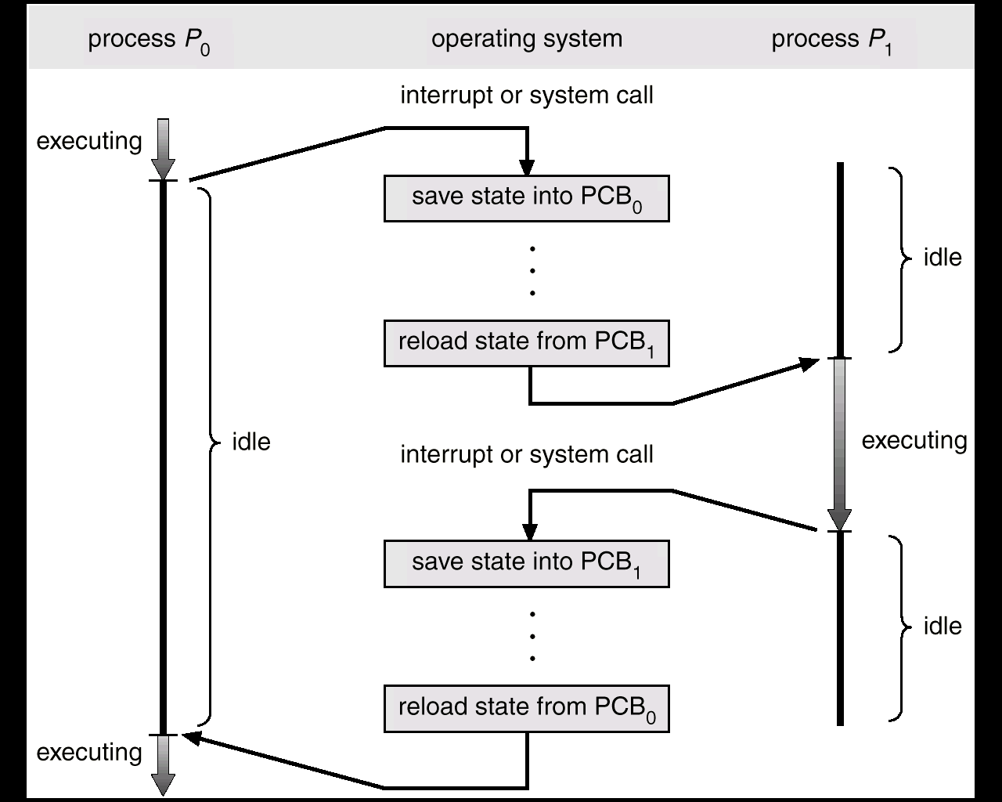
CPU Switch From Process to Process

Slide 13
Process Scheduling
The objective of the multiprogramming to have some process running all the, to maximize the CPU utilization.
The Objective of the Time sharing system is to switch the CPU among various processes so frequently that user can interact with the each program while it is running.
To meet above objectives “ Process Scheduler” selects an available process from the ready queue and allocates CPU to it.
This process is known as Process Scheduling.
In a single processor system- only one process can acquire the CPU. If there are more processes than rest will have to wait until the CPU is free.

Slide 14
Process Scheduling Queues
An operating system maintains various queues of the processes during the process scheduling. These are as follows.
Job Queue – when a process enter in the system, it is put in the job queue. This queue consists of all processes in the system.
Ready Queue – This queue is the set of all processes residing in main memory, ready and waiting to execute.
This queue is maintained as the linked list.
Ready queue header contains the pointer to the first and last PCBs in the queue.
Each PCB contains the pointer to the nest PCB in the queue.
Device Queues – set of processes waiting for an I/O device. each device maintains the device queue in the system.

Slide 15
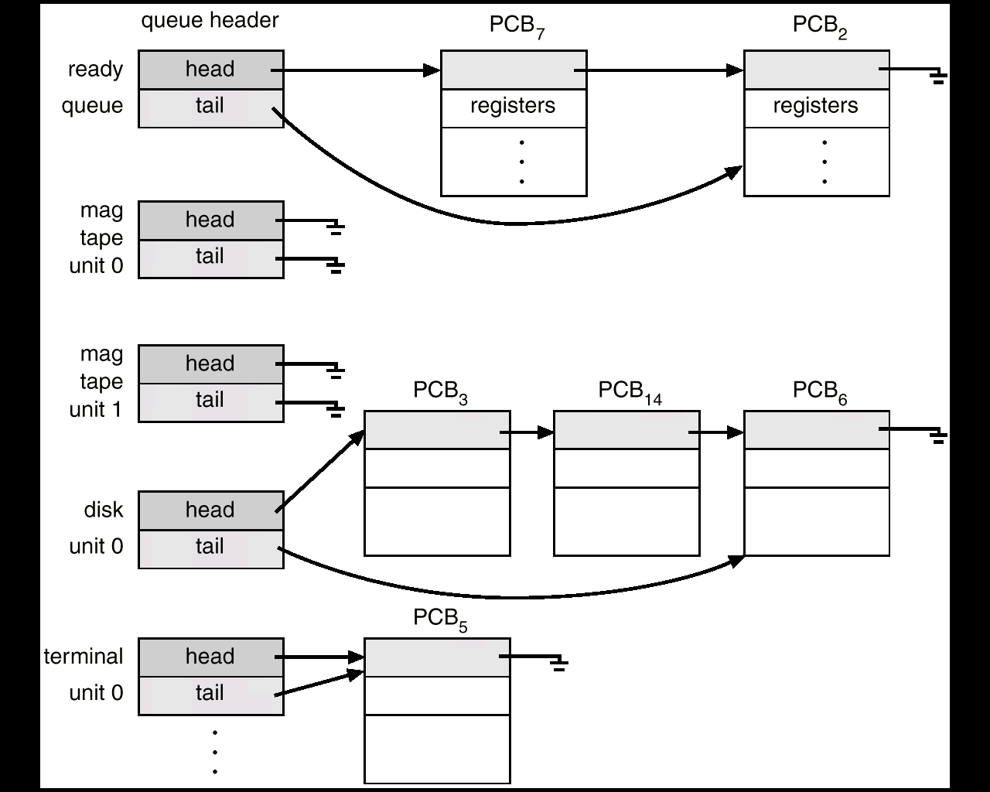

Slide 16
The Queuing Diagram can be used to represent various queues in the process scheduling.
Rectangular Box represents the queue.
Ready Queue.
Device Queues- each device has it’s separate device queue
Circle represents the resources that serves the queue.
Arrow represents the flow of processes in the system.
QUEUE
Resource
Flow of the process

Slide 17
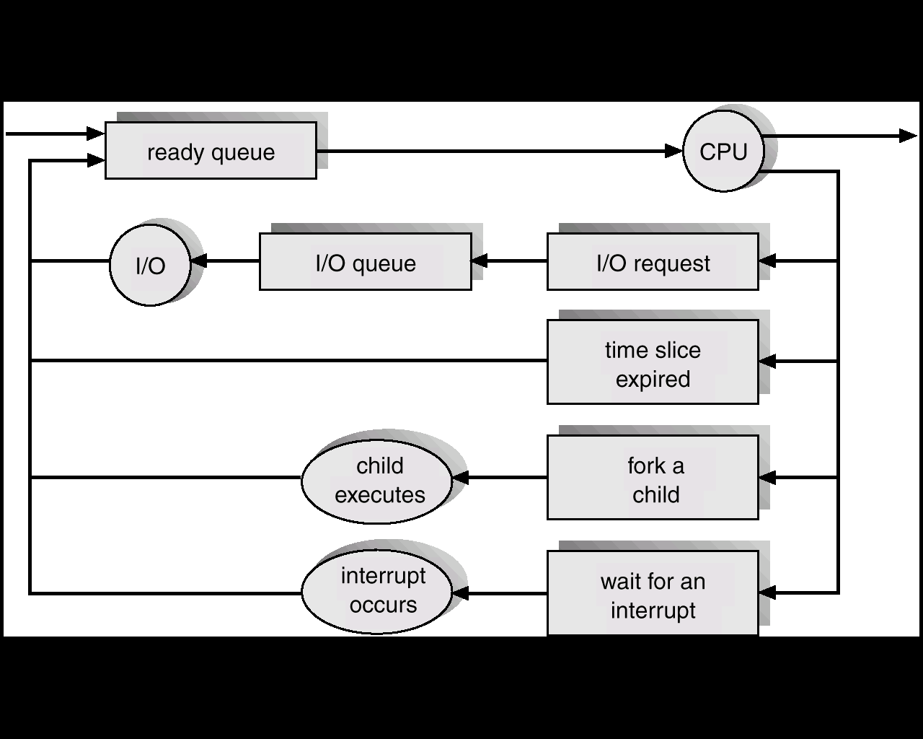
Queueing diagram Representation of Process Scheduling

