Slide 1
This work is licensed under a Creative Commons Attribution-ShareAlike 4.0 International License. This presentation is released under Creative Commons-A6ribute,on 4.0 License. You are free to use, distribute and modify it ,
including for commercial purposes, provided you acknowledge the source.

Slide 2
Module 2 Process Concept and Scheduling
CS-2013
Operating System
Lecture 7

Slide 3
Harish Tiwari
Faculty, Sir Padampat Singhania University, udaipur
Subject Name - Operating System
Subject Code - CS-2013
Branch - CSE
Semester - IV Semester (CSE IV+CTIS IV)
Credits - 4,0,0

Slide 4
Processes
Need of process
Process Concept.
Process Introduction
Process State
Process Control Block.
Process scheduling
Scheduling queues
Schedulers
Context Switching
Operations on Process.
Creating Process
Terminating Process
Cooperating process
Inter process Communication

Slide 5
Context Switch
When CPU switches to another process, the system must save the state of the old process and load the saved state for the new process. This task is known as Context Switching.
Context of the process is represented in the PCB.
When Context Switch occurs, the operating system saves the context of the old process in the PCB and loads the PCB of the new process.
Context-switch time is overhead; the system does no useful work while switching.
Time dependent on hardware support.

Slide 6
Operations on Processes.
Processor performs various operations on processes during the lifetime of the processes, this includes
Process Creation
Process Termination.

Slide 7
Process Creation
A process may create another new process via the create process system call
Parent process create children processes, which, in turn create other processes, forming a tree of processes.
Resource are required to accomplish its task.
A child may be able to obtain its resources directly from the OS.
Parent and children share all resources.
Children share subset of parent’s resources.
Parent and child share no resources.
When process creates the child process, two possibilities exist in term of execution.
Parent and children execute concurrently.
Parent waits until children terminate.

Slide 8
Process Creation (Cont.)
There are two possibilities in terms of address space of the new process.
Child duplicate of parent.
Child has a program loaded into it.
UNIX examples
fork system call creates new process
child process and parent process share the same address space, allowing parent the parent process to communicates easily with the child.
Both parent and child executes concurrently,

Slide 9
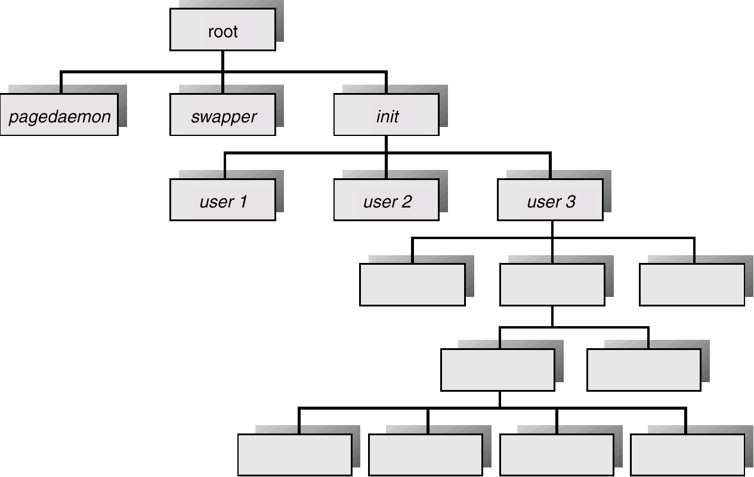
Processes Tree on a UNIX System

Slide 10
Process Termination
Process executes last statement and asks the operating system to delete it by using the exit system call.
Child process return data to it’s parent (via wait).
Process’ resources are deallocated by operating system.
Parent may terminate execution of children processes (abort) for the variety of the reasons such as.
Child has exceeded allocated resources.
Task assigned to child is no longer required.
Parent is exiting.
Operating system does not allow child to continue if its parent terminates.
Cascading termination( if parent is terminated then all its children must also be terminated.

Slide 11
Cooperating Processes
Processes that are executing concurrently in the OS may be as-
Independent process-
a process that cannot affect or be affected by the execution of another process.
A process that does not share data with other any other process is independent.
Cooperating process-
a process that can affect or be affected by the execution of another process.
A process that shares data with other any other process is independent.
Advantages of process cooperation
Information sharing.
Computation speed-up.(multiprocessor).
Modularity.
Convenience

Slide 12
Interprocess Communication (IPC)
Mechanism for processes to communicate and to synchronize their actions.
Shared Memory Model– A region of the memory is shared by the cooperating process. All processes communicate with each other by reading and writing data to the shared region.
Message Passing Model- communication takes place by means of message exchanged between the cooperating process.
Message passing is useful for exchanging small data.
Message Passing scheme is easier to implement.
Shared memory allows maximum speed up.
Shared memory scheme is faster than Message passing because message passing implemented by issuing system calls.

Slide 13
Message Passing Model.
Communication takes place by means of message exchanged between the cooperating process.
IPC facility provides two operations:
send(message) –
receive(message)
Message length may be fixed or variable.
If P and Q wish to communicate, they need to:
establish a communication link between them
exchange messages via send/receive
Implementation of communication link
physical (e.g., shared memory, hardware bus)
logical (e.g., logical properties)

Slide 14
Naming
Processes that want to communicate must have a way to refer to each other. They can use either
Direct Communication
Indirect Communication.

Slide 15
Direct Communication
Processes must name each other explicitly.
In this scheme send and receive primitives are defined as-
send (P, message) – send a message to process P
receive(Q, message) – receive a message from process Q
Properties of communication link
Links are established automatically between the communicating processes. Processes need to know the only each other’s identity.
A link is associated with exactly one pair of communicating processes.
Exactly one link exists exactly between each pair of processes.
The link may be unidirectional but is usually bi-directional.

Slide 16
Indirect Communication
Messages are sent to and received from mailboxes (also referred to as ports).
Each mailbox has a unique id.
Processes can communicate only if they share a mailbox.
Properties of communication link
Link established only if processes share a common mailbox
A link may be associated with many processes.
Each pair of processes may share several communication links.
Link may be unidirectional or bi-directional.

Slide 17
Indirect Communication
Operations
create a new mailbox
send and receive messages through mailbox
destroy a mailbox
Primitives are defined as:
send(A, message) – send a message to mailbox A
receive(A, message) – receive a message from mailbox A

Slide 18
Synchronization
Message passing may be either blocking or non-blocking.
Blocking is considered synchronous.
Non-blocking is considered asynchronous.
Blocking Send- sending process is blocked until the message is received by the receiving process
No blocking send- sending process sends the message and resumes its operation.
Blocking receive – receiver is blocked until the message is available.
Non blocking receive- a receiver either retrieves a valid message or a null.

Slide 19
Buffering
Messages exchanged between the communicating processes resides in a temporary queues on the communication link.
Queue of messages attached to the link can be implemented in one of three ways.
Zero capacity
0 messages thus the link can not have any message waiting in it. In this case, the Sender must block until the receiver receives the message.
Bounded capacity
finite length of n messages (at most n messages can resides on the communication link)
If the queue is not full and a new message is sent, the message is placed in the queue and sender can continue the execution without waiting. Sender must block if link full.
Unbounded capacity
infinite length thus any number of messages can reside on the communication link. The sender never block.

