Slide 1
This work is licensed under a Creative Commons Attribution-ShareAlike 4.0 International License. This presentation is released under Creative Commons-A6ribute,on 4.0 License. You are free to use, distribute and modify it ,
including for commercial purposes, provided you acknowledge the source.

Slide 2
Module 2 Process Concept and Scheduling
CS-2013
Operating System
Lecture 8

Slide 3
Topics to be cover
Introduction and Overview to Threads
Types of threads.
Single & Multi-threaded processes.
Multicore processors and threads

Slide 4
Introduction to Thread.
A thread is the basic unit of CPU utilization that forms the basis of multithreaded computer systems.
It comprises a
Thread ID,
a program counter,
a register set,
and stack.
But is shares
code section,
data section, and
other operating system resources(open files, signals)
with other threads belonging to the same process.
A process is the heavy weight entity, while thread is the light weight entity.
If a process a single thread of control it can perform single task only, but if it is multithreads of control it can perform more than one task at a time.

Slide 5
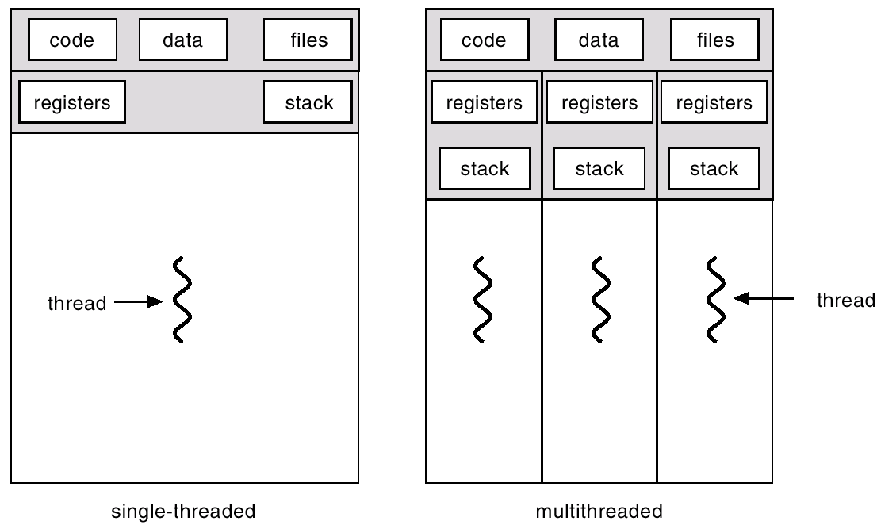
Single and Multithreaded Processes

Slide 6
Benefits of threads
Responsiveness: allow program to continue running even if part of it is blocked or is performing lengthy operation.
Resource Sharing : benefit of sharing code, data and resources allows application to have different thread of activities within the same address space.
Economy : more economical to create and context-switch thread.
Scalability: easy to extend the number of threads

Slide 7
User Threads
Thread management done by user-level threads library.
User threads are supported above the kernel and managed without the kernel support.
Three primary thread libraries:
POSIX Pthreads
Win32 threads
Java threads

Slide 8
Kernel Threads
Supported and managed directly by the operating system( Kernel).
All contemporary operating systems supports these threads.
Examples
Windows XP/2000
Solaris
Linux
Tru64 UNIX
Mac OS X

Slide 9
Multithreading Models
Many-to-One
One-to-One
Many-to-Many

Slide 10
Many-to-One
Many user-level threads mapped to single kernel thread.
Thread management is done by thread library in user space.
But entire process will block if the thread makes a blocking system call.
Since only one thread can access the kernel at a time.
Examples:
Solaris Green Threads
GNU Portable Threads

Slide 11
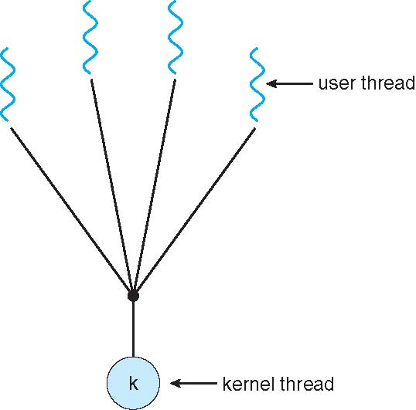
Many-to-One Model

Slide 12
One-to-One
Each user-level thread maps to kernel thread.
Provides more concurrency.
Also allow multiple threads to run in parallel on multiprocessor.
Drawback
Creating a user level thread requires creating the corresponding kernel thread.( can effect the performance)
Examples
Windows NT/XP/2000
Linux
Solaris 9 and later

Slide 13
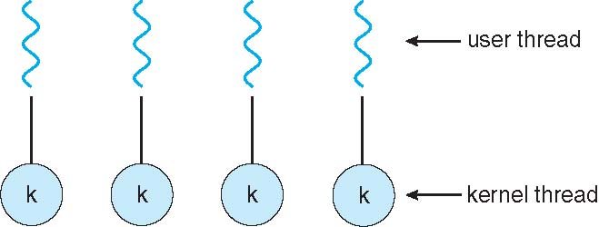
One-to-one Model

Slide 14
Many-to-Many Model
Allows many user level threads to be mapped to smaller or equal number of kernel threads.
Allows the operating system to create a sufficient number of kernel threads.
Developers can creates as many as necessary user threads, and corresponding kernel thread can run in parallel on a multiprocessor.
When a thread performs a blocking system call, the kernel can schedule another thread for execution.
Solaris prior to version 9
Windows NT/2000 with the ThreadFiber package

Slide 15
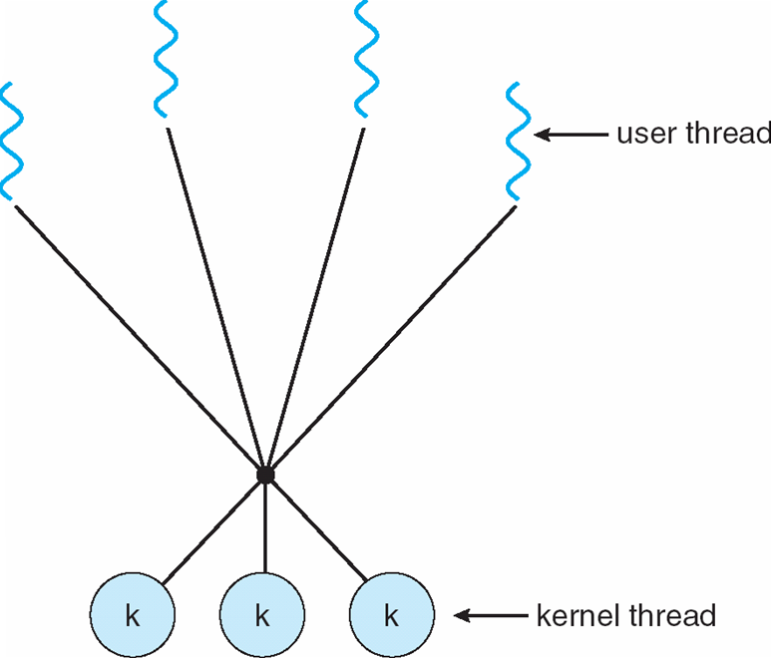
Many-to-Many Model

Slide 16
Linux Threads
Linux refers to them as tasks rather than threads.
Thread creation is done through clone() system call.
Clone() allows a child task to share the address space of the parent task (process)

Slide 17
Java Threads
Java threads may be created by:
Extending Thread class
Implementing the Runnable interface
Java threads are managed by the JVM.

Slide 18
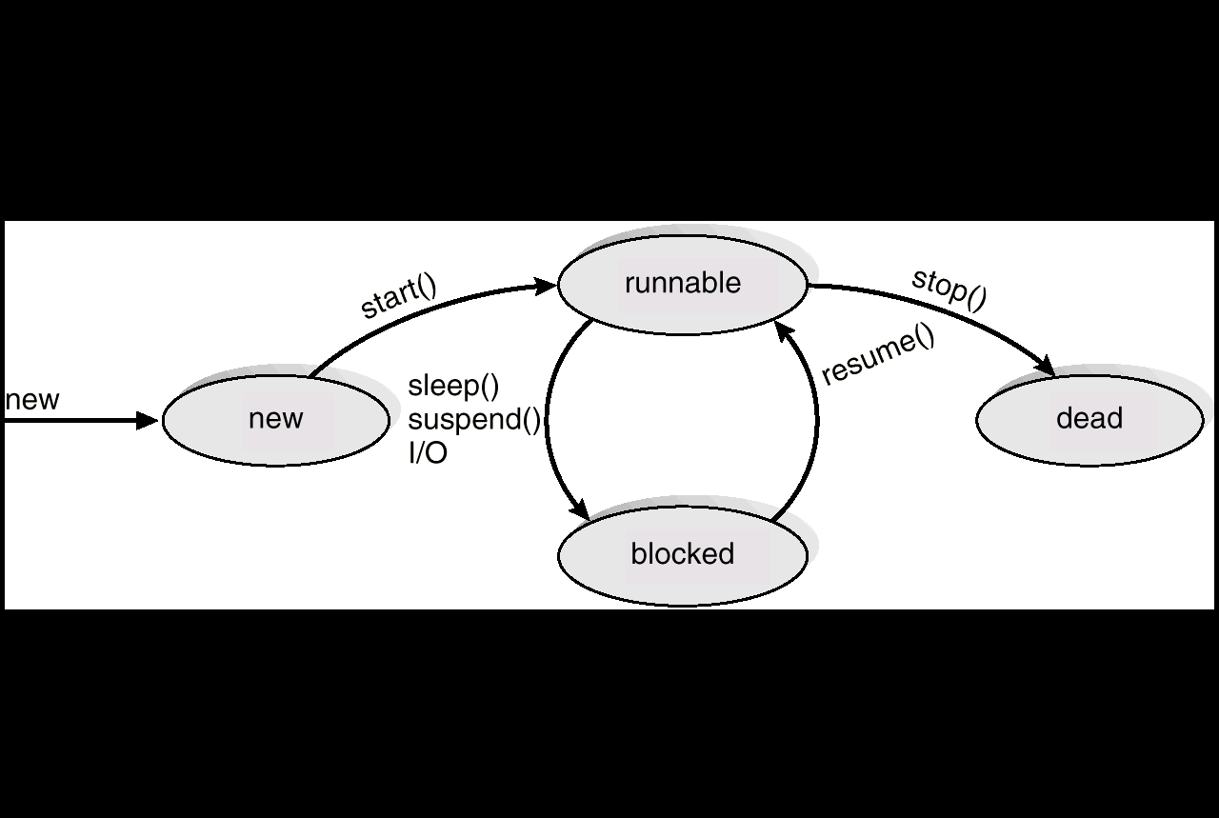
Java Thread States

Slide 19
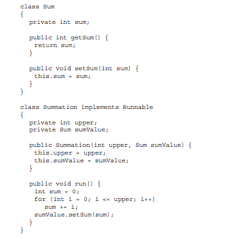
Java Multithreaded Program

Slide 20
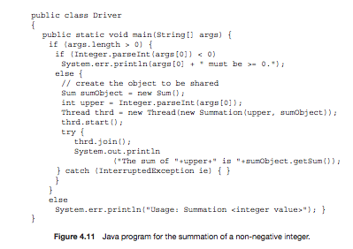
Java Multithreaded Program (Cont.)

