Slide 1
This work is licensed under a Creative Commons Attribution-ShareAlike 4.0 International License. This presentation is released under Creative Commons-A6ribute,on 4.0 License. You are free to use, distribute and modify it ,
including for commercial purposes, provided you acknowledge the source.

Slide 2
Module 3: Process Concept and Scheduling
Topic – Deadlock
CS-2013 (Operating System)
Lecture -16

Slide 3
Topic to be Cover
System Model
Deadlock Characterization
Methods for Handling Deadlocks
Deadlock Prevention
Deadlock Avoidance
Deadlock Detection
Recovery from Deadlock
Combined Approach to Deadlock Handling
Necessary Conditions
Resource- Allocation Graph

Slide 4
Methods for Handling Deadlocks
there are three different methods for dealing with the deadlock problem:
We can use a protocol to ensure that the system will never enter a deadlock state.(either a deadlock prevention or a deadlock-avoidance scheme.).
We can Allow the system to enter a deadlock state and then recover. (can provide an algorithm that examines the state of the system to determine whether a deadlock has occurred, and an algorithm to recover from the deadlock.)
Ignore the problem and pretend that deadlocks never occur in the system; used by most operating systems, including UNIX.

Slide 5
Deadlock Avoidance
An alternative method for avoiding deadlocks is to require additional information about how resources are to be requested.
With the knowledge of the complete sequence of requests and releases for each process, the system can decide for each request whether or not the process should wait in order to avoid a possible future deadlock.
To make decision the system consider the resources currently available, the resources currently allocated to each process, and the future requests and releases of each process.

Slide 6
Deadlock Avoidance cont.…..
Requires that the system has some additional a priori information available.
The various algorithms that use this approach differ in the amount and type of information required.
Simplest and most useful model requires that each process declare the maximum number of resources of each type that it may need; helps to construct the algorithm that ensures that the system will never enter inn the deadlock State. (deadlock avoidance algorithm).
The deadlock-avoidance algorithm dynamically examines the resource-allocation state to ensure that there can never be a circular-wait condition.
Resource-allocation state is defined by the number of available and allocated resources, and the maximum demands of the processes.

Slide 7
Safe State
When a process requests an available resource, system must decide if immediate allocation leaves the system in a safe state.
if the system can allocate resources to each process (up to its maximum) in some order and still avoid a deadlock.
System is in safe state if there exists a safe sequence of all processes.
Sequence <P₁, P₂, …, P_{n}> is safe if for each P_{i}, the resources that Pi can still request can be satisfied by currently available resources + resources held by all the P_{j}, with j<i.
If P_{i} resource needs are not immediately available, then P_{i} can wait until all P_{j} have finished.
When P_{j} is finished, P_{i} can obtain needed resources, execute, return allocated resources, and terminate.
When P_{i} terminates, P_{i+1} can obtain its needed resources, and so on.

Slide 8
Basic Facts
If a system is in safe state ⇒ no deadlocks.
If a system is in unsafe state ⇒ possibility of deadlock.
Avoidance ⇒ ensure that a system will never enter an unsafe state.

Slide 9
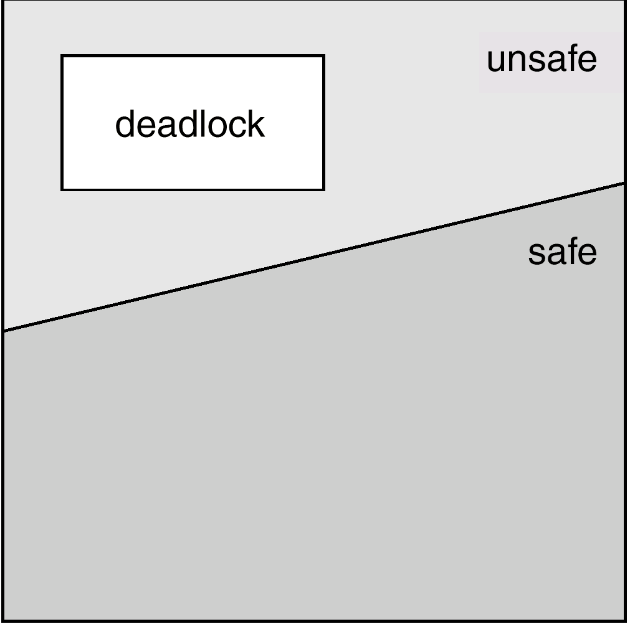
Safe, Unsafe , Deadlock State

Slide 10
Example:
No of tape drives in the System = 12
No of processes = 3(P0,P1,P2)
Process Maximum Needs Current Needs(At Time T0).
P0 10 5
P1 4 2
P2 9 2
Free tape drives at Time T0 = 3( safe state)
So we can allocate 2 more to the P1 so system has only one 1 tape drive.
At time T1
P2 requested one more, since it is available we can allocate.( remaining 0 tape drive).
At this point only P1 has all resources in hand. When it returns 4 available.
If P0 request more 5 tape drive( since it need 5 more). P0 will wait.
Similarly P2 may request 6 more tape drive.(P2 will wait.)
Resulting the deadlock.

Slide 11
Resource-Allocation Graph Algorithm
If we have a resource-allocation system with only one instance of each resource type
Claim edge P_{i} → R_{j} indicated that process P_{i} may request resource R_{j}; represented by a dashed line.
Claim edge converts to request edge when a process requests a resource.
When a resource is released by a process, assignment edge reconverts to a claim edge.
Resources must be claimed a priori in the system.

Slide 12
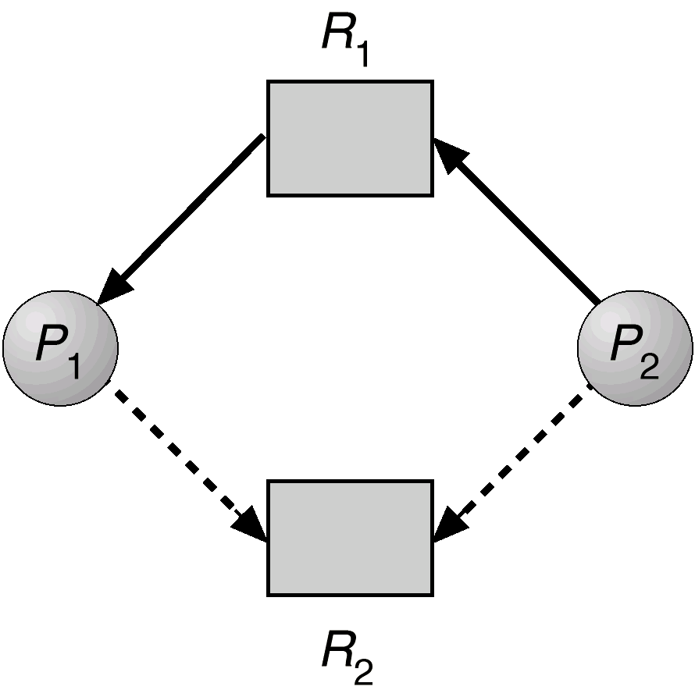
Resource-Allocation Graph For Deadlock Avoidance

Slide 13
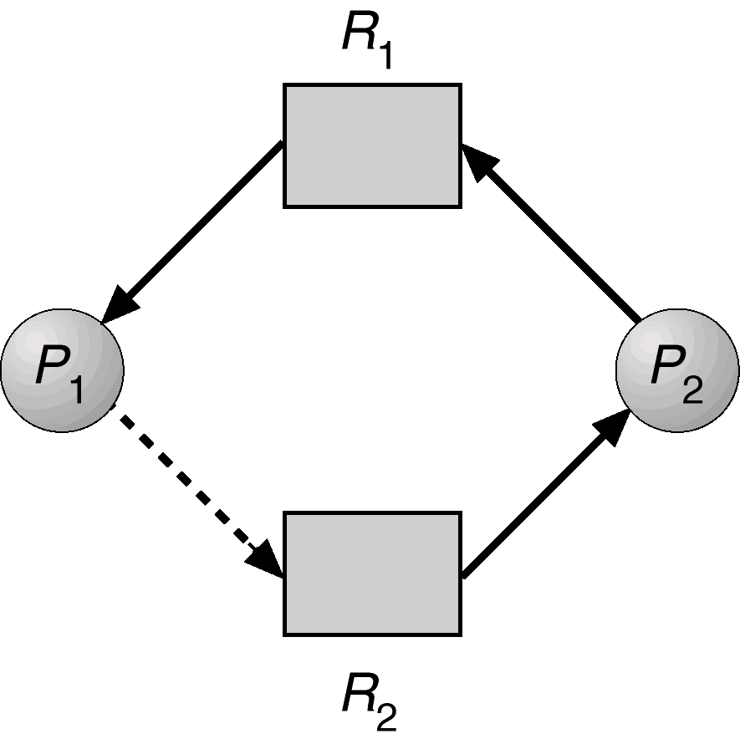
Unsafe State In Resource-Allocation Graph

