Slide 1
This work is licensed under a Creative Commons Attribution-ShareAlike 4.0 International License. This presentation is released under Creative Commons-A6ribute,on 4.0 License. You are free to use, distribute and modify it ,
including for commercial purposes, provided you acknowledge the source.

Slide 2
Chapter 8: Deadlocks
System Model
Deadlock Characterization
Methods for Handling Deadlocks
Deadlock Prevention
Deadlock Avoidance
Deadlock Detection
Recovery from Deadlock
Combined Approach to Deadlock Handling

Slide 3
Deadlock Detection
Allow system to enter deadlock state
Detection algorithm
Recovery scheme.
detection-and-recovery scheme requires overhead that includes not only the run-time costs of maintaining the necessary information and executing the detection algorithm

Slide 4
Single Instance of Each Resource Type
If all resources have only a single instance, then we can define a deadlock detection algorithm that uses a variant of the resource-allocation graph, called a wait-for graph.
We obtain this graph from the resource-allocation graph by removing the resource nodes and collapsing the appropriate edges.
Wait –for graph contains only processes.
an edge from P_{i} , to P_{j}, in a wait-for graph implies that process P_{i} is waiting for process P_{J}, to release a resource that P_{i} needs.
An edge P_{i} -> P_{J}, exists in a wait-for graph if and only if the corresponding resource allocation graph contains two edges P_{i} R_{q} and R_{q} P_{j}, for some resource

Slide 5
Single Instance of Each Resource Type
a deadlock exists in the system if and only if the wait-for graph contains a cycle.
To detect deadlocks, the system needs to maintain the wait-for graph and Periodically invoke an algorithm that searches for a cycle in the graph.
An algorithm to detect a cycle in a graph requires an order of n² operations, where n is the number of vertices in the graph.

Slide 6
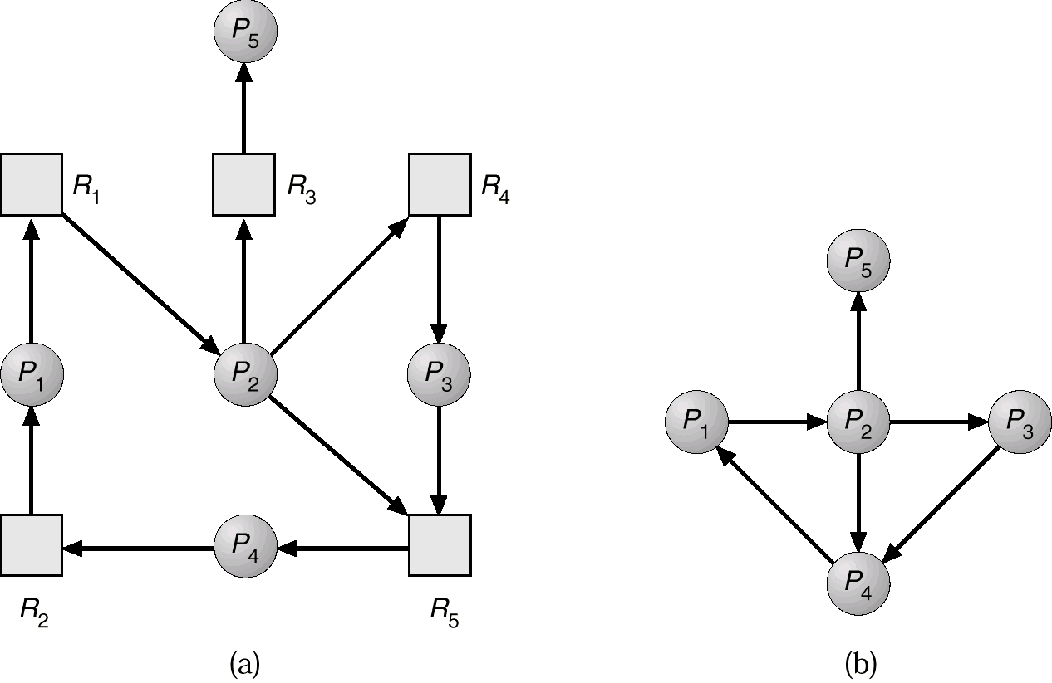
Resource-Allocation Graph and Wait-for Graph
Resource-Allocation Graph
Corresponding wait-for graph

Slide 7
Several Instances of a Resource Type
Available: A vector of length m indicates the number of available resources of each type.
Allocation: An n x m matrix defines the number of resources of each type currently allocated to each process.
Request: An n x m matrix indicates the current request of each process. If Request [i][j] = k, then process P_{i} is requesting k more instances of resource type. R_{j}.

Slide 8
Detection Algorithm
1. Let Work and Finish be vectors of length m and n, respectively Initialize:
(a) Work = Available
(b) For i = 1,2, …, n, if Allocation_{i} ≠ 0, then Finish[i] = false;otherwise, Finish[i] = true.
2. Find an index i such that both:
(a) Finish[i] == false
(b) Request_{i} ≤ Work
If no such i exists, go to step 4.

Slide 9
Detection Algorithm (Cont.)
3. Work = Work + Allocation_{i} Finish[i] = true go to step 2.
4. If Finish[i] == false, for some i, 1 ≤ i ≤ n, then the system is in deadlock state. Moreover, if Finish[i] == false, then P_{i} is deadlocked.
Algorithm requires an order of O(m x n²⁾ operations to detect whether the system is in deadlocked state.

Slide 10
Example of Detection Algorithm
Five processes P₀ through P₄; three resource types A (7 instances), B (2 instances), and C (6 instances).
Snapshot at time T₀:
Allocation Request Available
A B C A B C A B C
P₀ 0 1 0 0 0 0 0 0 0
P₁ 2 0 0 2 0 2
P₂ 3 0 3 0 0 0
P₃ 2 1 1 1 0 0
P₄ 0 0 2 0 0 2
Sequence <P₀, P₂, P₃, P₁, P₄> will result in Finish[i] = true for all i.

Slide 11
Example (Cont.)
P₂ requests an additional instance of type C.
Request
A B C
P₀ 0 0 0
P₁ 2 0 1
P₂ 0 0 1
P₃ 1 0 0
P₄ 0 0 2
State of system?
Can reclaim resources held by process P₀, but insufficient resources to fulfill other processes; requests.
Deadlock exists, consisting of processes P₁, P₂, P₃, and P₄.

Slide 12
Example 2:
Processes : P0 P1 P2 P3 P4
Resources : A B C
Assume that these request are granted.
Process Allocation Request Available
A B C A B C A B C
P0 1 1 2 3 3 1 2 1 0
P1 2 1 2 1 1 0
P2 4 0 1 6 0 1
P3 0 2 0 7 2 3
P4 1 1 2 0 1 1

Slide 13
Work=available=[2,1,0]; finish=[0,0,0,0,0]
P1 = 1 1 0 < 2 1 0. finish= [ 0 1 0 0 0 ]. Work = 2 1 0 + 2 1 2 = 4 2 2
P4 = 0 1 1 < 4 2 2. finish= [ 0 0 0 0 1 ]. Work = 4 2 2 + 1 1 2 = 5 3 4
P0 = 3 3 1 < 5 3 4. finish= [ 1 1 0 0 1 ]. Work = 5 3 4 + 1 1 2 = 6 4 6
P2 = 6 0 1 < 6 4 6. finish= [ 1 1 1 0 1 ]. Work = 6 4 6 + 4 0 1 = 1047
P3 = 7 2 3 < 106 finish= [ 1 1 1 1 1]. Work = 1047 + 020 = 1067 .
No dead lock sequence is < P₁, P₄, P₀, P₂, P₃>

Slide 14
Detection-Algorithm Usage
When, and how often, to invoke depends on:
How often a deadlock is likely to occur?
How many processes will need to be rolled back?
one for each disjoint cycle
If detection algorithm is invoked arbitrarily, there may be many cycles in the resource graph and so we would not be able to tell which of the many deadlocked processes “caused” the deadlock.

Slide 15
Recovery from Deadlock: Process Termination
Abort all deadlocked processes.
Abort one process at a time until the deadlock cycle is eliminated.
In which order should we choose to abort?
Priority of the process.
How long process has computed, and how much longer to completion.
Resources the process has used.
Resources process needs to complete.
How many processes will need to be terminated.
Is process interactive or batch?

Slide 16
Recovery from Deadlock: Resource Preemption
Selecting a victim – minimize cost.
Rollback – return to some safe state, restart process for that state.
Starvation – same process may always be picked as victim, include number of rollback in cost factor.

Slide 17
Combined Approach to Deadlock Handling
Combine the three basic approaches
prevention
avoidance
detection
allowing the use of the optimal approach for each of resources in the system.
Partition resources into hierarchically ordered classes.
Use most appropriate technique for handling deadlocks within each class.

