Slide 1
This work is licensed under a Creative Commons Attribution-ShareAlike 4.0 International License. This presentation is released under Creative Commons-A6ribute,on 4.0 License. You are free to use, distribute and modify it ,
including for commercial purposes, provided you acknowledge the source.

Slide 2
File-System Interface

Slide 3
File-System Interface
File Concept
  File Attributes
  File Operations
  File Types
  File Structures
Access Methods
  Sequential Access
  Direct Access
  Other Access Methods
Disk Structure
Directory Structure.
  Single - Level directory
  Two - Level Directory
  Tree - Structured Directory

Slide 4
Objectives
To explain the function of file systems
To describe the interfaces to file systems
To discuss file-system design tradeoffs, including access methods, file sharing, file locking, and directory structures
To explore file-system protection

Slide 5
Background
The file system provides the mechanism
  For on-line storage of the operating system and all the users of the computer system.
  For access to both data and programs of the operating system and all the users of the computer system.
The file system consists of two distinct parts:
  A collection of files, each storing related data.
  A directory structure- which organizes and provides information about all the files in the system.

Slide 6
File Concept
In general, a file is a sequence of bits, bytes, lines, or records, the meaning of which is defined by the file's creator and user.
“A file is a named collection of related information that is recorded on secondary storage. “
From a user's perspective, a File is the smallest allotment of logical secondary storage; that is, data cannot be written to secondary storage unless they are within a file.
Files are mapped by the operating system onto physical devices.
These storage devices are usually nonvolatile, so the contents are persistent through power failures and system reboots.
Computers can store information on various storage media, such as magnetic disks, magnetic tapes, and optical disks.
Types:
  Data files- may be numeric, character, alphanumeric or binary
  Program files:

Slide 7
File Concept Conti…
The information in a file is defined by its creator.
Many different types of information may be stored in a file—source programs, object programs, executable programs, numeric data, text, payroll records, graphic images, sound recordings, and so on.
A file has a certain defined structure, which depends on its type.
  A text file is a sequence of characters organized into lines (and possibly pages).
  A source file is a sequence of subroutines and functions, each of which is further organized as declarations followed by executable statements.
  An object file is a sequence of bytes organized into blocks understandable by the system's linker.
  An executable file is a series of code sections that the loader can bring into memory and execute.

Slide 8
File Attributes
A file is referred to by its name.
A name is usually a string of characters, such as example.c.
Some systems differentiate between uppercase and lowercase characters in names, whereas other systems do not.
A file's attributes vary from one operating system to another but typically consist of these:
  Name – symbolic file name is only information kept in human-readable form.
  Identifier – unique tag (number) identifies file within file system. it is the non-human-readable name for the file.
  Type – needed for systems that support different types.
  Location – pointer to file location on device
  Size – current file size (in bytes, words, or blocks).
  Protection – access control information that controls who can do reading, writing, executing and so on.
  Time, date, and user identification – data for protection, security, and usage monitoring like- creation, last modification, and last use.

Slide 9
Information about files are kept in the directory structure, which is maintained on the disk.
a directory entry consists of the file's name and its unique identifier. The identifier in turn locates the other file attributes.
like files, directories must be nonvolatile, they must be stored on the device and brought into memory piecemeal, as needed.

Slide 10
File Operations
File is an abstract data type.
The operating system can provide system calls to create, write, read, reposition, delete, and truncate files.
Create: Two steps are necessary to create a file.
  First, space in the file system must be found for the file.
  Second, an entry for the new file must be made in the directory.
Write: To write a file, we make a system call specifying
  the name of the file
  the information to be written to the file.
    Given the name of the file, the system searches the directory to find the file's location.
    The system must keep a write pointer to the location in the file where the next write is to take place.
    The write pointer must be updated whenever a write occurs.

Slide 11
File Operations
Read: To read from a file, we use a system call that specifies
  The name of the file
  where (in memory) the next block of the file should be put.
    the directory is searched for the associated entry.
    The system needs to keep a read pointer to the location in the file where the next read is to take place.
    Once the read has taken place, the read pointer is updated.
Reposition within file:
  The directory is searched for the appropriate entry,
  the current-file-position pointer is repositioned to a given value.
  Repositioning within a file need not involve any actual I/O.
  This file operation is also known as a file seek.

Slide 12
File Operations
Delete:
  To delete a file, we search the directory for the named file.
  Having found the associated directory entry, we release all file space, so that it can be reused by other files, and erase the directory entry.
Truncate:
  In this operation user can erase the contents of a file but keep its attributes.
  Rather than forcing the user to delete the file and then recreate it, this function allows all attributes to remain unchanged—except for file length

Slide 13
File Operations
Other common operations includes
  Appending- new information to the end of an existing file and renaming an existing file.
  copy of a file, or copy the file to another I/O device, by creating a new file and then reading from the old and writing to the new.
  get and set the various attributes of a file. For example, we may want to have operations that allow a user to determine the status of a file, such as the file's length, and to set file attributes, such as the file's owner.
  Open a file
  Close a file

Slide 14
Open Files
Several pieces of data are needed to manage open files:
  File pointer: pointer to last read/write location, per process that has the file open
  File-open count: counter of number of times a file is open – to allow removal of data from open-file table when last processes closes it
  Disk location of the file: cache of data access information
  Access rights: per-process access mode information

Slide 15
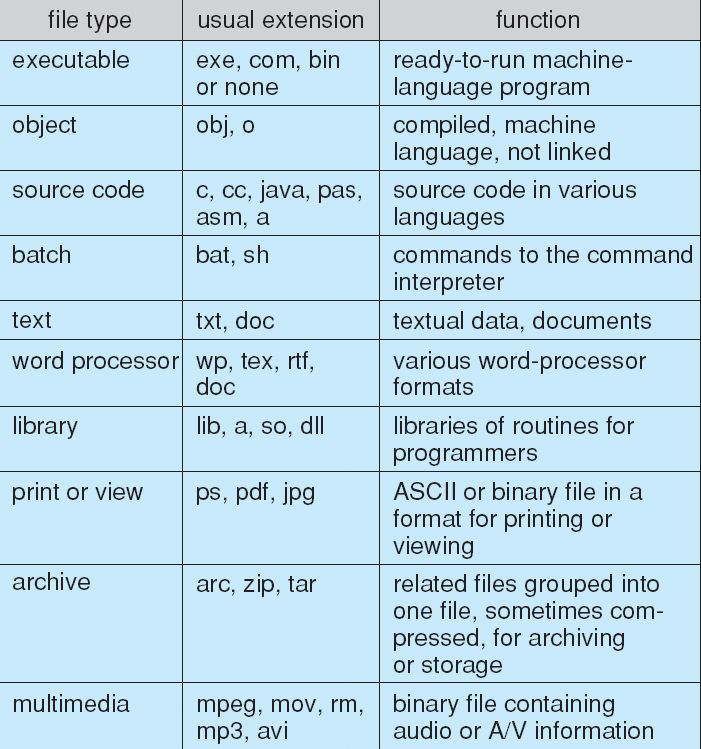
File Types – Name, Extension

