Slide 1
This work is licensed under a Creative Commons Attribution-ShareAlike 4.0 International License. This presentation is released under Creative Commons-A6ribute,on 4.0 License. You are free to use, distribute and modify it ,
including for commercial purposes, provided you acknowledge the source.

Slide 2
File System Implementation.

Slide 3
File System Implementation.
File system resides on secondary storage (disks)
Provided user interface to storage, mapping logical to physical
Provides efficient and convenient access to disk by allowing data to be stored, located retrieved easily.
Disks provide the bulk of secondary storage on which a file system is maintained. They have two characteristics that make them a convenient medium for storing multiple files:
A disk can be rewritten- it is possible to read a block from the disk, modify the block, and write it back into the same place.
A disk can access directly any given block of information it contains. Thus, it is simple to access any file either sequentially or randomly, and switching from one file to another requires only moving the read-write heads and waiting for the disk to rotate.

Slide 4
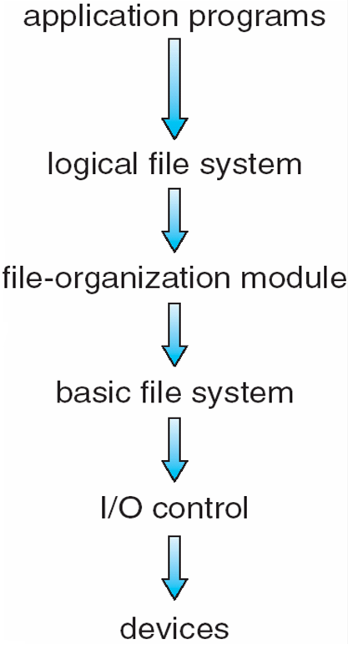
File System Implementation.
Rather than transferring a byte at a time. transfers between memory and disk are performed in units of blocks. (usually 512 bytes)
The file system itself is generally composed of many different levels.

Slide 5
File System Implementation.
The lowest level, the I/O control, consists of
device drivers
Interrupt handlers
to transfer information between the main memory and the disk system.
A device driver
can be thought of as a translator.
Its input consists of high-level commands such as "retrieve block 123."
Its output consists of low level, hardware-specific instructions that are used by the hardware controller, which interfaces the I/O device to the rest of the system.
The basic file system
to issue generic commands to the appropriate device driver to read and write physical blocks on the disk.
Also manages memory buffers and caches (allocation, freeing, replacement)
Buffers hold data in transit
Caches hold frequently used data

Slide 6
File System Implementation.
The file-organization module
knows about files and their logical blocks, as well as physical blocks.
By knowing the type of file allocation used and the location of the file, the file-organization module can translate logical block addresses to physical block addresses for the basic file system to transfer.
The file-organization module also includes the free-space manager, which tracks unallocated blocks and provides these blocks to the file-organization module when requested.

Slide 7
The logical file system
manages metadata information.
Metadata includes all of the file-system structure except the actual data (or contents of the files).
The logical file system manages the directory structure to provide the file organization module with the information the latter needs, given a symbolic file name.
It maintains file structure via file-control blocks. A file-control block (FCB) contains information about the file, including ownership, permissions, and location of the file contents.
The logical file system is also responsible for protection and security.

Slide 8
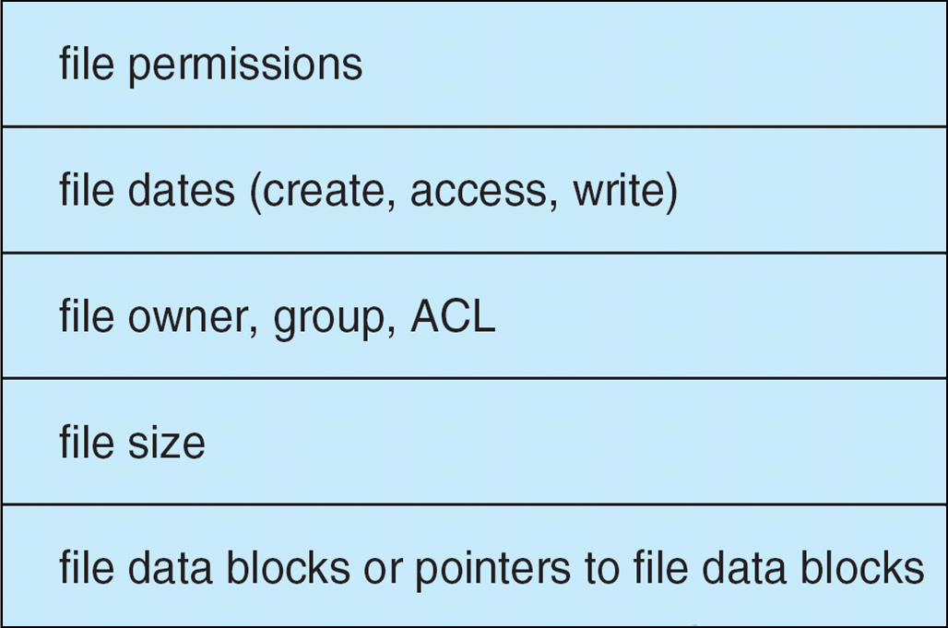
A Typical File Control Block

Slide 9
File System Implementation
Several on-disk and in-memory structures are used to implement a file system.
These structures vary depending on the operating system and the file system.
On disk, the file system may contain information about
how to boot an operating system stored there,
the total number of blocks,
the number and location of free blocks,
the directory structure,
individual files.

Slide 10
A boot control block (per volume) can contain information needed by the system to boot an operating system from that volume.
If the disk does not contain an operating system, this block can be empty.
It is typically the first block of a volume.
In UFS, it is called the boot block; in NTFS, it is the partition boot sector.
A volume control block (per volume) contains volume (or partition) details.
such as the number of blocks in the partition,
size of the blocks,
free block count and free-block pointers.
free FCB count and FCB pointers.
In UFS, this is called a superblock.
in NTFS, it is stored in. the master file table.

Slide 11
A directory structure per file system is used to organize the files.
In UFS, this includes file names and associated inode numbers.
In NTFS it is stored in the master file table.
A per-file FCB contains many details about the file, including
file permissions,
ownership, size, and location of the data blocks.
In UFS, this is called the inode.
In NTFS, this information is actually stored within the master file table,

Slide 12
Allocation Methods
An allocation method refers to how disk blocks are allocated for files:
how to allocate space to these files so that disk space is utilized effectively and files can be accessed quickly.
Three major methods of allocating disk space are in wide use:
contiguous
linked
indexed/.

Slide 13
Contiguous Allocation
In this method each file occupy a set of contiguous blocks on the disk.
Contiguous allocation of a file is defined by the disk address and length (in block units) of the first block.
For example If the file is n blocks long and starts at location b, then it occupies blocks b, b + 1, b + 2, ..., b + n — 1.
The directory entry for each file indicates the address of the starting block and the length of the area allocated for this file

Slide 14
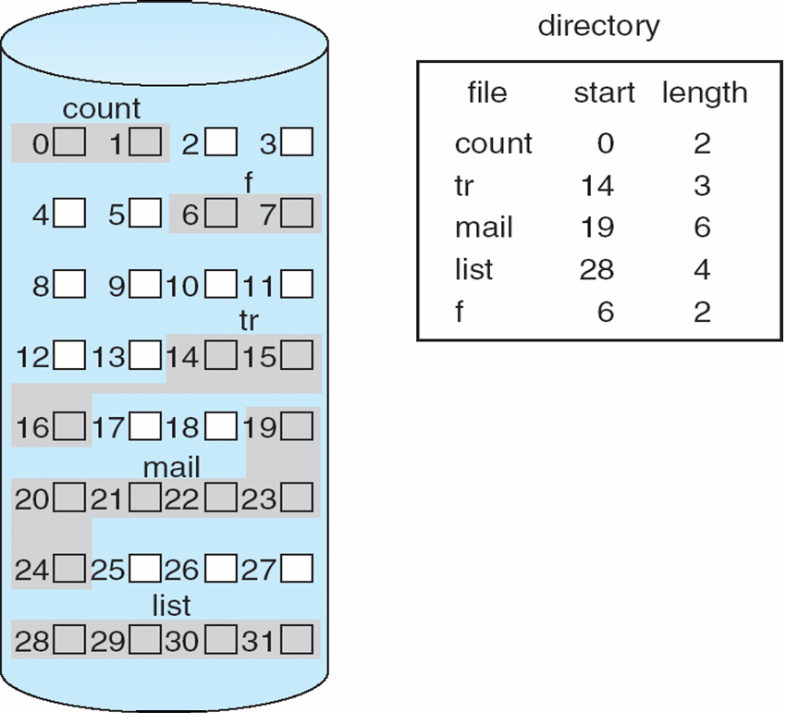
Contiguous Allocation of Disk Space

Slide 15
Contiguous Allocation- Conti..
both sequential and direct access can be supported by contiguous allocation.
For sequential access, the file system remembers the disk address of the last block referenced and, when necessary, reads the next block.
For direct access to block i of a file that starts at block b, we can immediately access block b + i.
One difficulty is finding space for a new file(how to satisfy a request of size n from a list of free holes.)
First fit and best fit are the most common strategies used to select a free hole from the set of available holes.

Slide 16
Contiguous Allocation- Conti..
Another problem with contiguous allocation is determining how much space is needed for a file.
When the file is created, the total amount of space it will need must be found and allocated.
How does the creator (program or person) know the size of the file to be created?
size of an output file may be difficult to estimate.
some operating systems use a modified contiguous-allocation scheme.
a contiguous chunk of space is allocated initially; and then, if that amount proves not to be large enough, another chunk of contiguous space, known as an extent, is added.
The location of a file's blocks is then recorded as a location and a block count, plus a link to the first block of the next extent.
Internal fragmentation can still be a problem if the extents are too large, and external fragmentation can become a problem as extents of varying sizes are allocated and deallocated.

Slide 17
Allocation Methods - Linked
Linked allocation – each file a linked list of blocks
File ends at nil pointer
No external fragmentation
Each block contains pointer to next block
No compaction, external fragmentation
Free space management system called when new block needed
Improve efficiency by clustering blocks into groups but increases internal fragmentation
Reliability can be a problem
Locating a block can take many I/Os and disk seeks
FAT (File Allocation Table) variation
Beginning of volume has table, indexed by block number
Much like a linked list, but faster on disk and cacheable
New block allocation simple

Slide 18
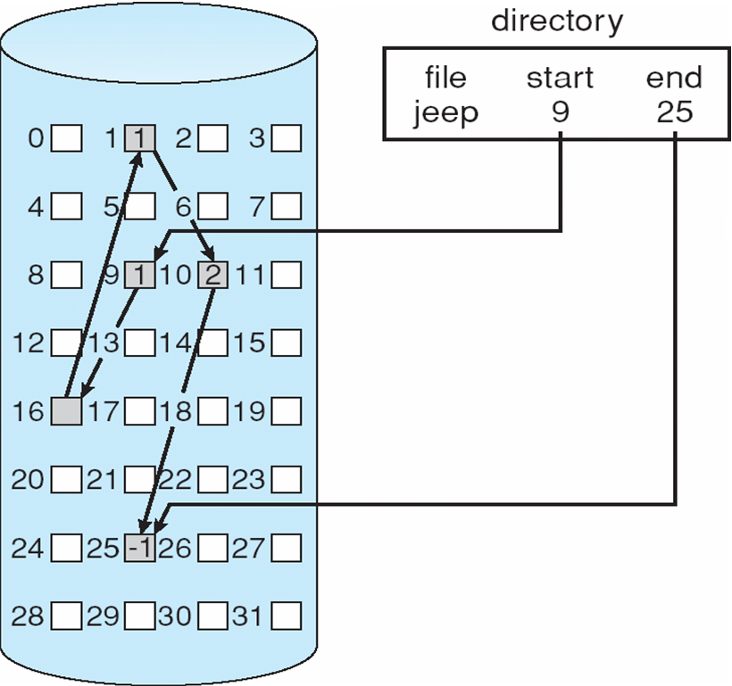
Linked Allocation

Slide 19
Linked Allocation
With linked allocation, each file is a linked list of disk blocks; the disk blocks may be scattered anywhere on the disk.
The directory contains a pointer to the first and last blocks of the file.
For example, a file of five blocks might start at block 9 and continue at block 16, then block 1, then block 10, and finally block 25.
Each block contains a pointer to the next block.
These pointers are not made available to the user.
Thus, if each block is 512 bytes in size, and a disk address (the pointer) requires 4 bytes, then the user sees blocks of 508 bytes.
To create a new file, we simply create a new entry in the directory.
the pointer to the first disk block of the file.
This pointer is initialized to nil (the end-of-list pointer value) to signify an empty file.
To write in to the file causes the free-space management system to find a free block, and this new block is written to and is linked to the end of the file.

Slide 20
Linked Allocation
To read a file, we simply read blocks by following the pointers from block to block.
Advantages
There is no external fragmentation with linked allocation,
The size of a file need not be declared when that file is created.
A file can continue to grow as long as free blocks are available.
Disadvantages
it can be used effectively only for sequential-access files. it is inefficient to support a direct-access capability for linked-allocation files.
the space required for the pointers.
If a pointer requires 4 bytes out of a 512-byte block, then 0.78 percent of the disk is being used for pointers, rather than for information. Each file requires slightly more space than it would otherwise.
another problem of linked allocation is reliability.
if a pointer were lost or damaged. We wont able to access blocks following the lost pointer.

Slide 21
Allocation Methods - Indexed
Indexed allocation
Indexed allocation solves the problem of sequential access limitation of linked allocation by bringing all the pointers together into one location: the index block.
Each file has its own index block, which is an array of disk-block addresses.
The i th entry in the index block points to the i th block of the file.
The directory contains the address of the index block (Figure ).
To find and read the i th block, we use the pointer in the i index-block entry.

Slide 22
Allocation Methods - Indexed
When the file is created, all pointers in the index block are set to nil. When the ith block is first written, a block is obtained from the free-space manager, and its address is put in the ith index-block entry.
Advantages
Indexed allocation supports direct access, without suffering from external fragmentation.
Indexed allocation does suffer from wasted space.
Disadvantages
The pointer overhead of the index block is generally greater than the pointer overhead of linked allocation.

Slide 23
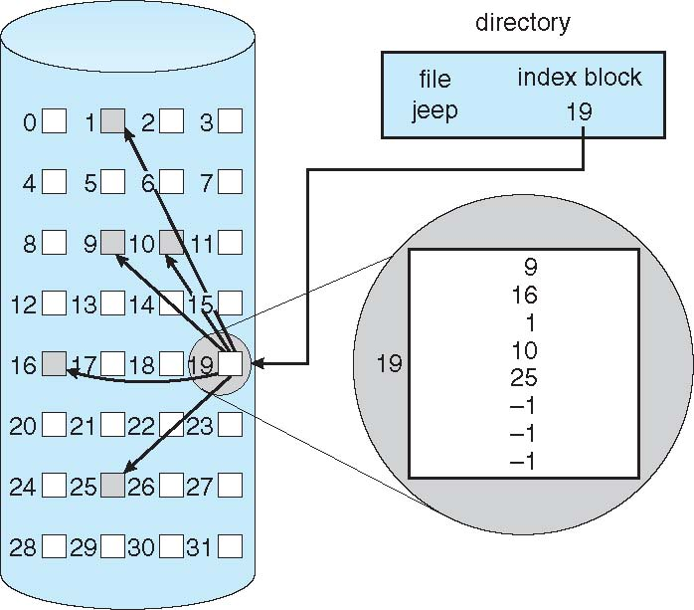
Example of Indexed Allocation

