Slide 1
This work is licensed under a Creative Commons Attribution-ShareAlike 4.0 International License. This presentation is released under Creative Commons-A6ribute,on 4.0 License. You are free to use, distribute and modify it ,
including for commercial purposes, provided you acknowledge the source.

Slide 2
Module 4: Memory Management
Topic – Memory Concept
CS-2013 (Operating System)
Lecture -21

Slide 3
Topic to be Cover
Introduction and Background of Memory Management
Memory Partitioning
Single Relocatable Partitions.
Multiple Partitions.
Multiple Fixed Partitions(MFP).
Multiple Variable Partitions(MVP).
Swapping
Contiguous Allocation
Paging
Segmentation
Segmentation with Paging.
Numerical examples.
Single Absolute Partitions.
Best-Fit,
First-Fit,
Worst Fit,
Next - Fit

Slide 4
Dynamic Loading
The entire program and all data of a process must be in physical memory for the process to execute.
The size of a process is thus limited to the size of physical memory.
All routines are kept on disk in a relocatable load format. The main program is loaded into memory and is executed.
When a routine needs to call another routine, the calling routine first checks to see whether the other routine has been loaded.
If not, the relocatable linking loader is called to load the desired routine into memory.
Then control is passed to the newly loaded routine.
Advantage:
Better memory-space utilization; unused routine is never loaded.
No special support from the operating system is required implemented through program design.

Slide 5
Dynamic Linking
static linking - in which system language libraries are treated like any other object module and are combined by the loader into the binary program image.
Linking postponed until execution time.
Without this facility, each program on a system must include a copy of its language library (or at least the routines referenced by the program) in the executable image.
This requirement wastes both disk space and main memory.

Slide 6
Dynamic Linking conti…
Small piece of code, stub, used to locate the appropriate memory-resident library routine.
The stub is a small piece of code that indicates how to locate the appropriate memory-resident library routine or how to load the library if the routine is not already present.
When the stub is executed, it checks to see whether the needed routine is already in memory. If not, the program loads the routine into memory.
Stub replaces itself with the address of the routine and executes the routine.
Thus, the next time that particular code segment is reached, the library routine is executed directly, incurring no cost for dynamic linking.
Operating system needed to check if routine is in processes’ memory address.
Dynamic linking is particularly useful for libraries.

Slide 7
Logical vs. Physical Address Space
The concept of a logical address space that is bound to a separate physical address space is central to proper memory management.
Logical address – generated by the CPU; also referred to as virtual address.
Physical address – address seen by the memory unit.(that is, the one loaded into the memory-address register of the memory)
Logical and physical addresses are the same in compile-time and load-time address-binding schemes; logical (virtual) and physical addresses differ in execution-time address-binding scheme.

Slide 8
Logical vs. Physical Address Space
The set of all logical addresses generated by a program is a logical address space; the set of all physical addresses corresponding to these logical addresses is a physical address space.
Thus, in the execution-time address-binding scheme, the logical and physical address spaces differ.

Slide 9
Memory-Management Unit (MMU)
MMU is a Hardware device that maps virtual/logical to physical address.
In MMU scheme, the value in the relocation register is added to every address generated by a user process at the time it is sent to memory.
The user program deals with logical addresses; it never sees the real physical addresses.

Slide 10
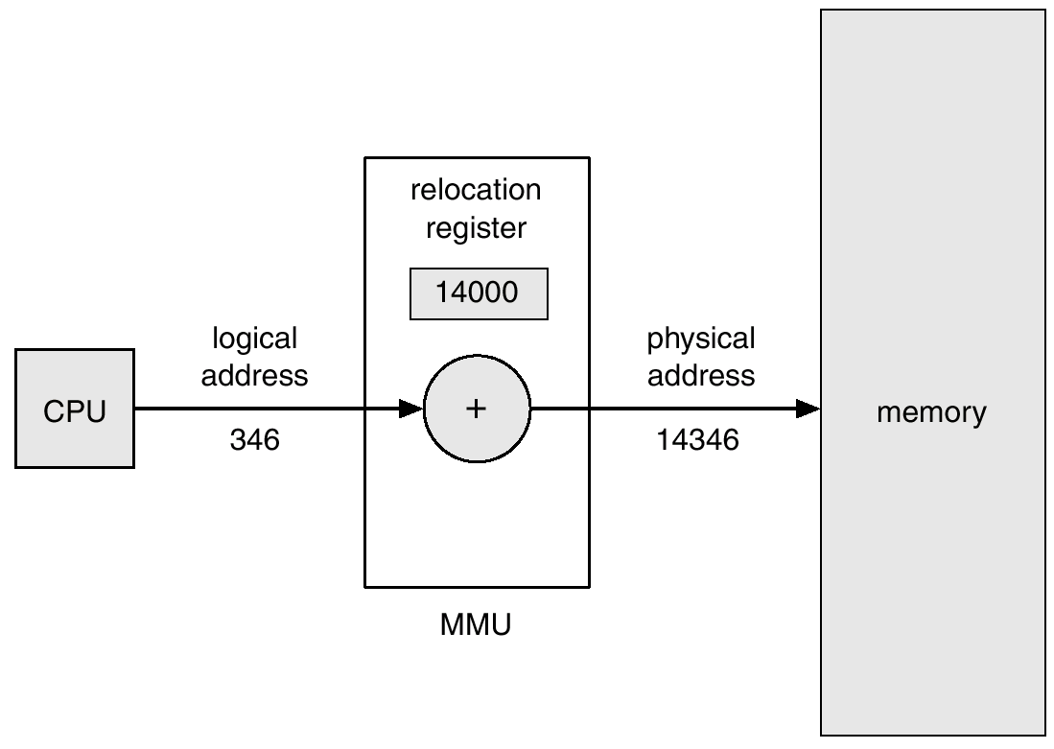
Dynamic relocation using a relocation register

Slide 11
Swapping
A process can be swapped temporarily out of memory to a backing store, and then brought back into memory for continued execution.
Backing store – fast disk large enough to accommodate copies of all memory images for all users; must provide direct access to these memory images.
Roll out, roll in – swapping variant used for priority-based scheduling algorithms; lower-priority process is swapped out so higher-priority process can be loaded and executed.
Major part of swap time is transfer time; total transfer time is directly proportional to the amount of memory swapped.
Modified versions of swapping are found on many systems, i.e., UNIX, Linux, and Windows.

Slide 12
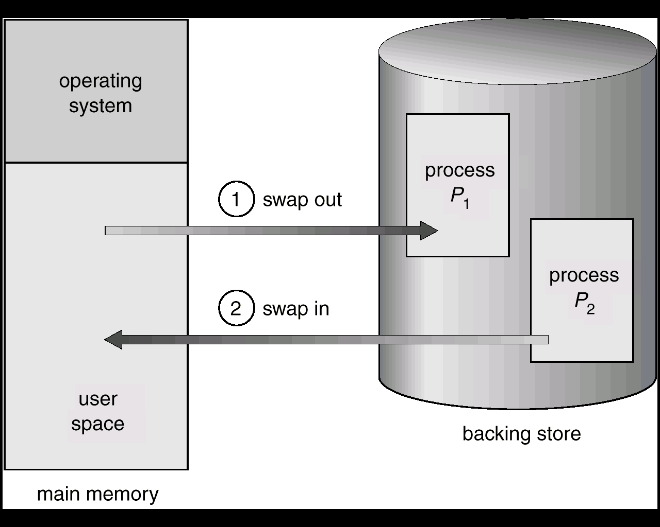
Schematic View of Swapping

