Slide 1
This work is licensed under a Creative Commons Attribution-ShareAlike 4.0 International License. This presentation is released under Creative Commons-A6ribute,on 4.0 License. You are free to use, distribute and modify it ,
including for commercial purposes, provided you acknowledge the source.

Slide 2
Module 4: Memory Management
Topic – Memory Concept
CS-2013 (Operating System)
Part III
Lecture -22

Slide 3
Topic to be Cover
Introduction and Background of Memory Management
Memory Partitioning
Single Relocatable Partitions.
Multiple Partitions.
Multiple Fixed Partitions(MFP).
Multiple Variable Partitions(MVP).
Swapping
Contiguous Allocation
Paging
Segmentation
Segmentation with Paging.
Numerical examples.
Single Absolute Partitions.
Best-Fit,
First-Fit,
Worst Fit,

Slide 4
Contiguous Allocation
Main memory usually into two partitions:
Resident operating system, usually held in low memory with interrupt vector.
User processes then held in high memory.
Single-Partition Allocation
Relocation-register scheme used to protect user processes from each other, and from changing operating-system code and data.
Relocation register contains value of smallest physical address; limit register contains range of logical addresses – each logical address must be less than the limit register.

Slide 5
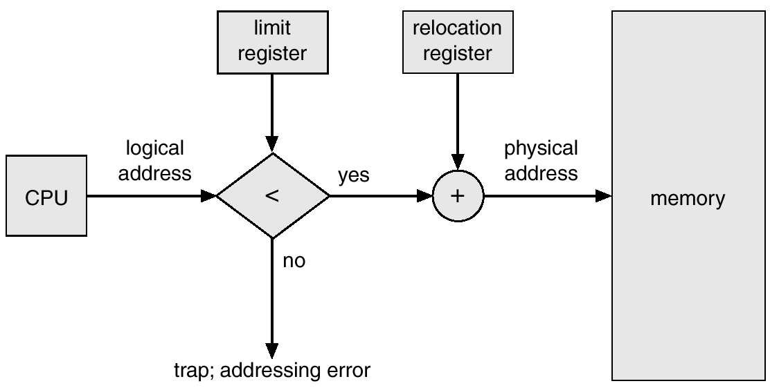
Hardware Support for Relocation and Limit Registers

Slide 6
Contiguous Allocation (Cont.)
Multiple-Partition Allocation
Hole – block of available memory; holes of various size are scattered throughout memory.
When a process arrives, it is allocated memory from a hole large enough to accommodate it.
Operating system maintains information about: a) allocated partitions b) free partitions (hole)
OS
OS
OS
OS
process 5
process 5
process 5
process 5
process 9
process 9
process 8
process 10
process 2
process 2
process 2
process 2

Slide 7
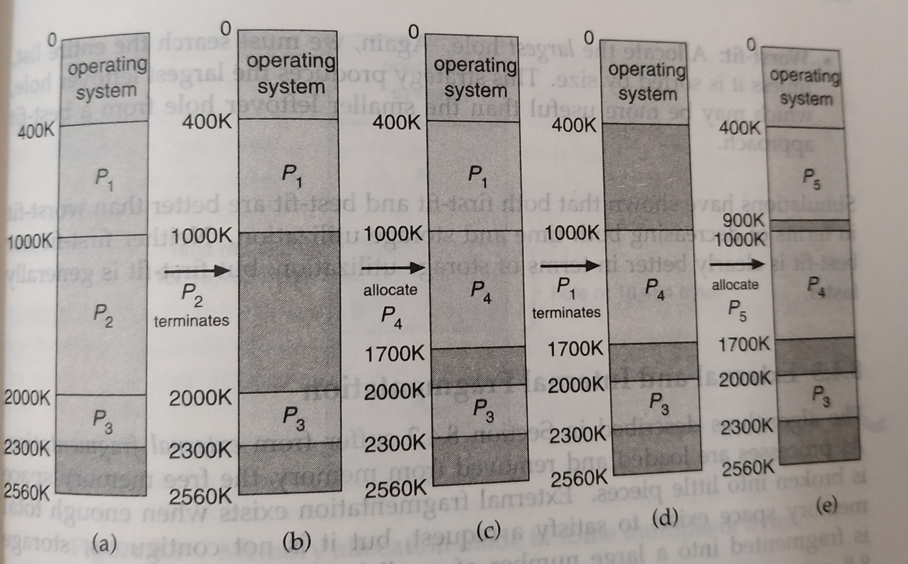
Contiguous Allocation (Cont.) Multiple-Partition Allocation

Slide 8
Dynamic Storage-Allocation Problem
How to satisfy a request of size n from a list of free holes.
First-fit: Allocate the first hole that is big enough.
Best-fit: Allocate the smallest hole that is big enough; must search entire list, unless ordered by size. Produces the smallest leftover hole.
Worst-fit: Allocate the largest hole; must also search entire list. Produces the largest leftover hole.
First-fit and best-fit better than worst-fit in terms of speed and storage utilization.

Slide 9
Fragmentation
As processes are loaded and removed from memory, the free memory space is broken into little pieces.
External Fragmentation – it exists when there is enough total memory space to satisfy a request, but the available spaces are not contiguous; storage is fragmented into a large number of small holes.
Statistical analysis of first fit proved that even with some optimization, given N allocated blocks, another 0.5 N blocks will be lost to fragmentation. That is, one-third of memory may be unusable! This property is known as the 50-percent rule.
Internal Fragmentation – it exists when allocated memory may be slightly larger than requested memory; this size difference is memory internal to a partition, but not being used.

Slide 10
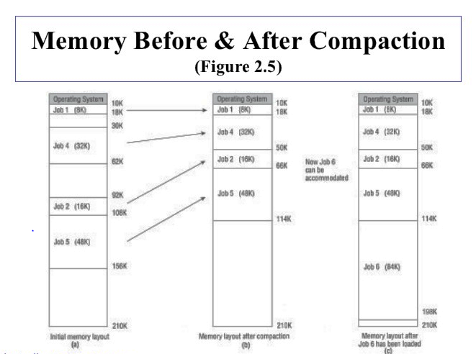
Fragmentation
Solution of external fragmentation is the “compaction”
Shuffle memory contents to place all free memory together in one large block.
If relocation is static, compaction cannot be done
Compaction is possible only if relocation is dynamic, and is done at execution time.
The simplest compaction algorithm is to move all processes toward one end of memory; all holes move in the other direction, producing one large hole of available memory.

Slide 11
Fragmentation
Another possible solution to the external-fragmentation problem is to permit the logical address space of the processes to be noncontiguous. this solution includes
1. Paging
2. Segmentation

