Slide 1
This work is licensed under a Creative Commons Attribution-ShareAlike 4.0 International License. This presentation is released under Creative Commons-A6ribute,on 4.0 License. You are free to use, distribute and modify it ,
including for commercial purposes, provided you acknowledge the source.

Slide 2
Module 4: Memory Management
Topic – Memory Concept
CS-2013 (Operating System)
Part VI
Lecture -25

Slide 3
Topic to be Cover
Introduction and Background of Memory Management
Memory Partitioning
Single Relocatable Partitions.
Multiple Partitions.
Multiple Fixed Partitions(MFP).
Multiple Variable Partitions(MVP).
Swapping
Contiguous Allocation
Paging
Segmentation
Segmentation with Paging.
Numerical examples.
Single Absolute Partitions.
Best-Fit,
First-Fit,
Worst Fit,

Slide 4
Implementation of Page Table
Each operating system has its own methods for storing page tables.
Most allocate a page table for each process.
A pointer to the page table is stored with the other register values (like the instruction counter) in the process control block.
When the dispatcher is told to start a process, it must reload the user registers and define the correct hardware page-table values from the stored user page table.

Slide 5
Implementation of Page Table (Memory Protection)
Memory protection implemented by associating protection bit with each frame.
Valid-invalid bit attached to each entry in the page table:
“valid” indicates that the associated page is in the process’ logical address space and is thus a legal page.
“invalid” indicates that the page is not in the process’ logical address space.

Slide 6
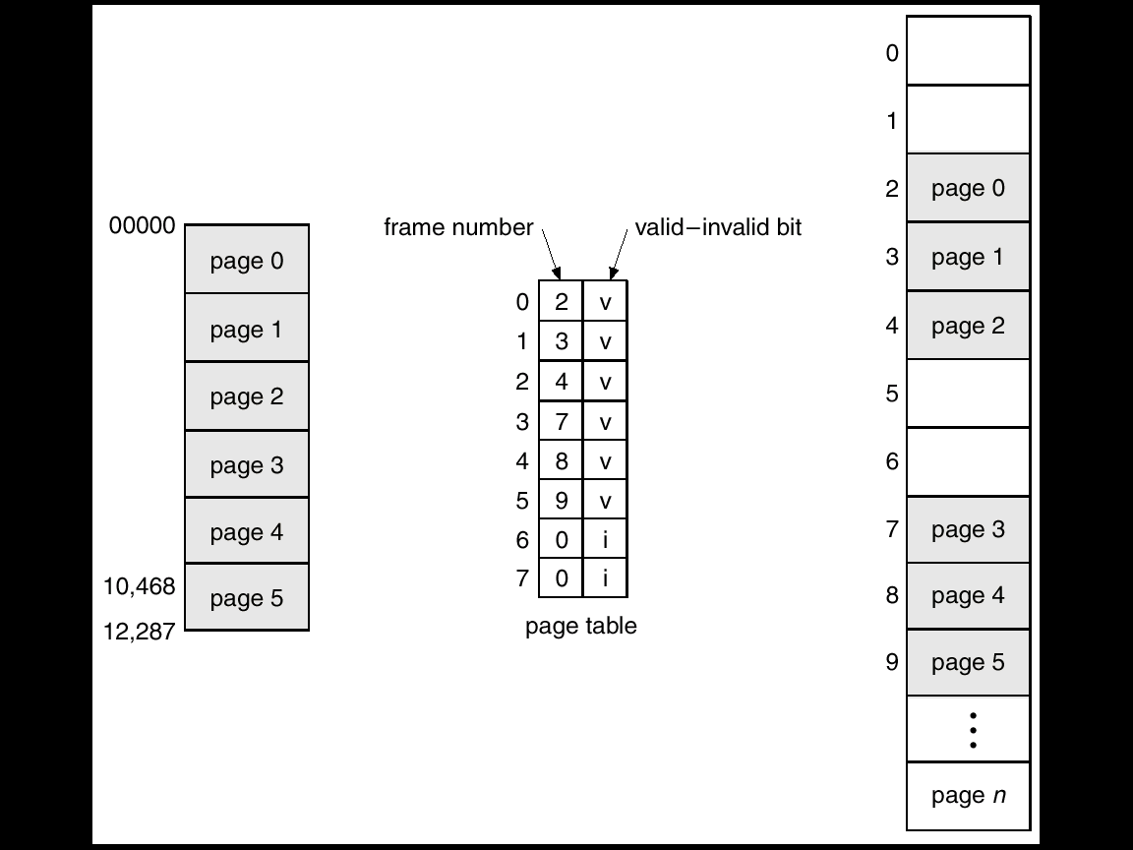
Implementation of Page Table (Memory Protection)
Valid (v) or Invalid (i) Bit In A Page Table

Slide 7
Page Table Structure
Hierarchical Paging
Hashed Page Tables
Inverted Page Tables

Slide 8
Hierarchical Page Tables
Break up the logical address space into multiple page tables.
A simple technique is a two-level page table.

Slide 9
Two-Level Paging Example
A logical address (on 32-bit machine with 4K page size) is divided into:
a page number consisting of 20 bits.
a page offset consisting of 12 bits.
Since the page table is paged, the page number is further divided into:
a 10-bit page number.
a 10-bit page offset.
Thus, a logical address is as follows: where p_{i} is an index into the outer page table, and p₂ is the displacement within the page of the outer page table.
page number
page offset
p_{i}
p₂
d
10
10
12

Slide 10
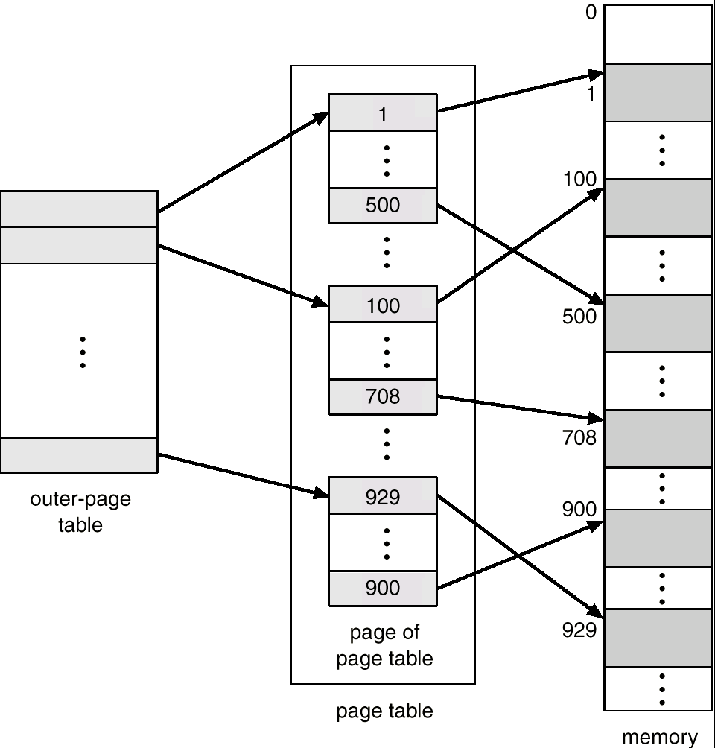
Two-Level Page-Table Scheme

Slide 11
Address-Translation Scheme
Address-translation scheme for a two-level 32-bit paging architecture

Slide 12
Hashed Page Tables
Common in address spaces > 32 bits.
The virtual page number is hashed into a page table. This page table contains a chain of elements hashing to the same location.
Virtual page numbers are compared in this chain searching for a match. If a match is found, the corresponding physical frame is extracted.

Slide 13
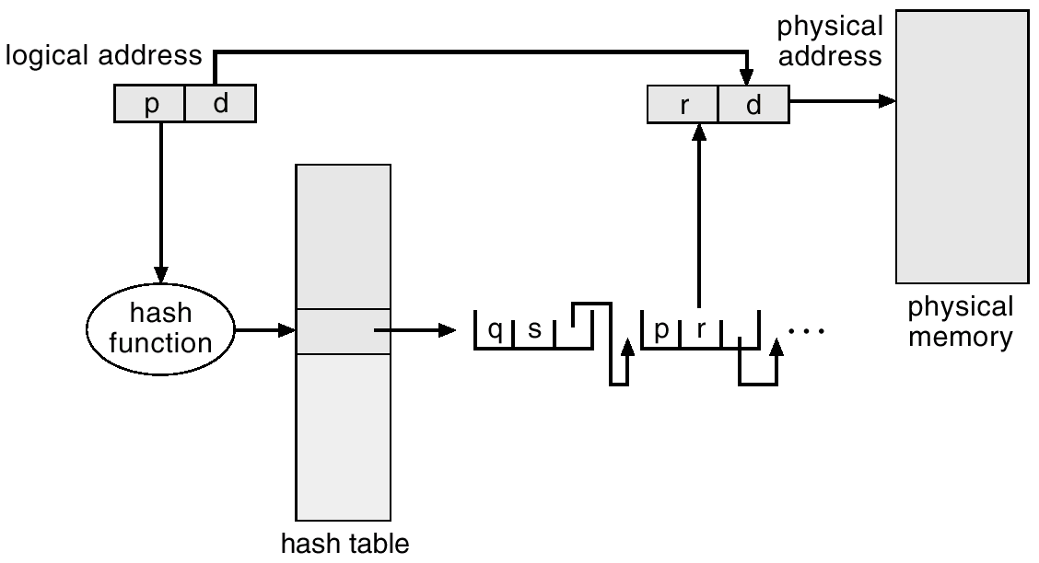
Hashed Page Table

Slide 14
Inverted Page Table
One entry for each real page of memory.
Entry consists of the virtual address of the page stored in that real memory location, with information about the process that owns that page.
Decreases memory needed to store each page table, but increases time needed to search the table when a page reference occurs.
Use hash table to limit the search to one — or at most a few — page-table entries.

Slide 15
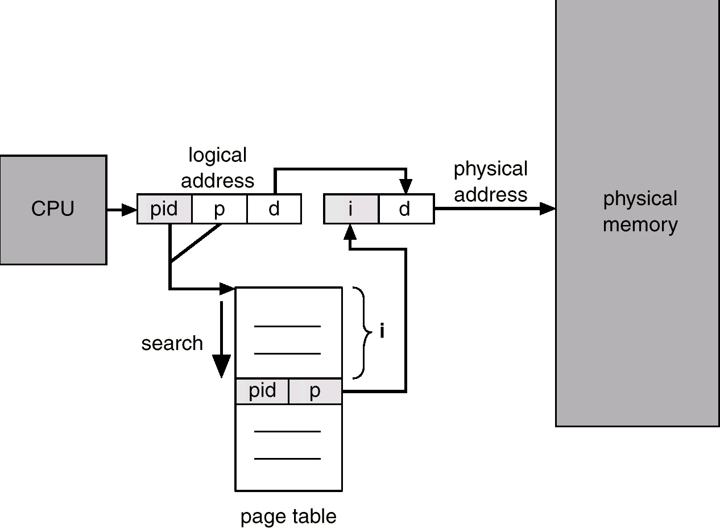
Inverted Page Table Architecture

Slide 16
Implementation of Page Table (Shared pages)
An advantage of paging is the possibility of sharing common code.
Reentrant code (or pure code) it can be shared.
It is non-self-modifying code ( it never changes during execution).
Multiple processes can execute the same code at the same time.
Each process has its own copy of registers and data storage ( data for different processes will , be different.
Shared code
One copy of read-only (reentrant) code shared among processes (i.e., text editors, compilers, window systems).
Shared code must appear in same location in the logical address space of all processes.
Private code and data
Each process keeps a separate copy of the code and data.
The pages for the private code and data can appear anywhere in the logical address space.

Slide 17
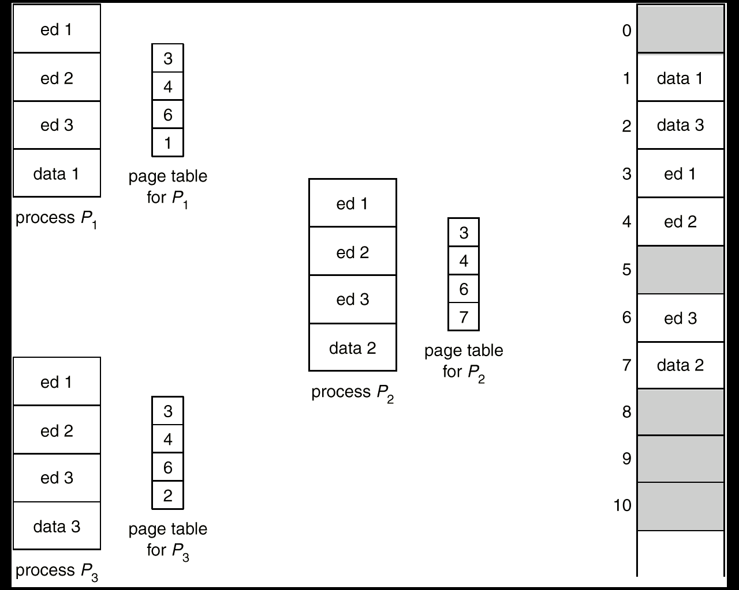
Implementation of Page Table (Shared pages Example)

Slide 18
Implementation of Page Table (Shared pages)
Heavily used programs can also be shared( code must be reentrant):
Compilers.
Window systems.
Run-time libraries.
Database systems etc.
The sharing of memory among processes is like the sharing of the address space of a task by threads.

Slide 20
Segmentation
Memory-management scheme that supports user view of memory.
A program is a collection of segments. A segment is a logical unit such as:
main program,
procedure,
function,
method,
object,
local variables, global variables,
common block,
stack,
symbol table, arrays

Slide 21
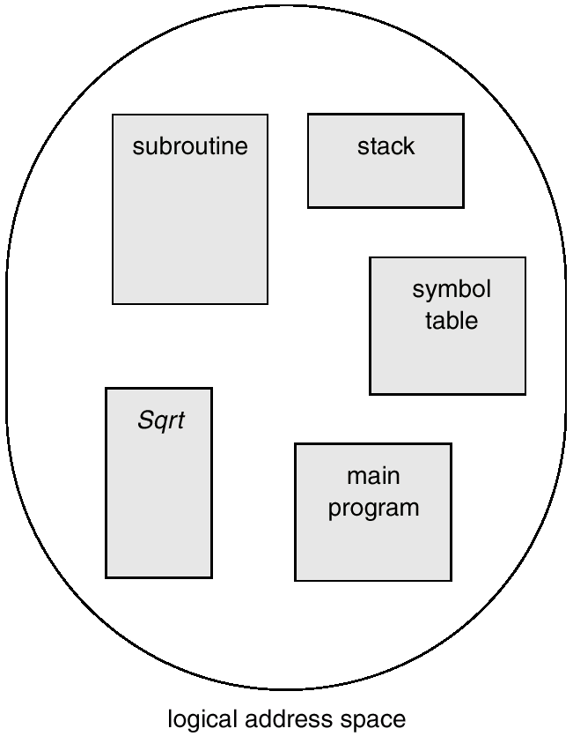
User’s View of a Program

Slide 22
Logical View of Segmentation
1
1
4
2
3
4
2
3
user space
physical memory space

Slide 23
Segmentation Architecture
Logical address consists of a two tuple:
<segment-number, offset>,
Segment table – maps two-dimensional physical addresses; each table entry has:
base – contains the starting physical address where the segments reside in memory.
limit – specifies the length of the segment.
Segment-table base register (STBR) points to the segment table’s location in memory.
Segment-table length register (STLR) indicates number of segments used by a program;
segment number s is legal if s < STLR.

Slide 24
Segmentation Architecture (Cont.)
Relocation.
dynamic
by segment table
Sharing.
shared segments
same segment number
Allocation.
first fit/best fit
external fragmentation

Slide 25
Segmentation Architecture (Cont.)
Protection. With each entry in segment table associate:
validation bit = 0 ⇒ illegal segment
read/write/execute privileges
Protection bits associated with segments; code sharing occurs at segment level.
Since segments vary in length, memory allocation is a dynamic storage-allocation problem.
A segmentation example is shown in the following diagram

Slide 26
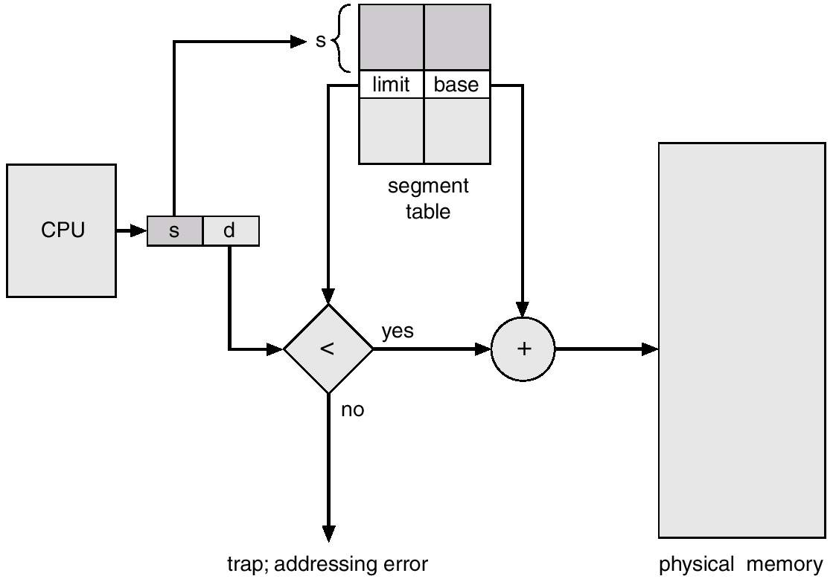
Segmentation Hardware

Slide 27
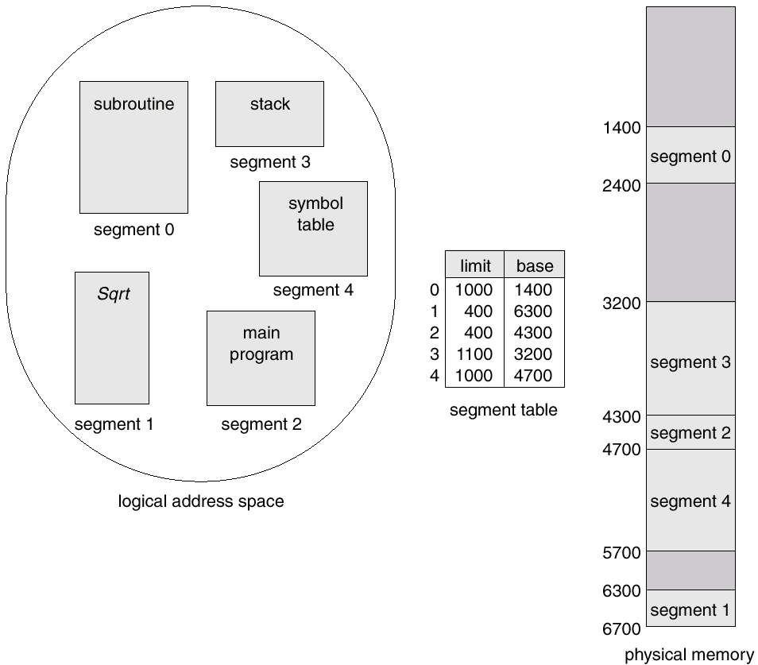
Example of Segmentation

Slide 28
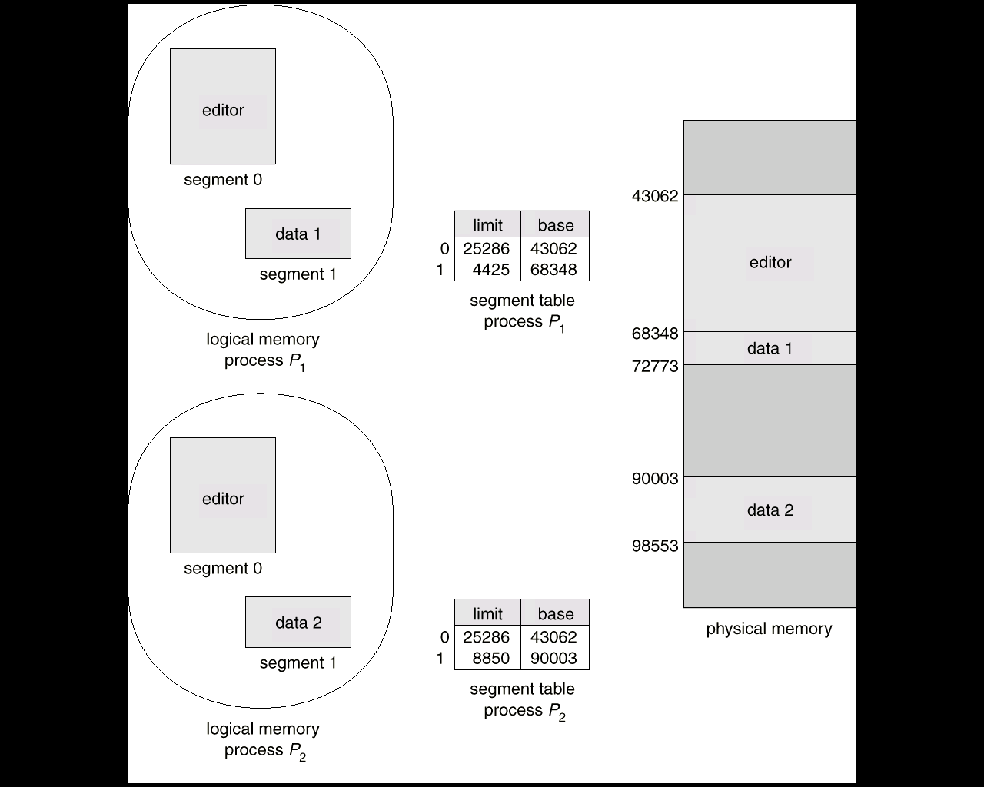
Sharing of Segments

Slide 29
Segmentation with Paging – MULTICS
The MULTICS system solved problems of external fragmentation and lengthy search times by paging the segments.
Solution differs from pure segmentation in that the segment-table entry contains not the base address of the segment, but rather the base address of a page table for this segment.

Slide 30
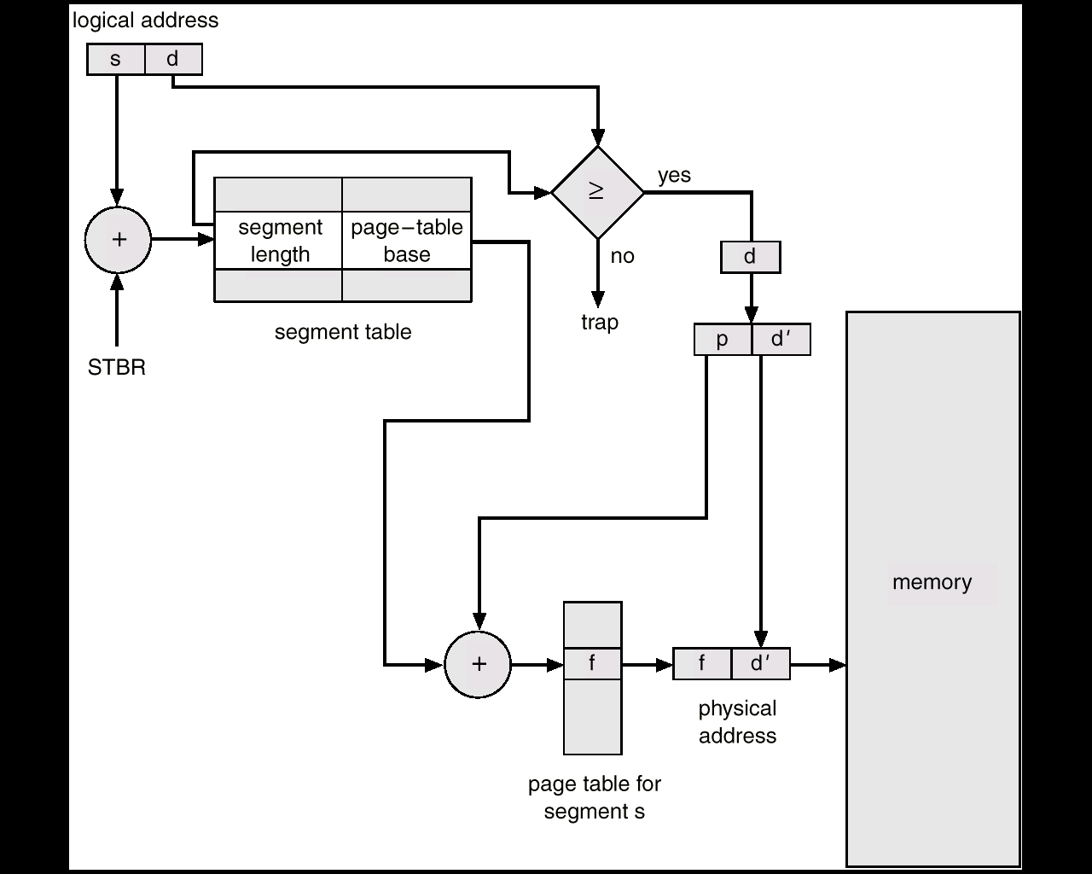
MULTICS Address Translation Scheme

Slide 31
Segmentation with Paging
Segmentation and paging can be combined to provide
Efficiency of paging scheme
Protection and sharing capability of the of segmentation
with simple segmentation the logical address space contains- segment Number and offset.
When paging is added the segment offset is further divided into page number and page offset.
The segment table entry contains the address of the segment’s page table.
The hardware adds the logical address’s page number bits to the page table address to locate the page table entry.
The final physical address is formed by appending the page offset to the page frame number, specified in the page table entry.

Slide 32
Segmentation with Paging
Logical Address
S | P | D
Pf
+
+
Pf | D
Segment Table Address
Physical Address
Segment Table
Page Table

Slide 33
Numericals
Question 1 : Why the page sizes always power of 2 ?
Answer :
All addresses are binary and are divided into page or, page frame and offset. By making the page size a power of 2, the page number, page frame number and the offset can be determined by looking at particular bits in the address; no mathematical calculation is required.

Slide 34
Question 2:
On a simple paging scheme with following parameters:
physical memory - 2²⁴ bytes.
No of pages in logical address space - 256 pages.
page size - 2¹⁰ bytes.
How many bits are in the logical address space.
Answer:
to find out the total bits in logical address space, we need to find out the total logical address space.
Total Logical address space is = No of pages*size of each page.
= 256 x 2¹⁰
= 2⁸ x 2¹⁰
= 2¹⁸
so an 18 bit address is required to cover 2¹⁸ bytes address space

Slide 35
Question 3:
On a simple paging scheme with following parameters:
physical memory - 2²⁴ bytes.
No of pages in logical address space - 256 pages.
page size - 2¹⁰ bytes.
How many bits in the logical address space used for the page number and offset.
Answer:
total logical address space - 2¹⁸ bytes ( 2^{M} )
Size of the one page is - 2¹⁰ bytes ( 2^{N} )
so the no of bits for Page number = (M-N) bits
= 18-10
= 8 bits(no of pages)
so the no of bits for offset = N bits
10 bits

Slide 36
Question 4 :
On a simple paging scheme with following parameters:
physical memory - 2²⁴ bytes.
No of pages in logical address space - 256 pages.
page size - 2¹⁰ bytes.
How many bytes are in the page frame..
Answer:
the page frame size is same as the page size. Since page size is 2¹⁰ so the frame size is also 2¹⁰

Slide 37
Question 5 :
On a simple paging scheme with following parameters:
physical memory - 2²⁴ bytes.
No of pages in logical address space - 256 pages.
page size - 2¹⁰ bytes.
How many bits in the physical address is specify the page frame.
Answer:
24 bit address is required to cover 2^{24 –} bytes physical address.
page size and the frame size is same so last 10 bits out of 24 of the physical address is used as offset bits.
Remaining 14 bits specifies the page frame number.

Slide 38
Question 6 :
On a simple paging scheme with following parameters:
physical memory - 2²⁴ bytes.
No of pages in logical address space - 256 pages.
page size - 2¹⁰ bytes.
How many entries are in the page table?
Answer:
since there are 256 pages in the logical address space. So the page table must be 256 entries long.

Slide 39
When page table parameters given….
Question 7 :
On a simple paging scheme with following parameters:
page Table entries - 512 entries.
length of page table entry -16 bits(including valid/invalid bit).
page size - 1024 bytes.
How many bits in the logical address specifies the page number and offset and how many bits are in the logical address?
Answer:
we know that total number of pages are - 512 pages
so we need to refer 512 pages - 2⁹
so we need 9 bits to specify the page number.
offset bits = size of the page
= 1024 Bytes
= 2¹⁰
So 10 bits are used to specify the offset.
so total bits in the logical address is 19.

Slide 40
Question 8 :
On a simple paging scheme with following parameters:
page Table entries - 512 entries.
length of page table entry -16 bits(including valid/invalid bit).
page size - 1024 bytes.
what is the size of the logical address space.?
Answer:
9 bits to specify the page number.
10 bits are used to specify the offset.
bits in the logical address is 19.
so the total logical address space= 2¹⁹ bytes.

Slide 41
Question 9 :
On a simple paging scheme with following parameters:
page Table entries - 512 entries.
length of page table entry -16 bits(including valid/invalid bit).
page size - 1024 bytes.
how many bits in the physical address specify the page frame numbers and offset and also find out the total physical address space?
Answer:
each entry in the page table is 16 bit long( including the 1 bit valid/ invalid bit. So 15 bit is the physical address is used to specify the frame number.
offset is same in the logical address and physical address so number of bits in the physical address specifies the offset is 10.
Total number of bits in the physical address-15+10=25 bits.
Total physical address space is = 2²⁵ bytes.

Slide 43
Unsolved Questions
What are the two major difference between segmentation and paging?
2. Clearly distinguish between the physical address space and logical address space of a process?
3. What is the effect of allowing two entries in a page table to point to the same frame in the memory?
4. On simple paged system, can the logical address space be larger than the physical address space?
5. Why paging is faster than segmentation?
6. Explain the difference between internal and external fragmentation.
7. What is the advantages of combining the segmentation and paging scheme into one scheme?
8. What do you understand by dynamic linking and dynamic loading.?

