Slide 1
This work is licensed under a Creative Commons Attribution-ShareAlike 4.0 International License. This presentation is released under Creative Commons-A6ribute,on 4.0 License. You are free to use, distribute and modify it ,
including for commercial purposes, provided you acknowledge the source.

Slide 2
Module 4: Memory Management
Topic – Memory Concept
CS-2013 (Operating System)
Part VIII
Lecture -27

Slide 3
Topic to be Cover
Introduction and Background of Memory Management
Memory Partitioning
Single Relocatable Partitions.
Multiple Partitions.
Multiple Fixed Partitions(MFP).
Multiple Variable Partitions(MVP).
Swapping
Contiguous Allocation
Paging
Segmentation
Segmentation with Paging.
Numerical examples.
Single Absolute Partitions.
Best-Fit,
First-Fit,
Worst Fit,

Slide 4
Segmentation with Paging
Segmentation and paging can be combined to provide
Efficiency(paging scheme)
Protection and sharing capability (segmentation)
The Logical address space contains- segment Number and offset(segmentation).
The segment offset is further divided into page number and page offset.( Paging )
The segment table entry contains the address of the segment’s page table.
The hardware adds the logical address’s page number bits to the page table address to locate the page table entry.
The final physical address is formed by appending the page offset to the page frame number, specified in the page table entry.

Slide 5
Segmentation with Paging
Logical Address
S | P | D
Pf
+
+
Pf | D
Segment Table Address
Physical Address
Segment Table
Page Table

Slide 6
Segmentation with Paging – MULTICS
The MULTICS system solved problems of external fragmentation and lengthy search times by paging the segments.
Solution differs from pure segmentation in that the segment-table entry contains not the base address of the segment, but rather the base address of a page table for this segment.
Segment number(18 Bit)
Offset(16)
S1
S2
d1
d2
8
10
6
10

Slide 7
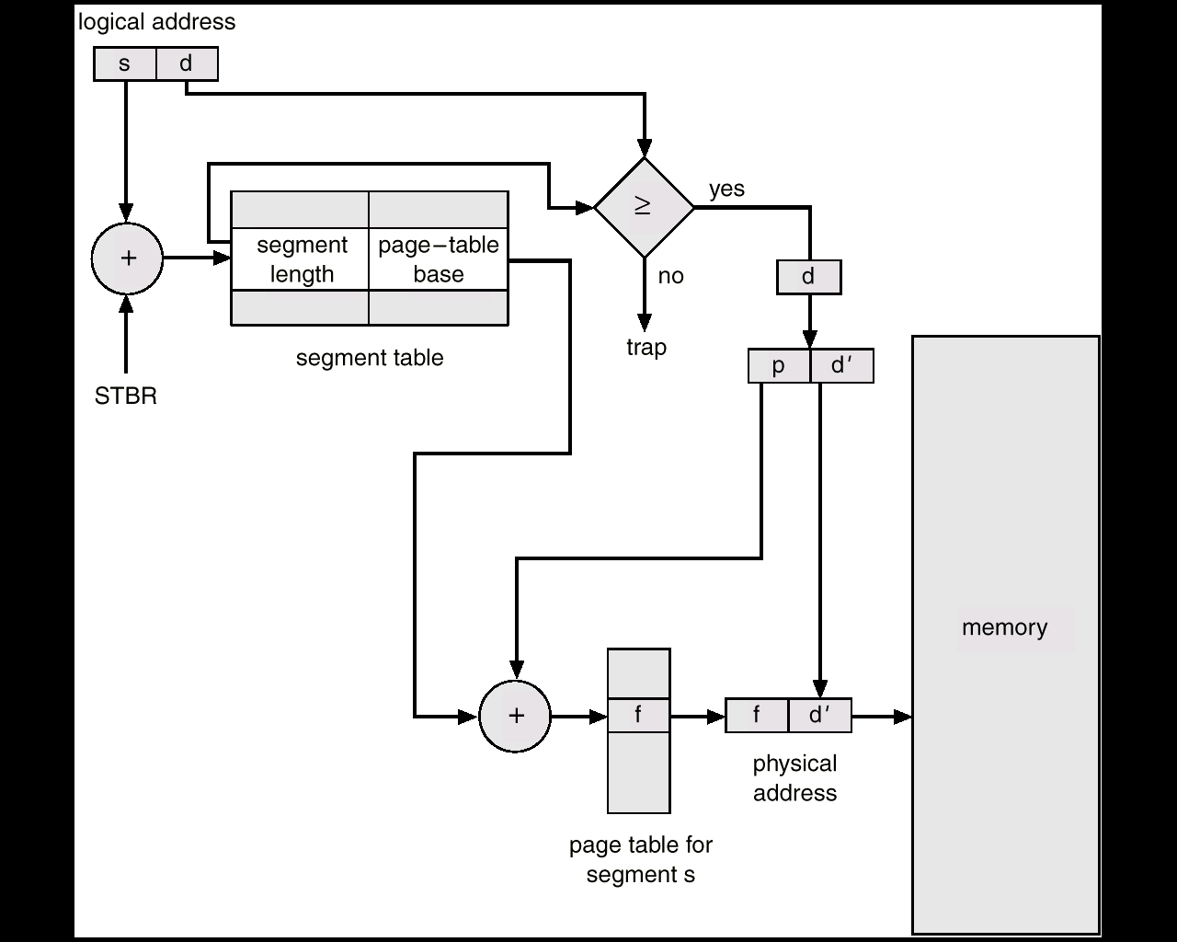
MULTICS Address Translation Scheme

Slide 8
Numericals
Question 1 : Why the page sizes always power of 2 ?
Answer :
All addresses are binary and are divided into page or, page frame and offset. By making the page size a power of 2, the page number, page frame number and the offset can be determined by looking at particular bits in the address; no mathematical calculation is required.

Slide 9
Question 2:
On a simple paging scheme with following parameters:
physical memory - 2²⁴ bytes.
No of pages in logical address space - 256 pages.
page size - 2¹⁰ bytes.
How many bits are in the logical address space.
Answer:
to find out the total bits in logical address space, we need to find out the total logical address space.
Total Logical address space is = No of pages*size of each page.
= 256 x 2¹⁰
= 2⁸ x 2¹⁰
= 2¹⁸
so an 18 bit address is required to cover 2¹⁸ bytes address space

Slide 10
Question 3:
On a simple paging scheme with following parameters:
physical memory - 2²⁴ bytes.
No of pages in logical address space - 256 pages.
page size - 2¹⁰ bytes.
How many bits in the logical address space used for the page number and offset.
Answer:
total logical address space - 2¹⁸ bytes ( 2^{M} )
Size of the one page is - 2¹⁰ bytes ( 2^{N} )
so the no of bits for Page number = (M-N) bits
= 18-10
= 8 bits(no of pages)
so the no of bits for offset = N bits
10 bits

Slide 11
Question 4 :
On a simple paging scheme with following parameters:
physical memory - 2²⁴ bytes.
No of pages in logical address space - 256 pages.
page size - 2¹⁰ bytes.
How many bytes are in the page frame..
Answer:
the page frame size is same as the page size. Since page size is 2¹⁰ so the frame size is also 2¹⁰

Slide 12
Question 5 :
On a simple paging scheme with following parameters:
physical memory - 2²⁴ bytes.
No of pages in logical address space - 256 pages.
page size - 2¹⁰ bytes.
How many bits in the physical address is specify the page frame.
Answer:
24 bit address is required to cover 2^{24 –} bytes physical address.
page size and the frame size is same so last 10 bits out of 24 of the physical address is used as offset bits.
Remaining 14 bits specifies the page frame number.

Slide 13
Question 6 :
On a simple paging scheme with following parameters:
physical memory - 2²⁴ bytes.
No of pages in logical address space - 256 pages.
page size - 2¹⁰ bytes.
How many entries are in the page table?
Answer:
since there are 256 pages in the logical address space. So the page table must be 256 entries long.

Slide 14
When page table parameters given….
Question 7 :
On a simple paging scheme with following parameters:
page Table entries - 512 entries.
length of page table entry -16 bits(including valid/invalid bit).
page size - 1024 bytes.
How many bits in the logical address specifies the page number and offset and how many bits are in the logical address?
Answer:
we know that total number of pages are - 512 pages
so we need to refer 512 pages - 2⁹
so we need 9 bits to specify the page number.
offset bits = size of the page
= 1024 Bytes
= 2¹⁰
So 10 bits are used to specify the offset.
so total bits in the logical address is 19.

Slide 15
Question 8 :
On a simple paging scheme with following parameters:
page Table entries - 512 entries.
length of page table entry -16 bits(including valid/invalid bit).
page size - 1024 bytes.
what is the size of the logical address space.?
Answer:
9 bits to specify the page number.
10 bits are used to specify the offset.
bits in the logical address is 19.
so the total logical address space= 2¹⁹ bytes.

Slide 16
Question 9 :
On a simple paging scheme with following parameters:
page Table entries - 512 entries.
length of page table entry -16 bits(including valid/invalid bit).
page size - 1024 bytes.
how many bits in the physical address specify the page frame numbers and offset and also find out the total physical address space?
Answer:
each entry in the page table is 16 bit long( including the 1 bit valid/ invalid bit. So 15 bit is the physical address is used to specify the frame number.
offset is same in the logical address and physical address so number of bits in the physical address specifies the offset is 10.
Total number of bits in the physical address-15+10=25 bits.
Total physical address space is = 2²⁵ bytes.

Slide 17
Unsolved Questions
What are the two major difference between segmentation and paging?
2. Clearly distinguish between the physical address space and logical address space of a process?
3. What is the effect of allowing two entries in a page table to point to the same frame in the memory?
4. On simple paged system, can the logical address space be larger than the physical address space?
5. Why paging is faster than segmentation?
6. Explain the difference between internal and external fragmentation.
7. What is the advantages of combining the segmentation and paging scheme into one scheme?
8. What do you understand by dynamic linking and dynamic loading.?

